Slide 1
Dedicated to all Homoeopathic devotees
Dr. P.R. Sisir M.D. (Hom.)
Professor & Head
Department of Paediatrics

Slide 2
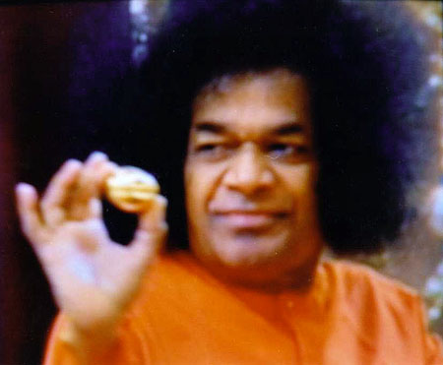
PRANAMS AT THE FEET OF

Slide 3
EXPLOIT HOMOEOPATHY !
Dr. P. R. SISIR M. D. (Hom)
Prof. & Head, Dept. of Paediatrics
Sarada Krishna Homoeopathic Medical College,
Kulasekharam, Kanyakumari Dist., Tamil Nadu.

Slide 4
Scope of Homoeopathy
Homoeopathy has proved itself to be of great
scope in treating all diseases, both acute and
chronic.
It is also capable of effectively and efficaciously
preventing and curing communicable and
infectious diseases.
It can also successfully manage gynaecological
and obstetrical cases.
It is also successful in the management of
paediatric and geriatric ailments.

Slide 5
Scope of Homoeopathy
Almost all kinds of behavioral disorders,
neurological problems, metabolic diseases are also
within its effective curability.
Many surgical conditions relating to peptic ulcer,
tonsillitis, goitre, kidney, urinary bladder, gall
bladder, pancreas etc. can be safely dealt with
through homoeopathic medicine.
Tendencies leading to surgical intervention can be
well avoided of early diagnosis is made and
prompt homoeopathic treatment is done.

Slide 6
Scope of Homoeopathy
Its role in primary health care is also highly
rewarding, especially in a developing country like
India.
Homoeopathy has a ready and effective answer to
the menace of addiction to drugs, tobacco and
alcohol and is highly efficacious in ridding the
addicts of their craving for these noxious
substances.
Efficacious in controlling and containing
epidemics.

Slide 7
Present Status of Homoeopathy
Homoeopathy is currently prevailing in practice over eighty countries in the
world.
The practice of homoeopathy is widespread in Europe, the United Kingdom,
India, Pakistan, Srilanka, Malaysia, South Africa, Nigeria, Russian, South
and North America, New Zealand and the South Pacific.
Homoeopathy has been integrated in to the National Health Care Systems of
many countries including India, Mexico, Pakistam Srilanka and United
Kingdom.
The forward march of homoeopathy is steady and impressive. The World
Health Organisation states that homoeopathy is the second most used
medical system internationally.

Slide 8
PAEDIATRIC CASE - THE STATISTICS IN SKHMC SINCE 15th AUG. 2009
Frequented Conditions | No. of Cases | Average / Month
Respiratory ailments | 1169 | 97
Fever | 550 | 46
Skin complaints | 232 | 19
Worm infestation | 77 | 06
G.I.T. disorders | 241 | 20
Other conditions: U.T.I., Thyroid condition, Renal conditions, Cervical lymphadenopathy, Ear affections, Mile stones delayed… | 969 | 81

Slide 9
FEW CASES PRESENTED THROUGH
THE ORIGINAL DOCUMENTS -
SKHMC CASE RECORDS

Slide 10
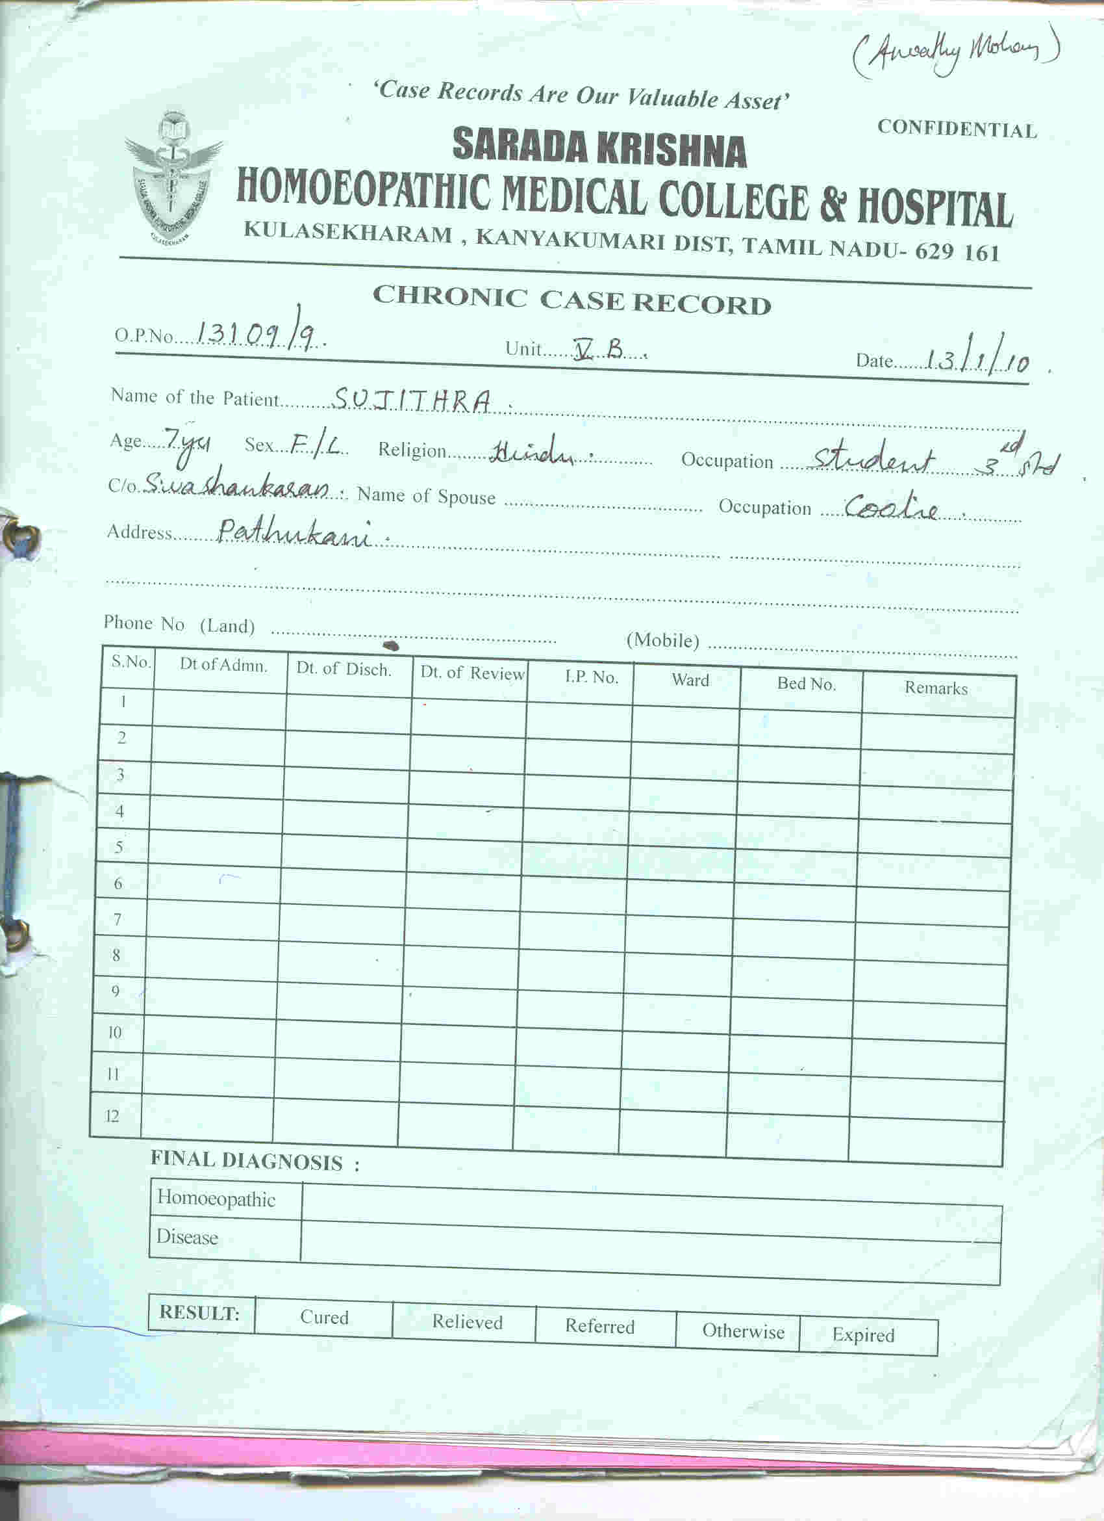
C
A
S
E
1

Slide 11
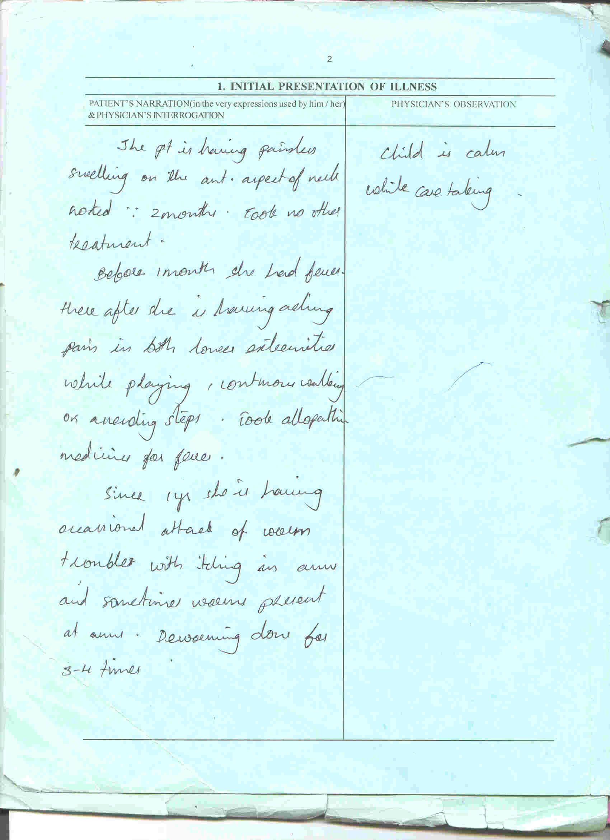
C
A
S
E
1

Slide 12
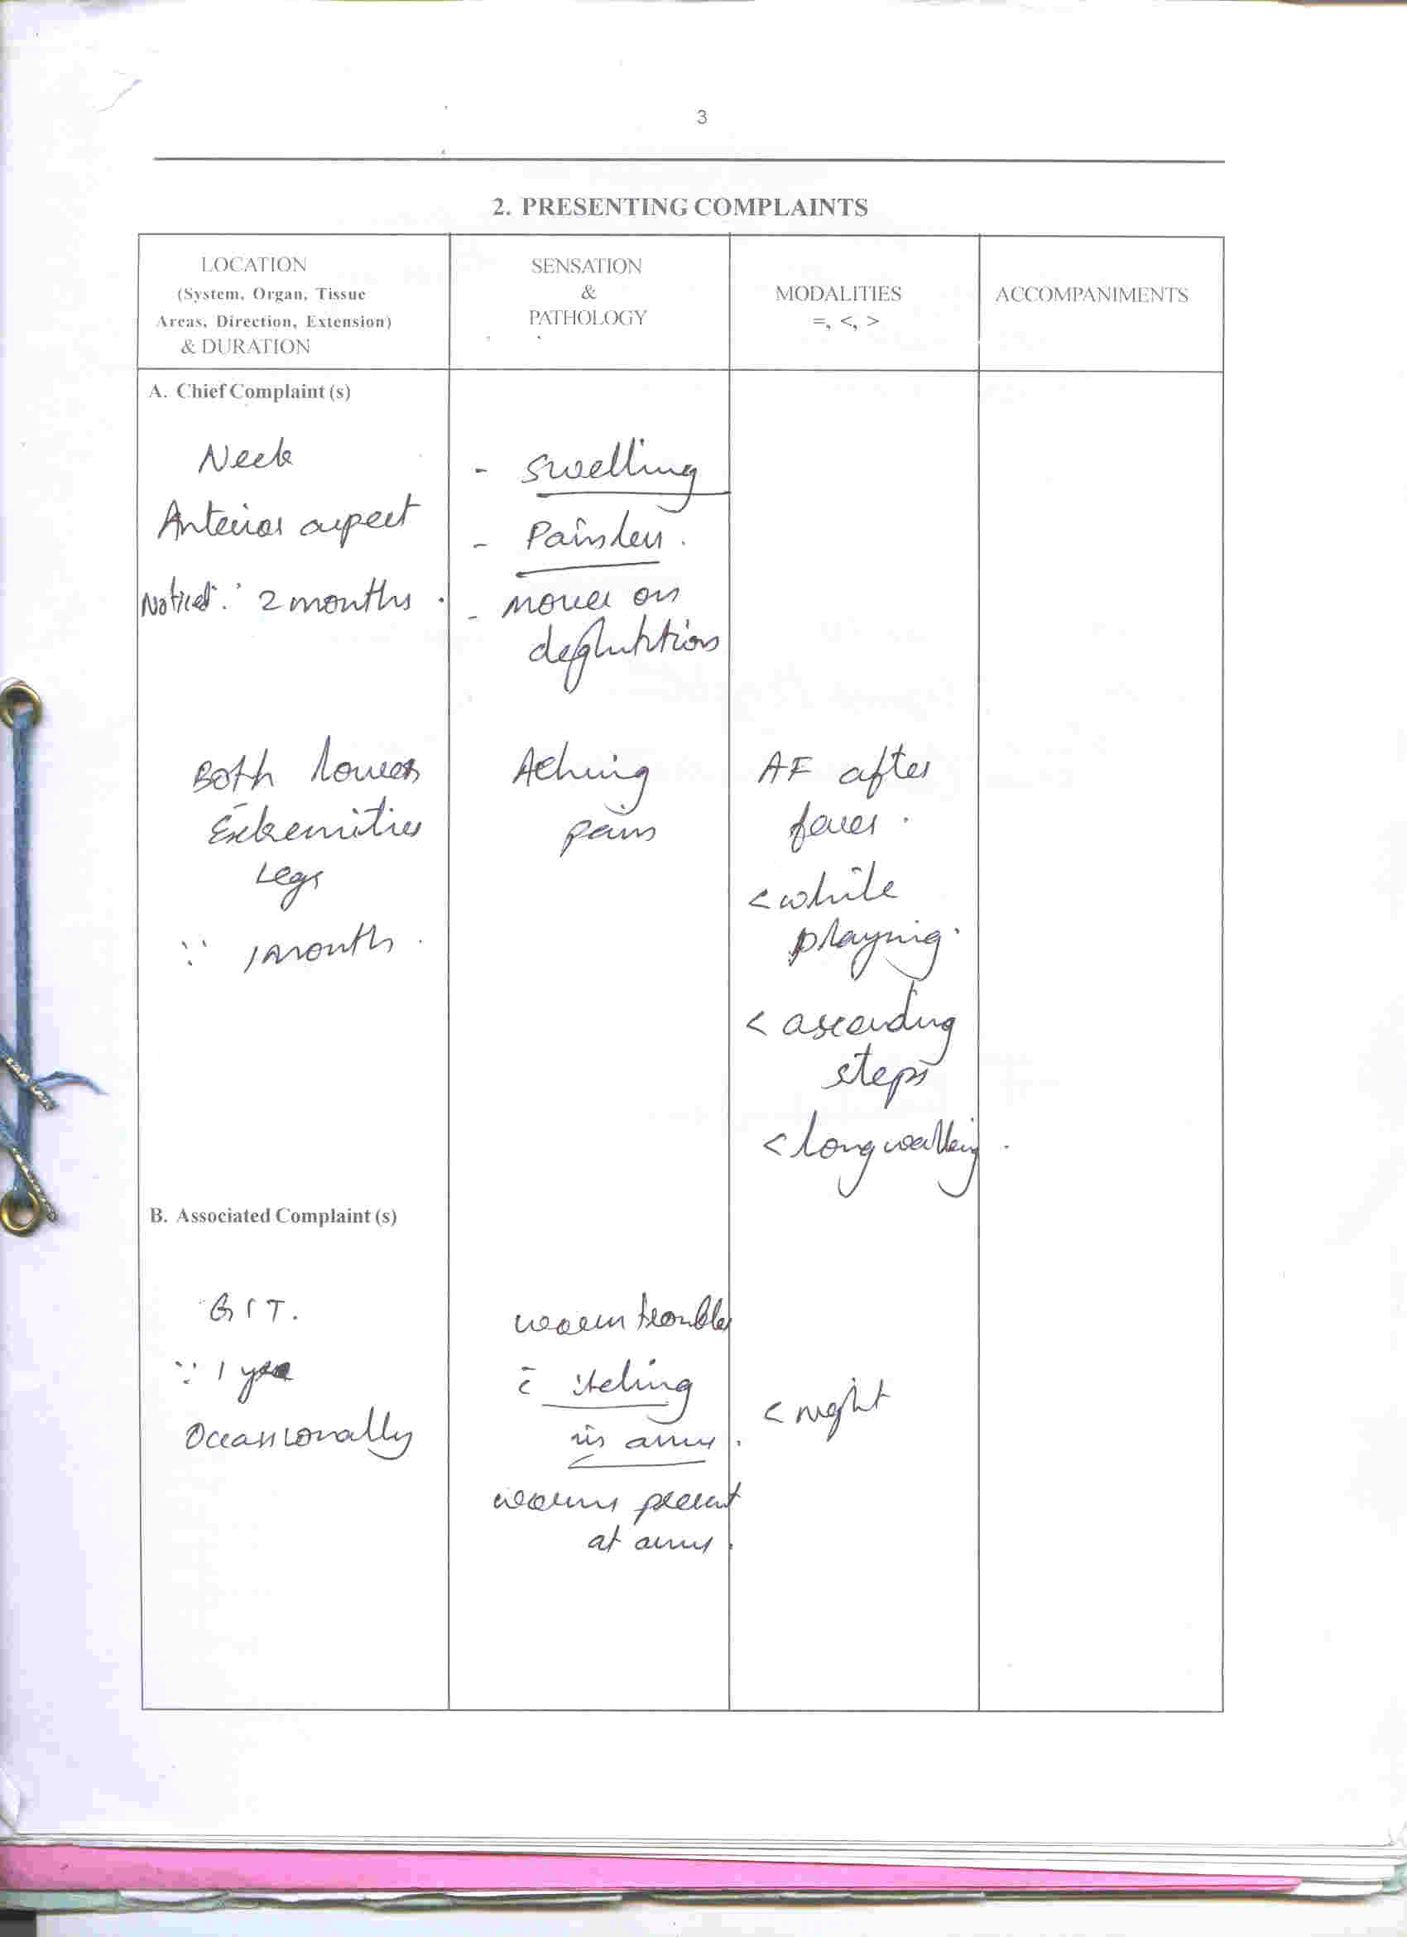
C
A
S
E
1

Slide 13
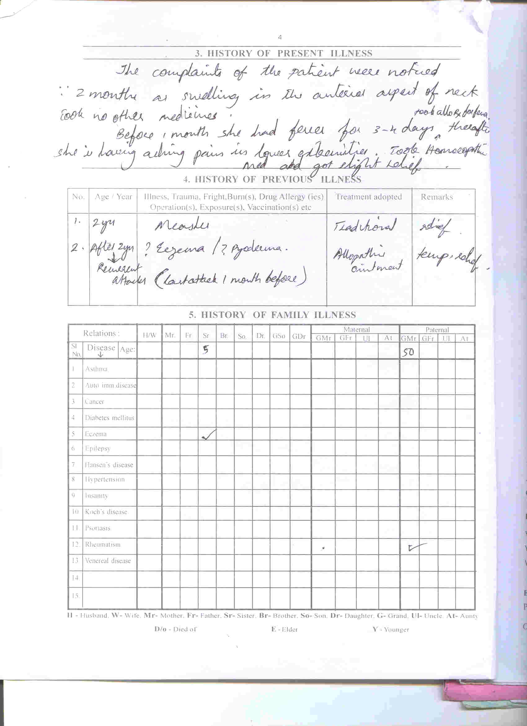
C
A
S
E
1

Slide 14
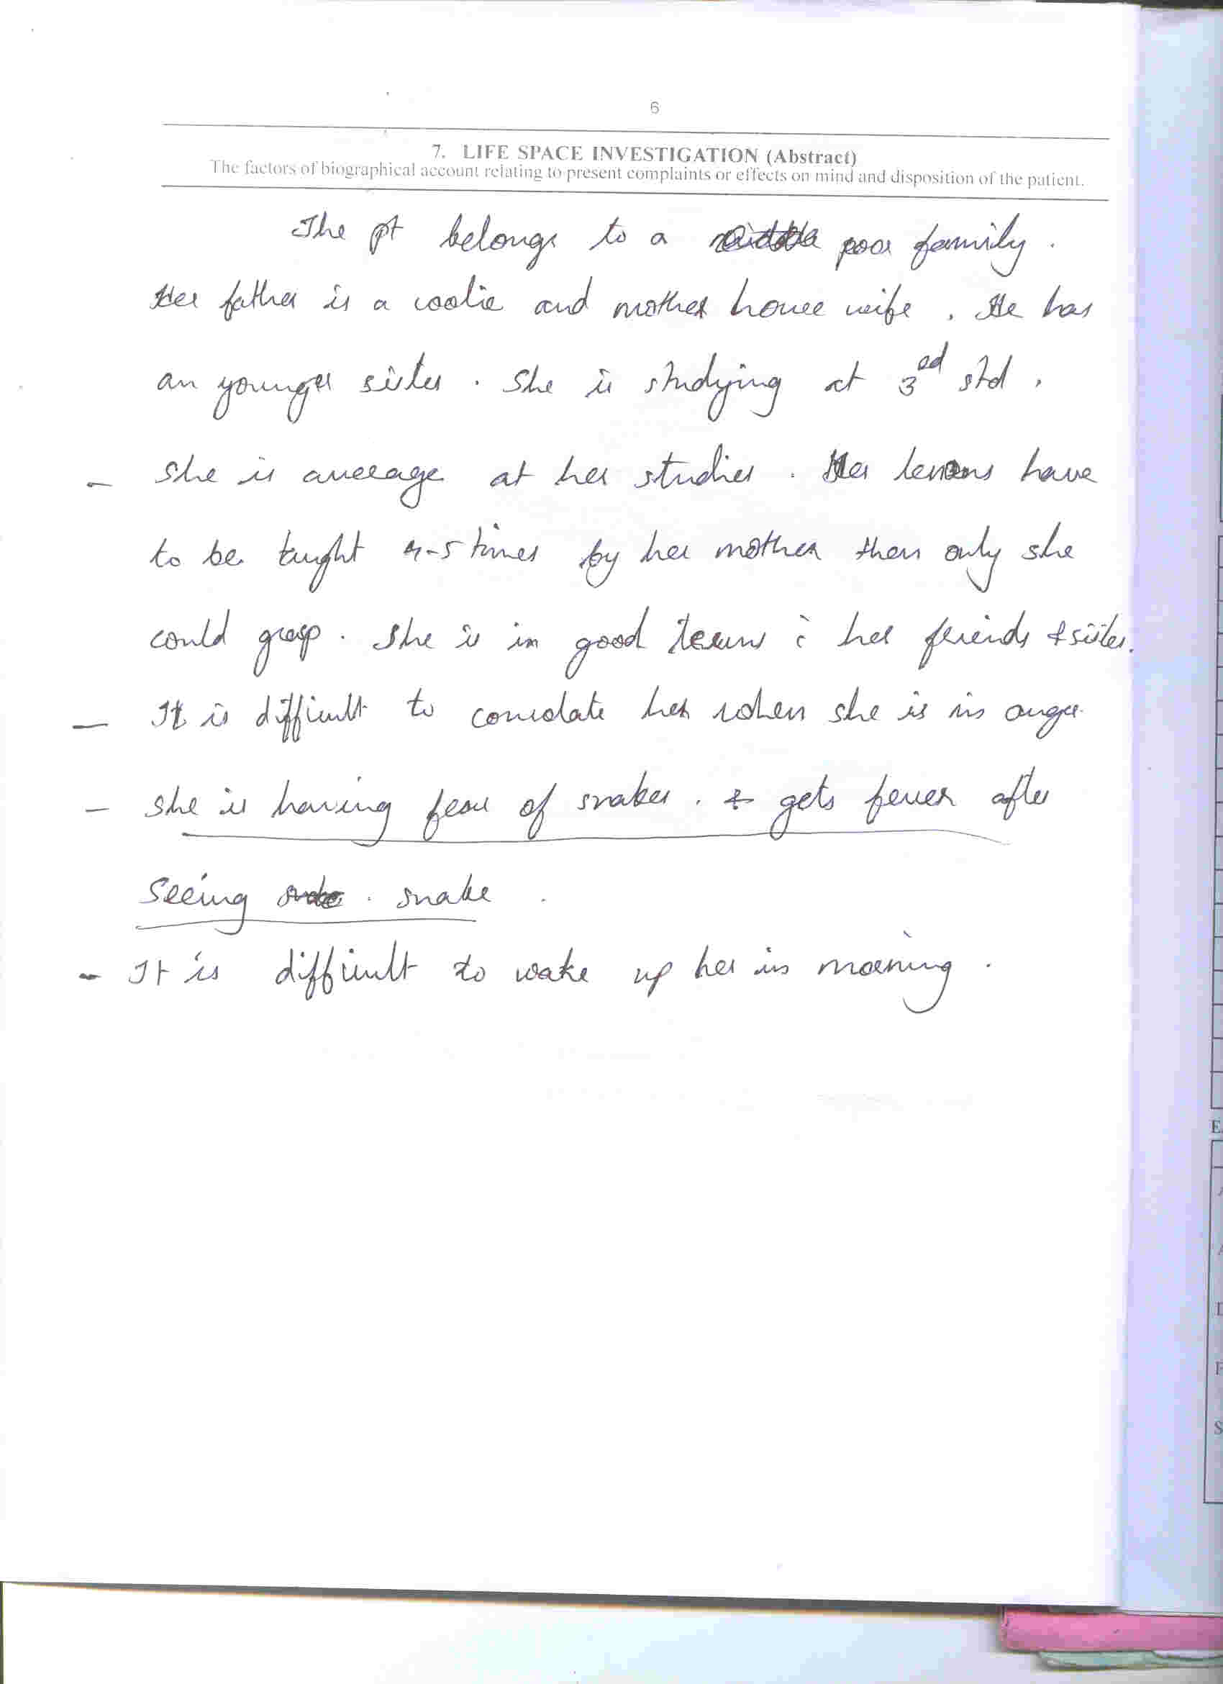
C
A
S
E
1

Slide 15
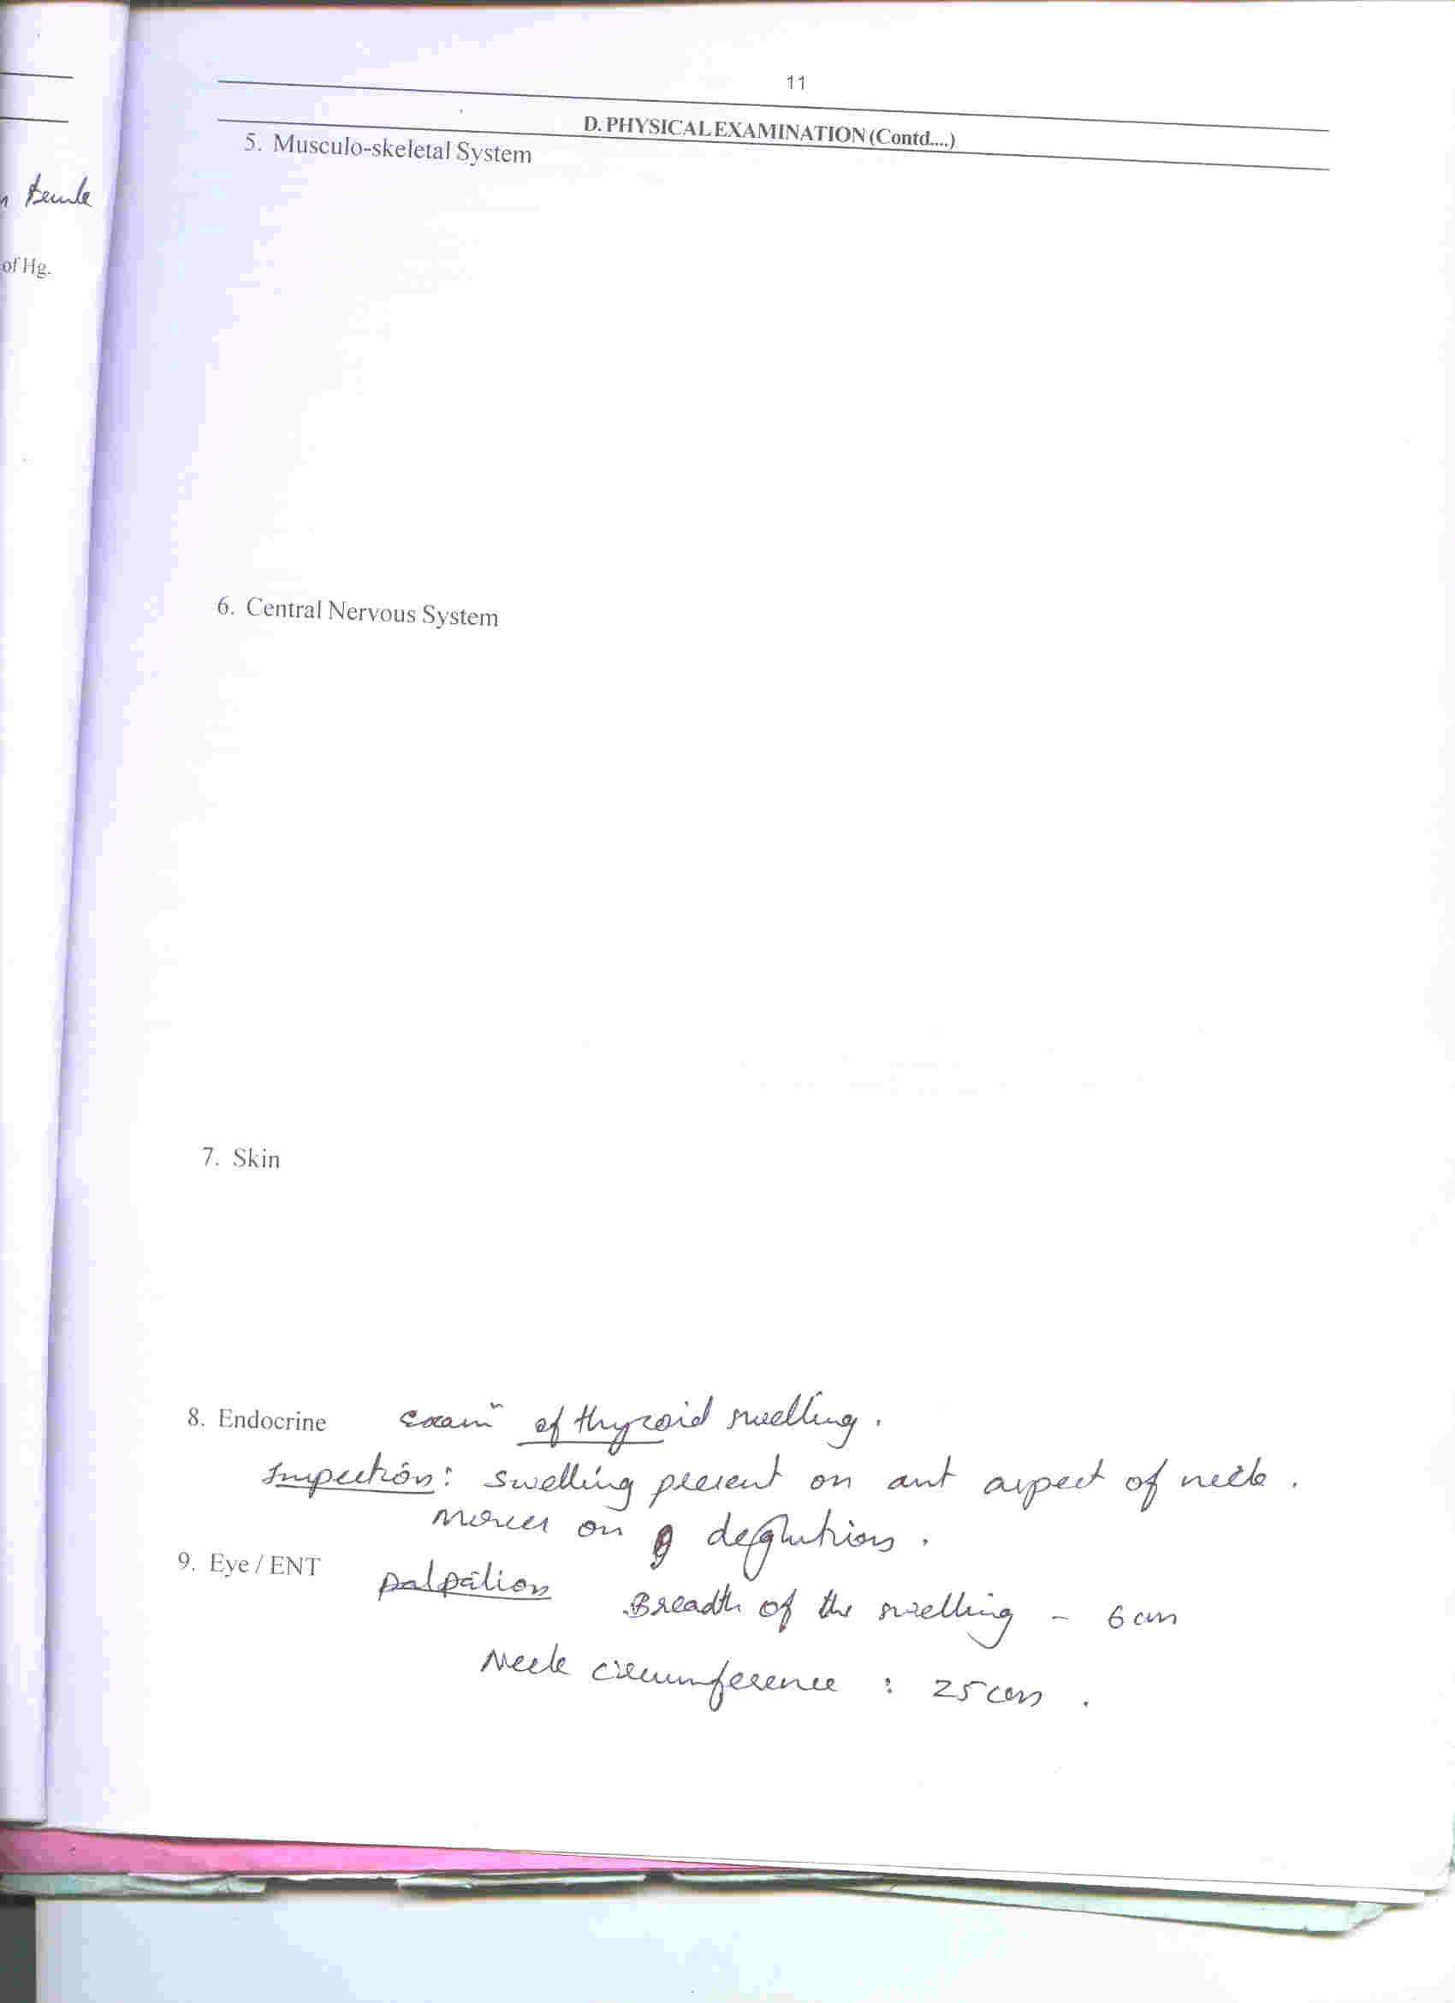
C
A
S
E
1

Slide 16
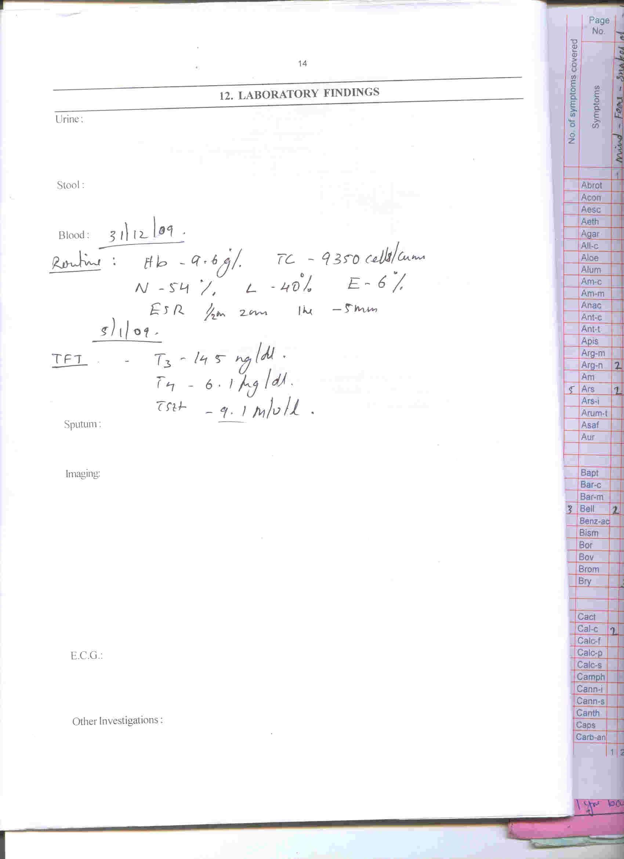
C
A
S
E
1

Slide 17
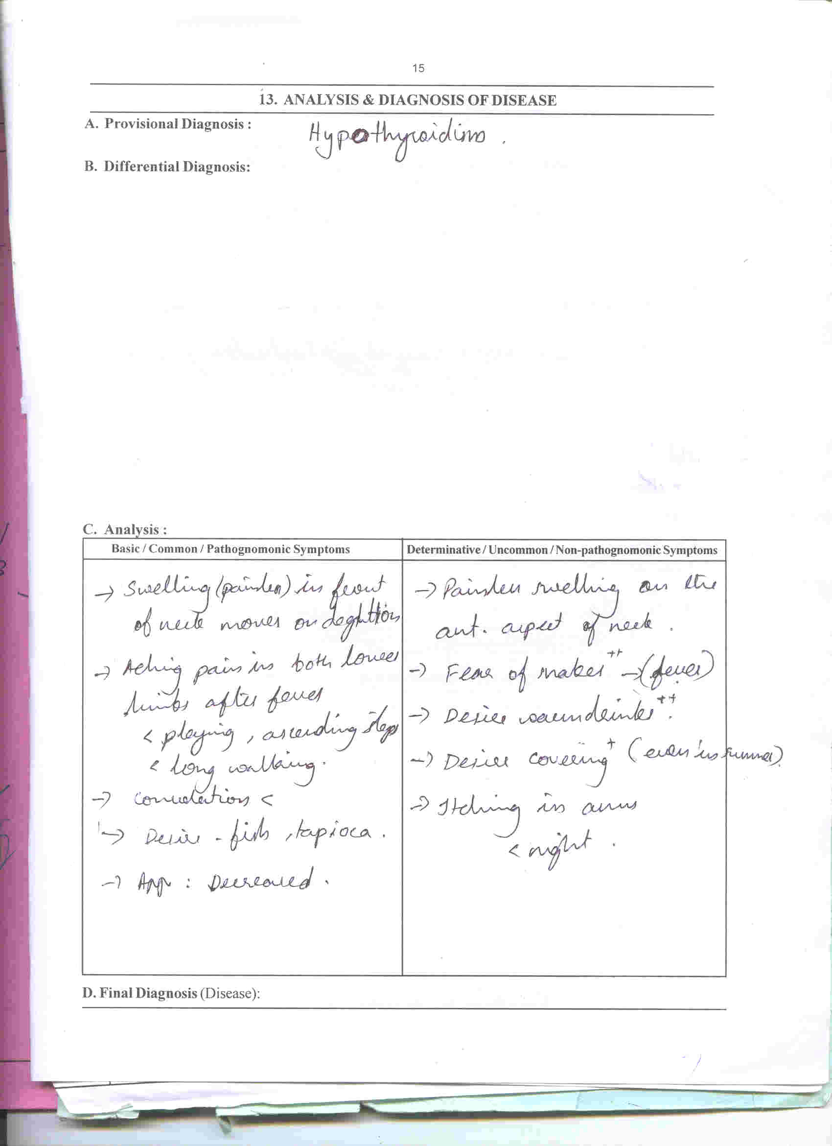
C
A
S
E
1

Slide 18
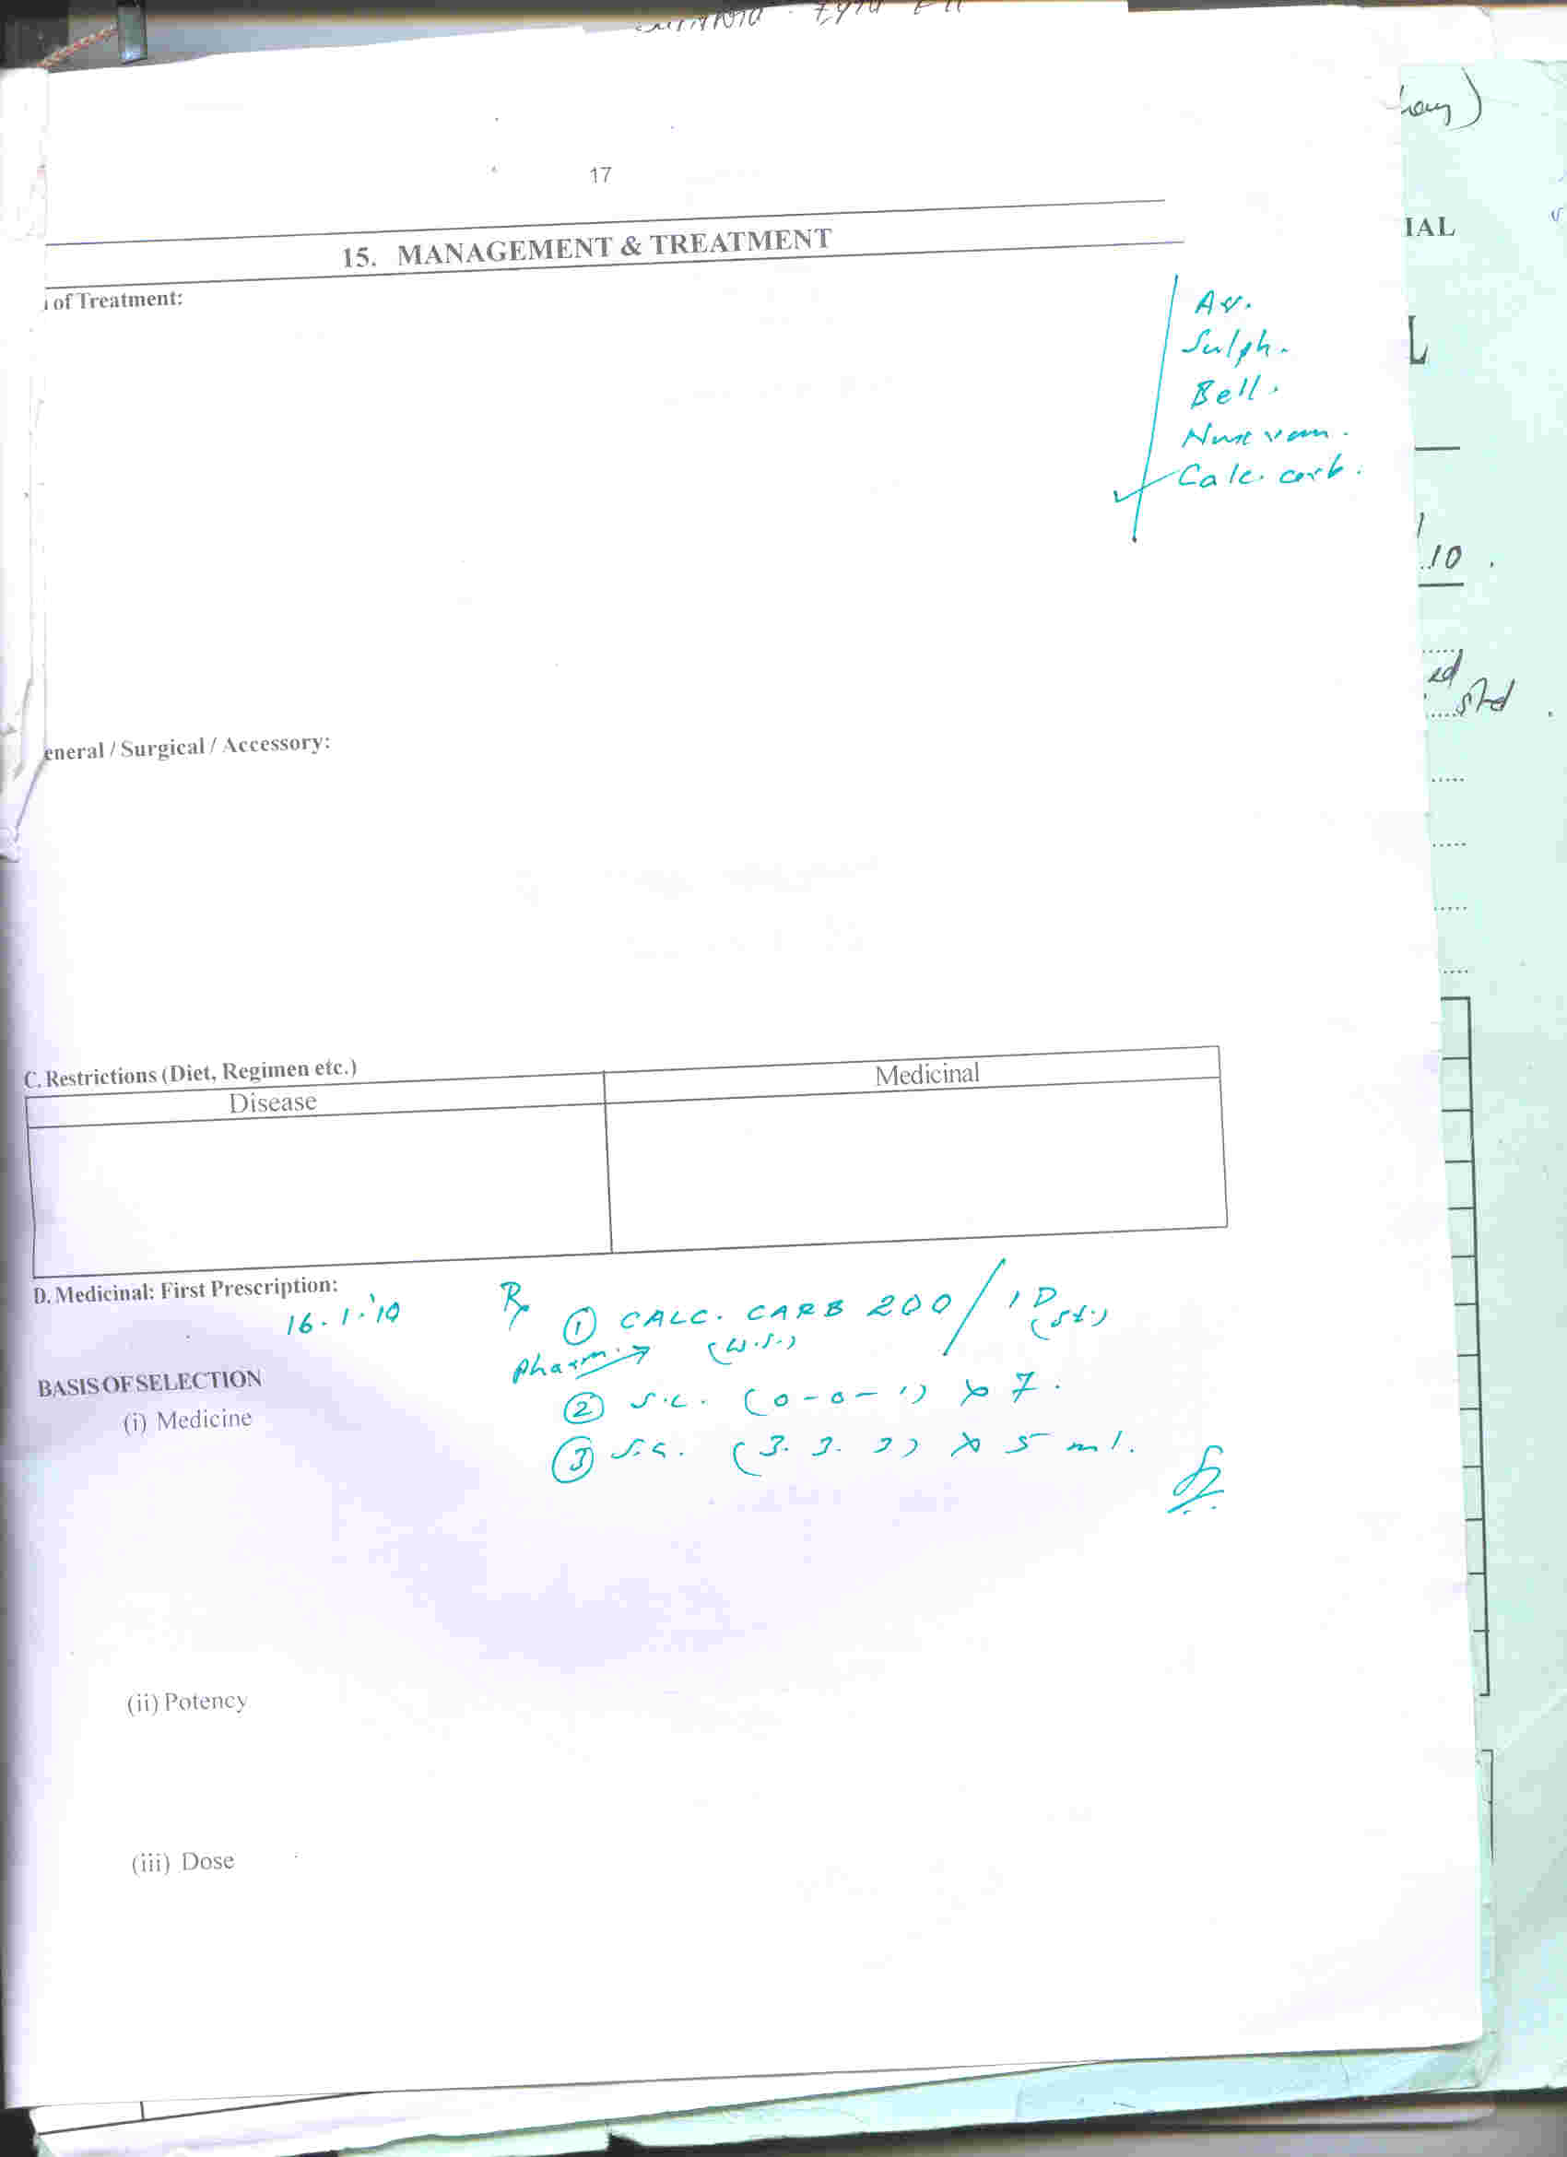
C
A
S
E
1

Slide 19
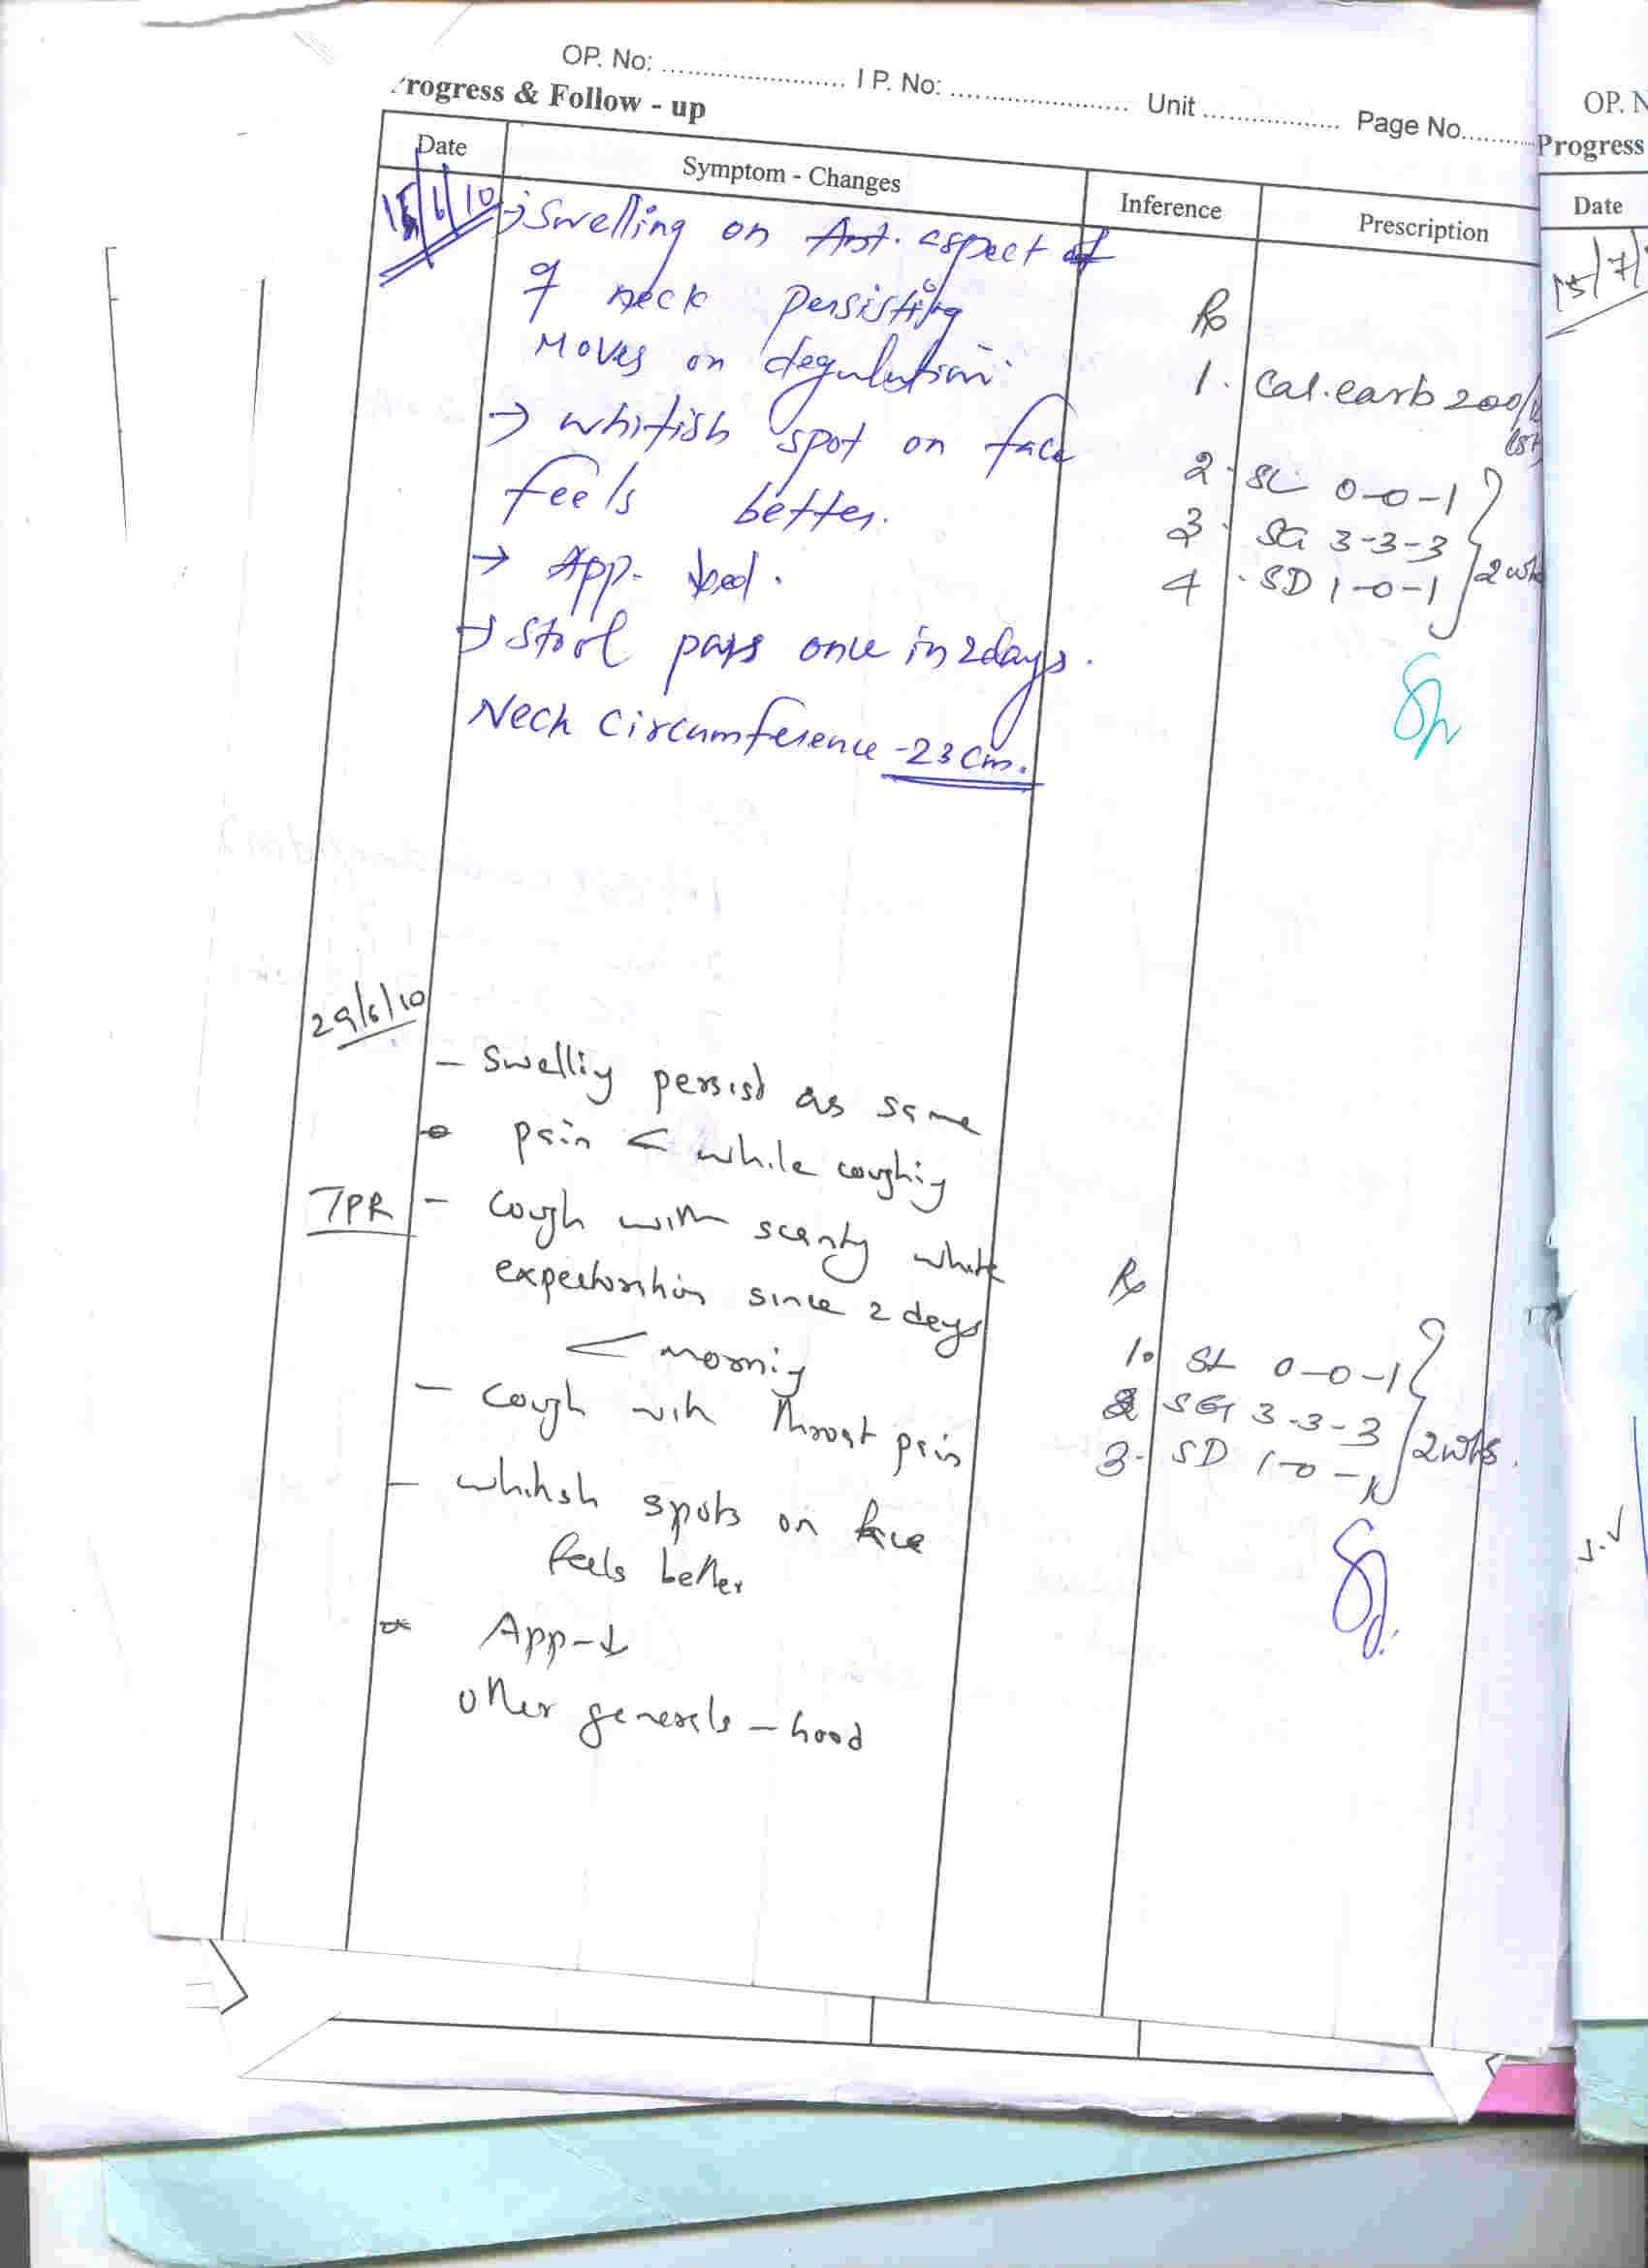
C
A
S
E
1

Slide 20
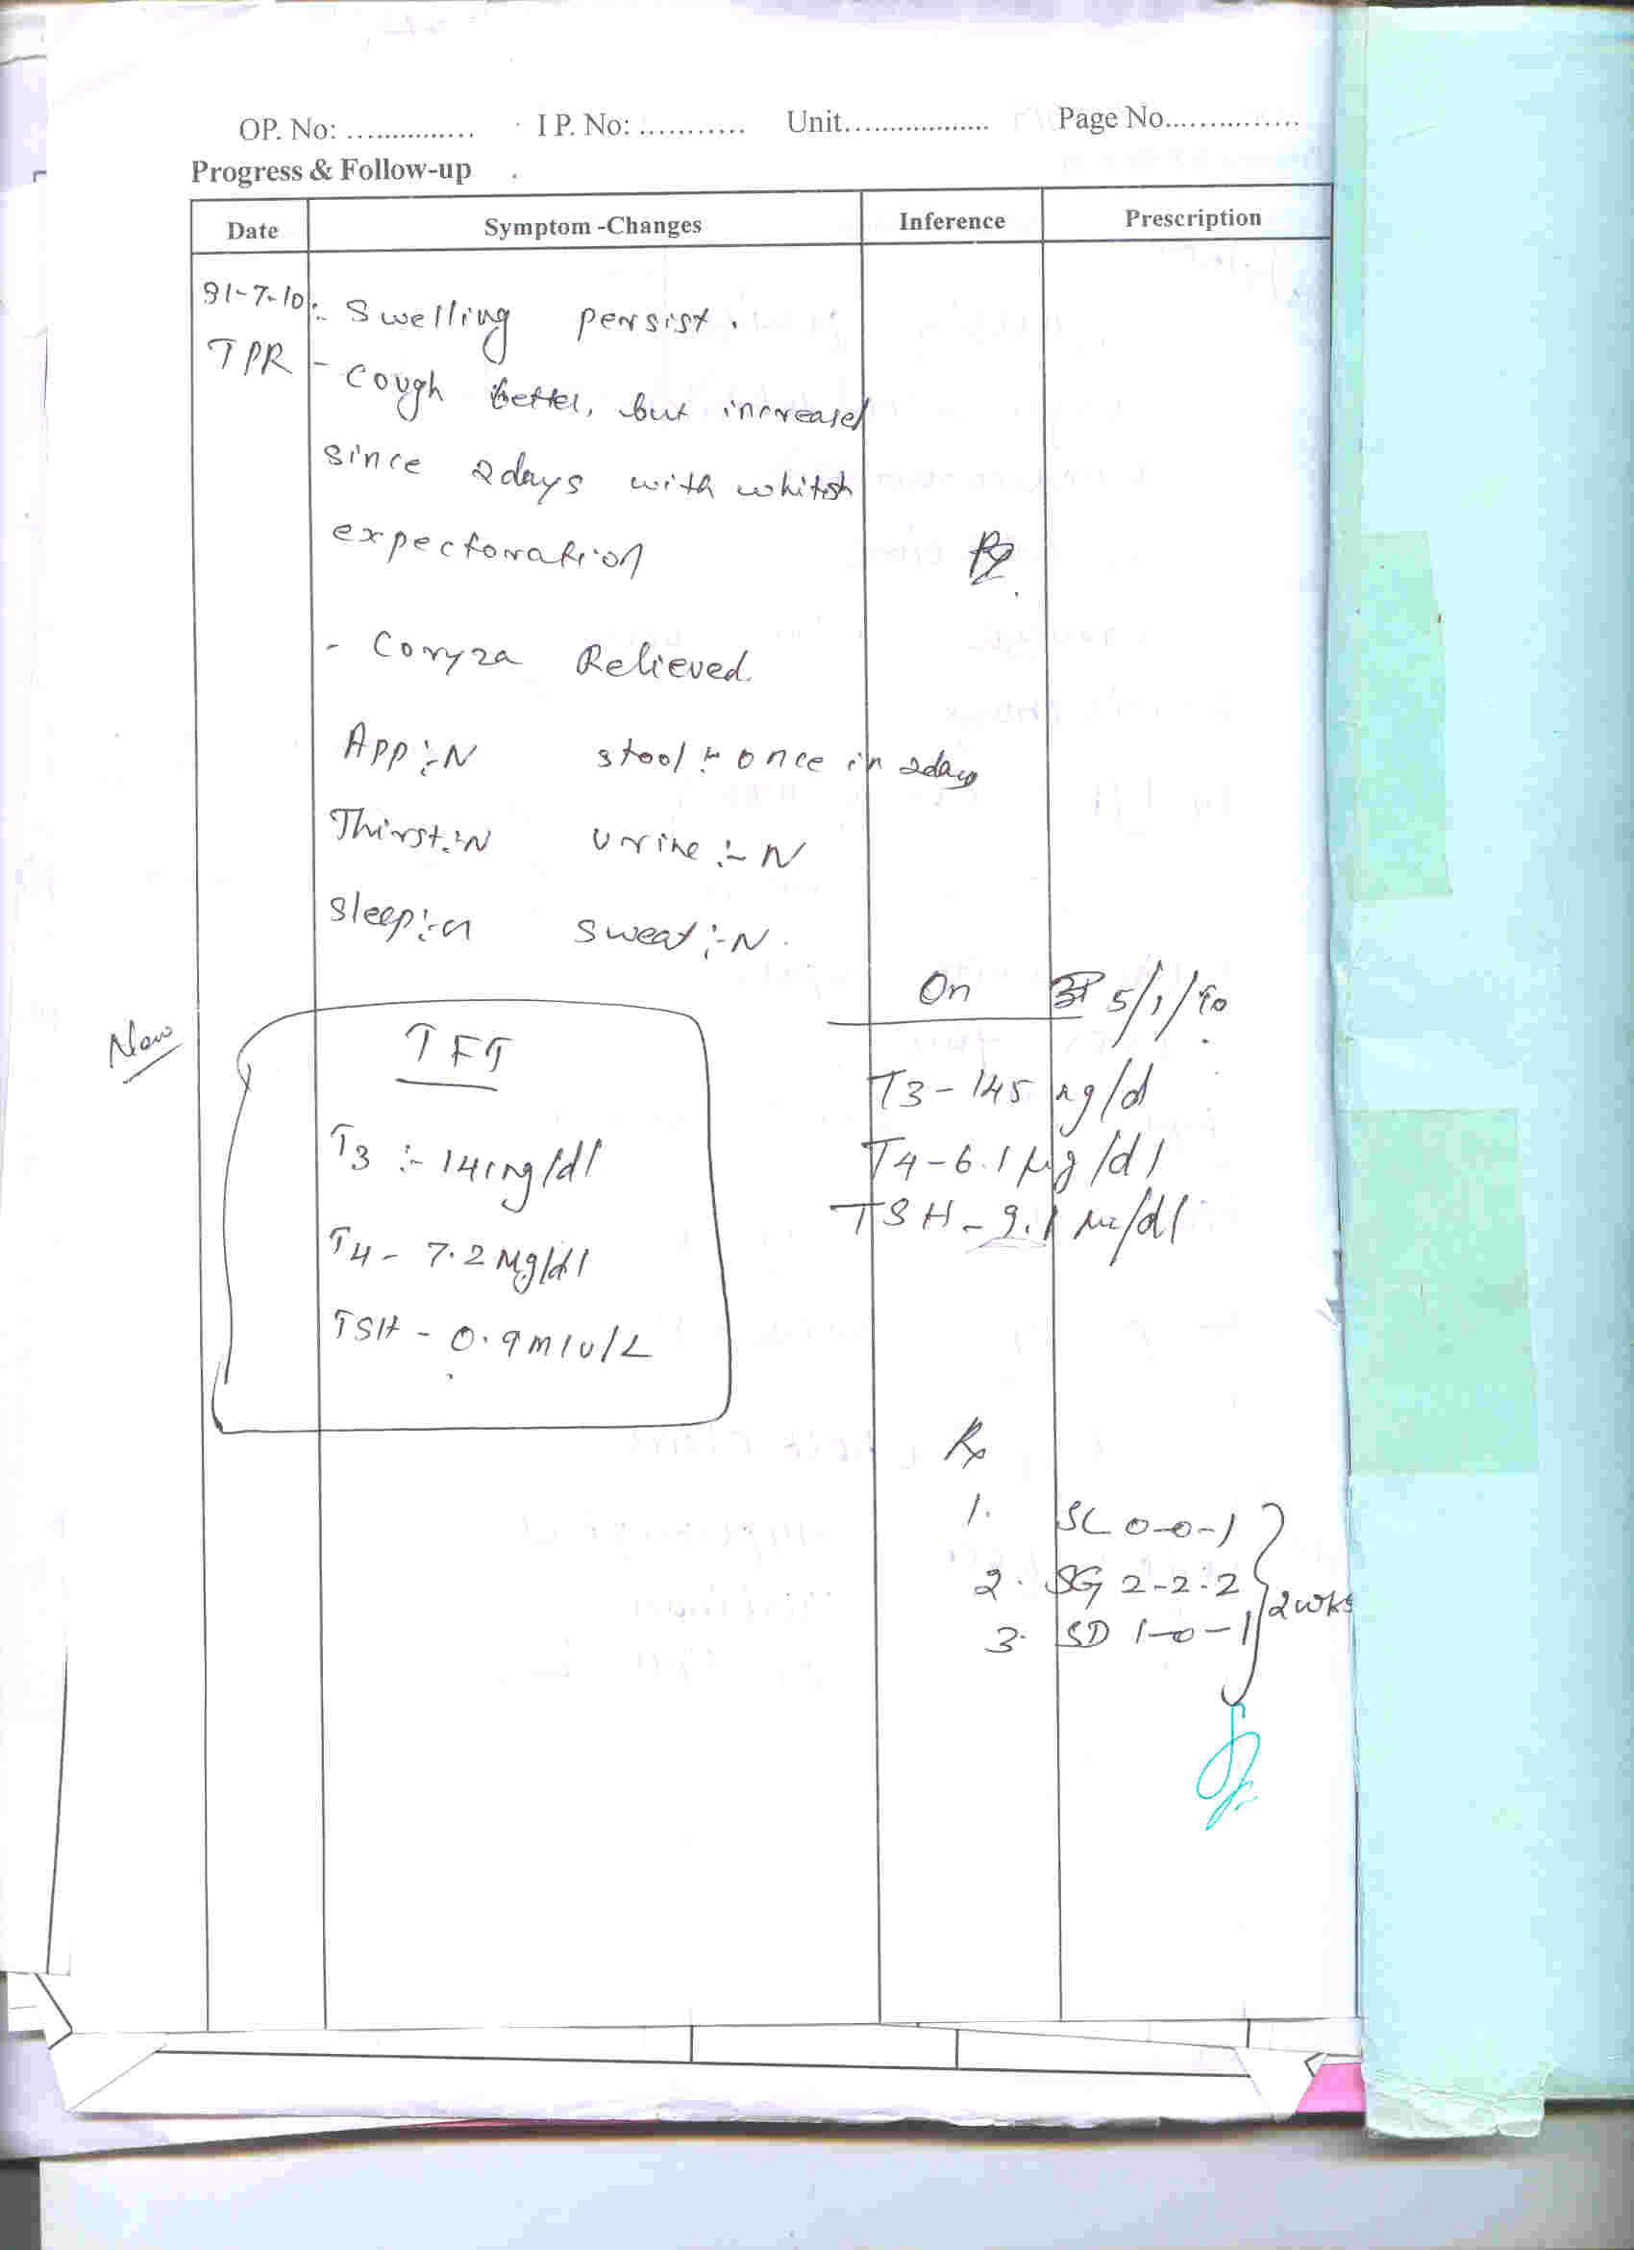
C
A
S
E
1

Slide 21
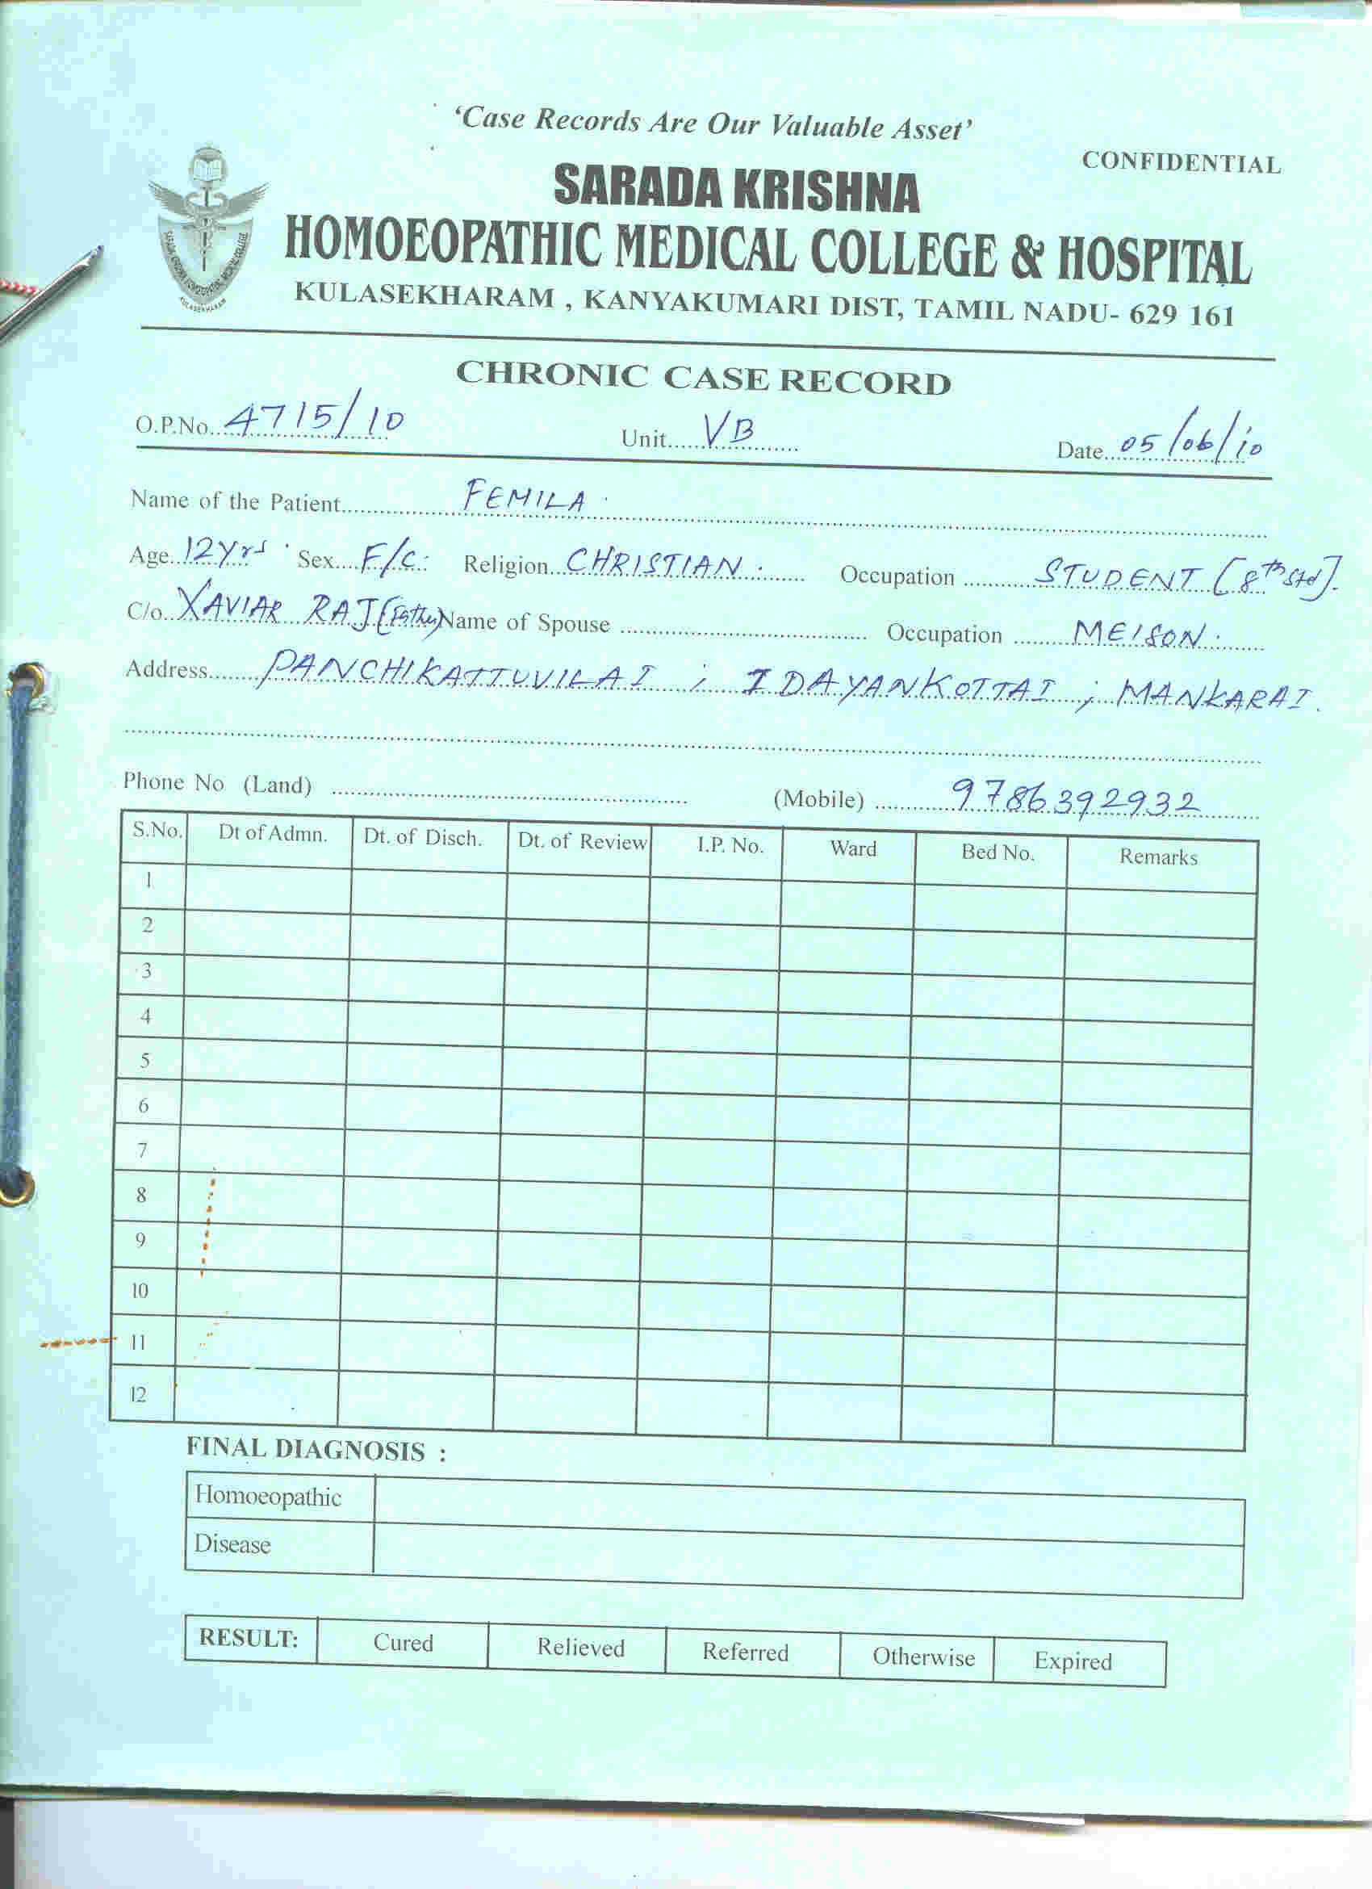
C
A
S
E
2

Slide 22
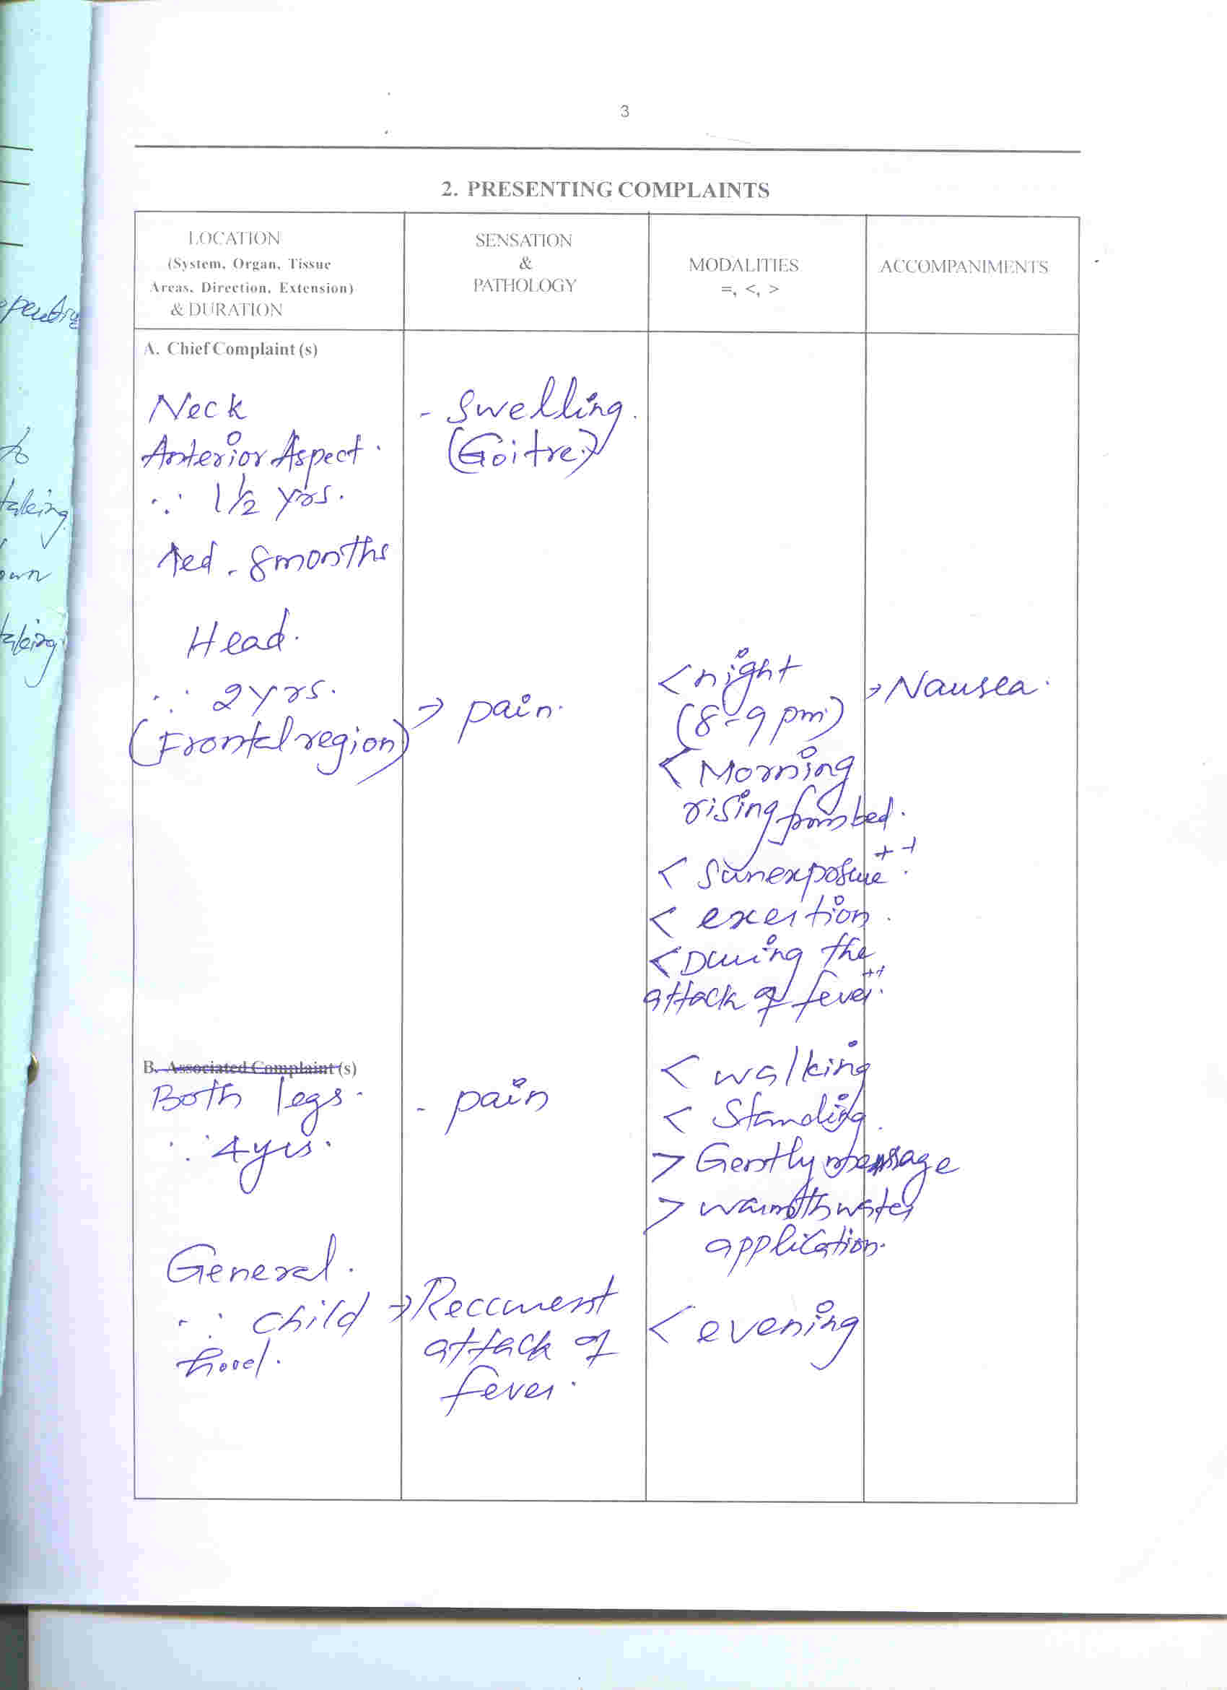
C
A
S
E
2

Slide 23
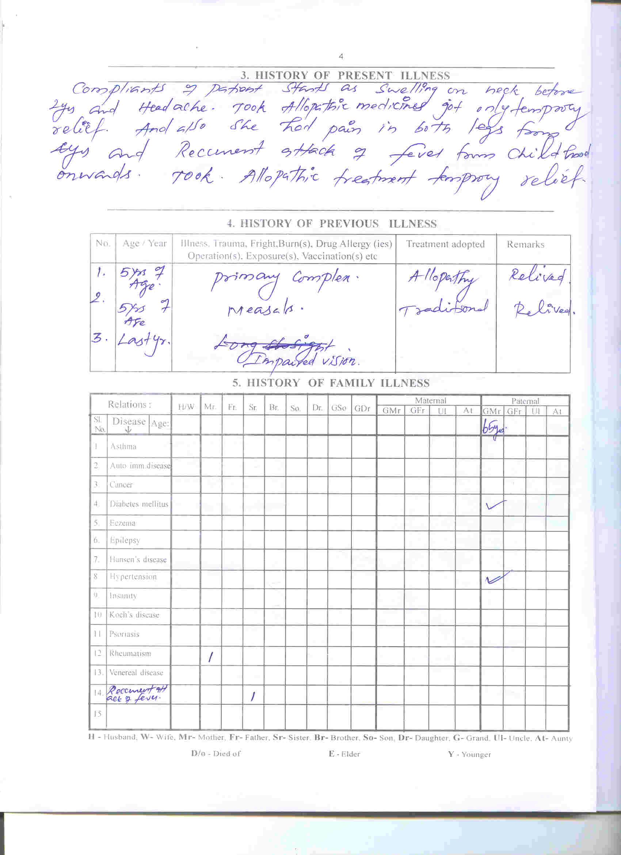
C
A
S
E
2

Slide 24
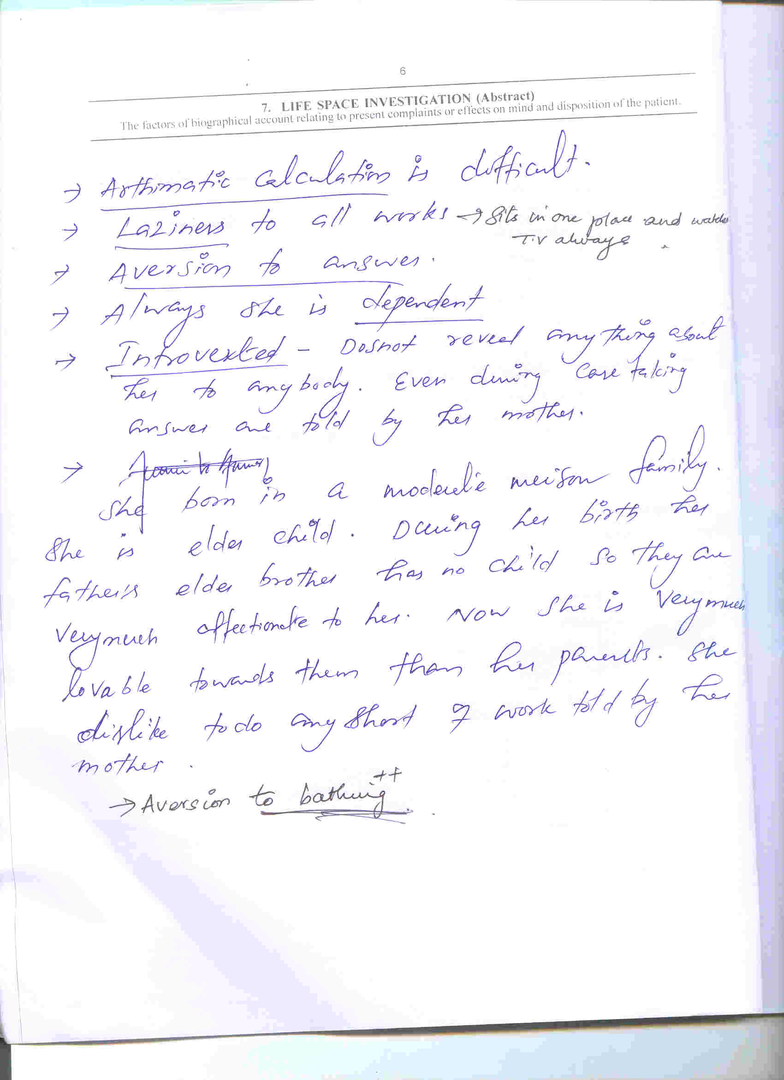
C
A
S
E
2

Slide 25
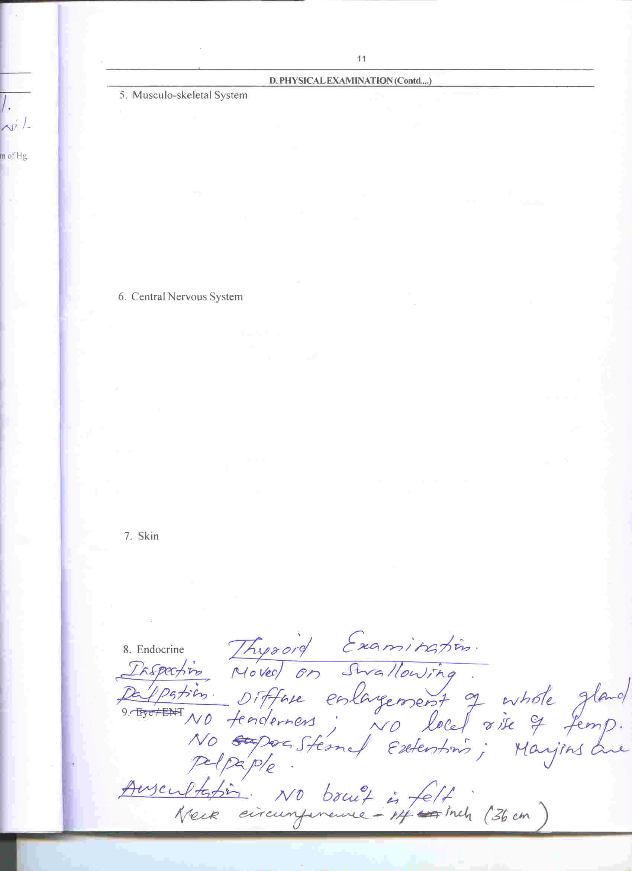
C
A
S
E
2

Slide 26
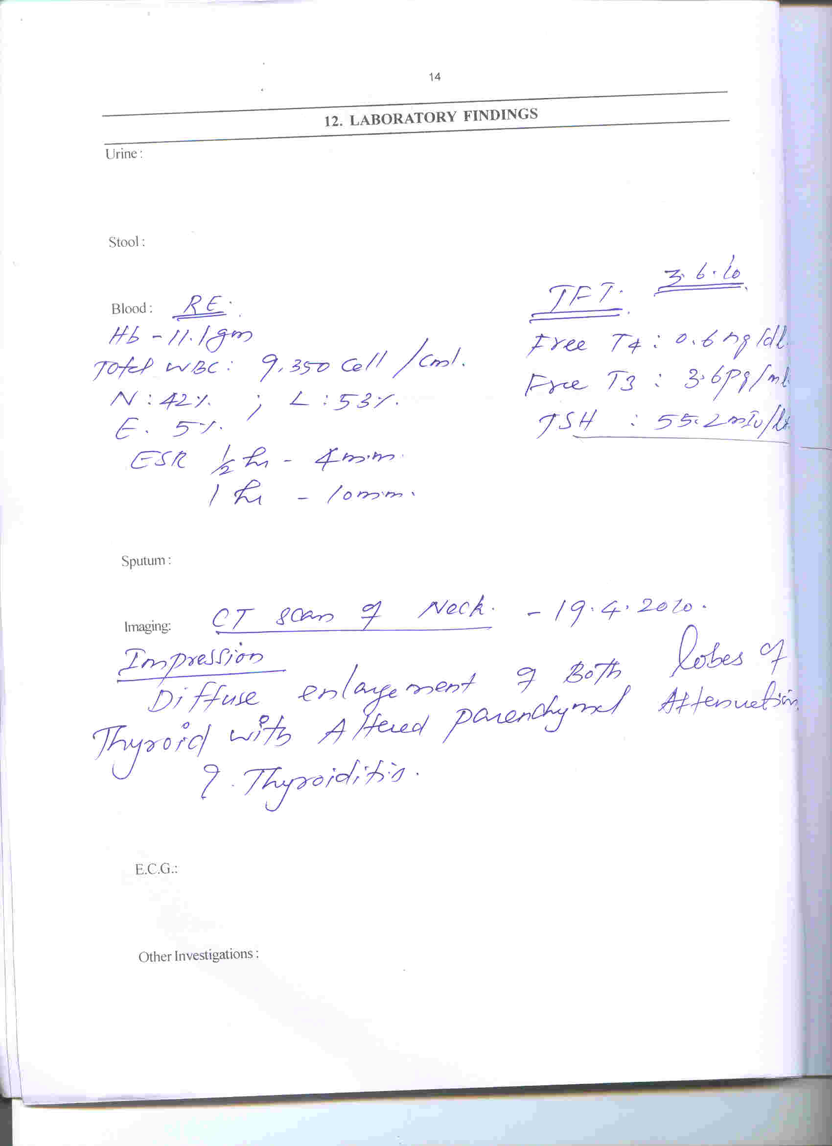
C
A
S
E
2

Slide 27
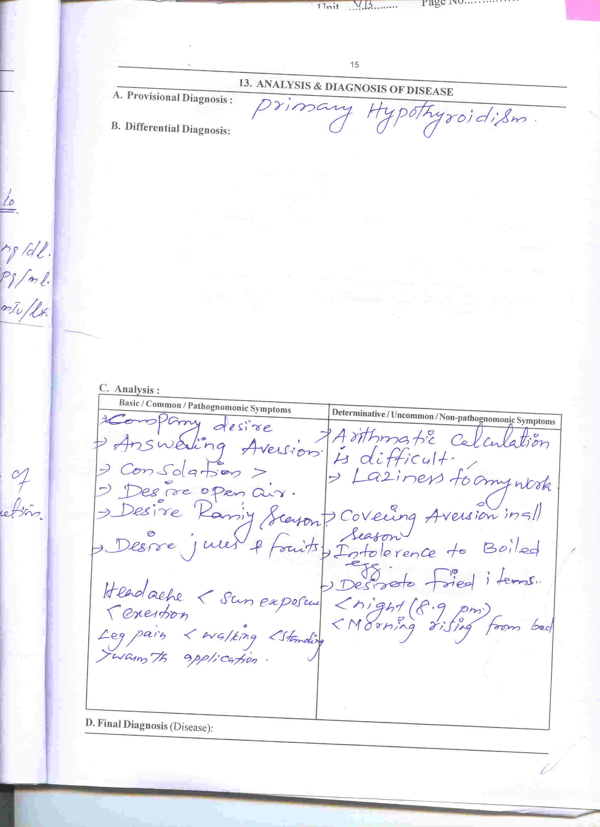
C
A
S
E
2

Slide 28
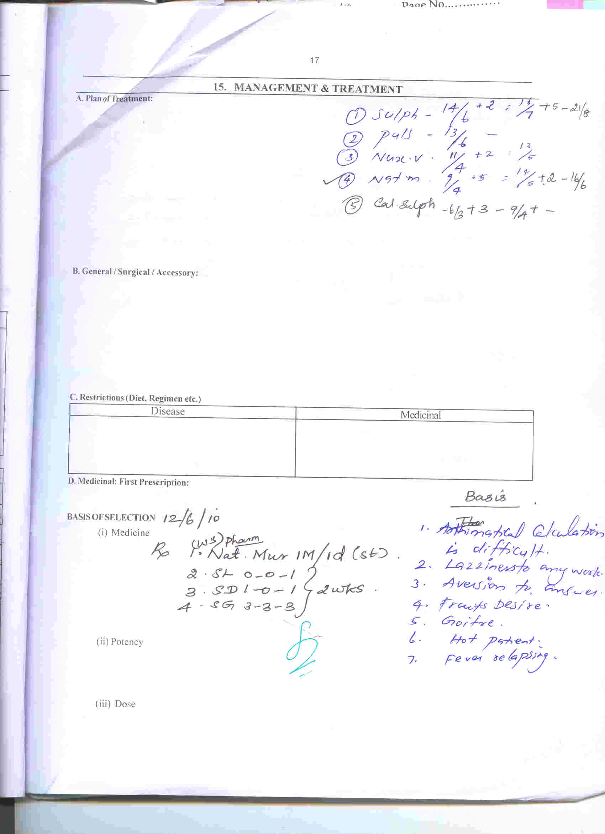
C
A
S
E
2

Slide 29
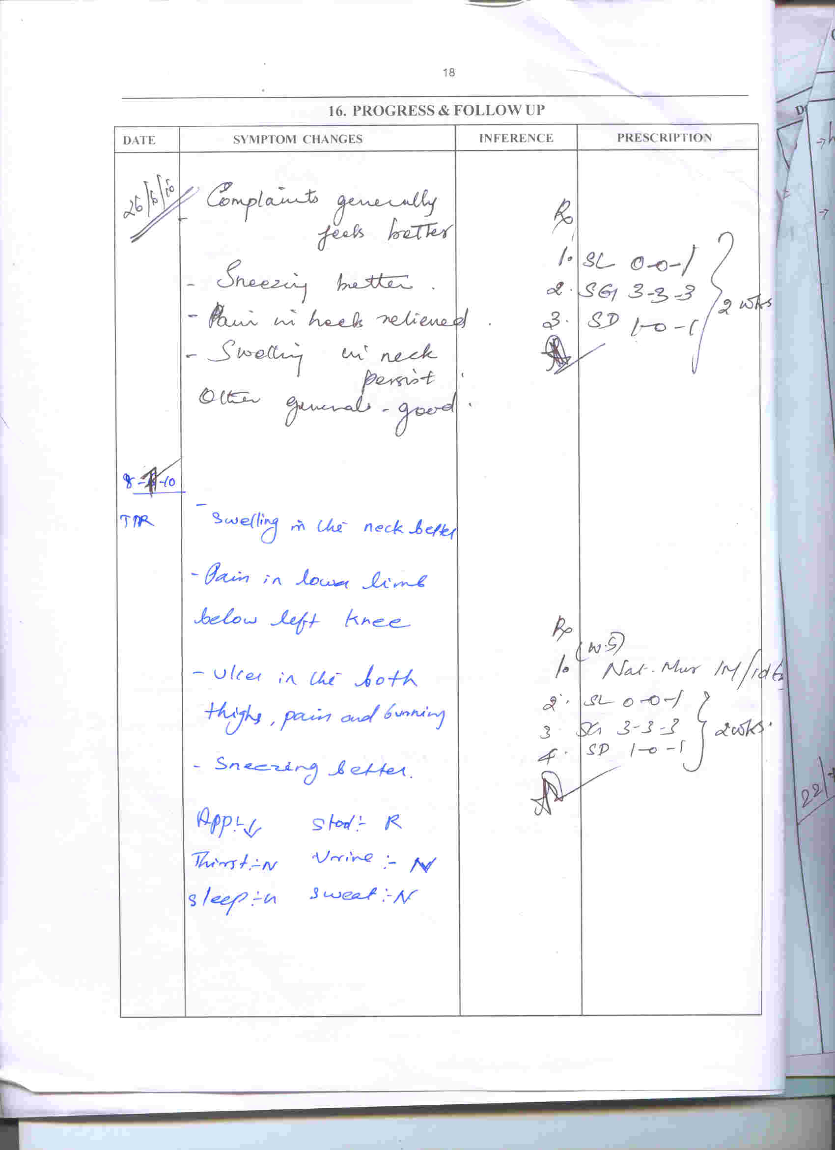
C
A
S
E
2

Slide 30
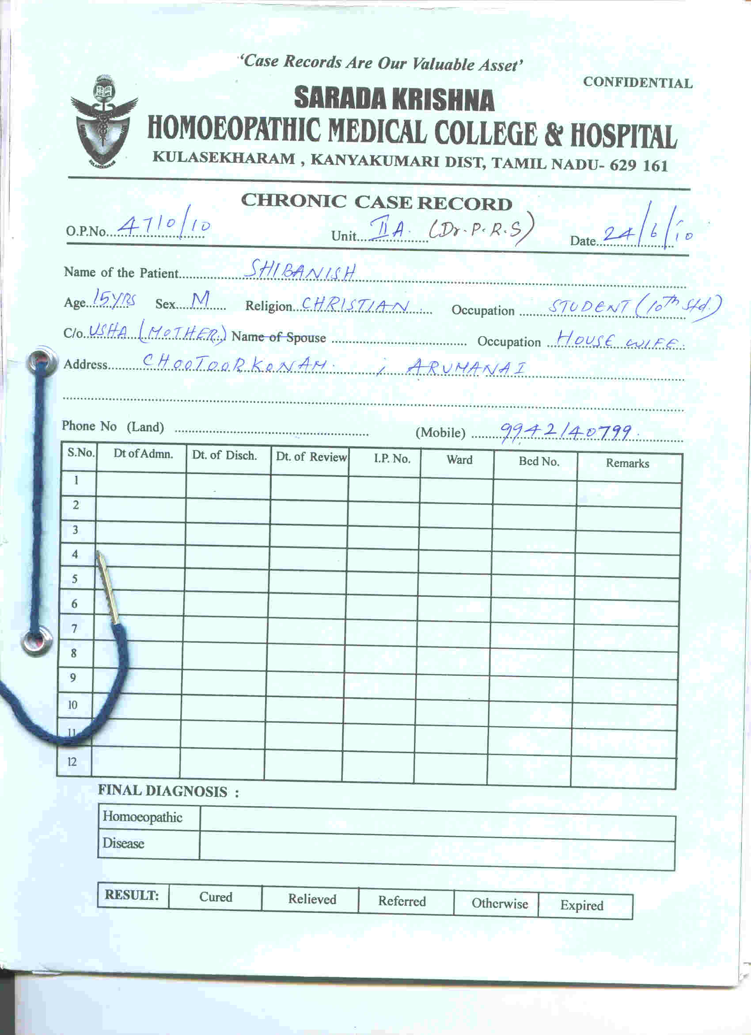
C
A
S
E
3

Slide 31
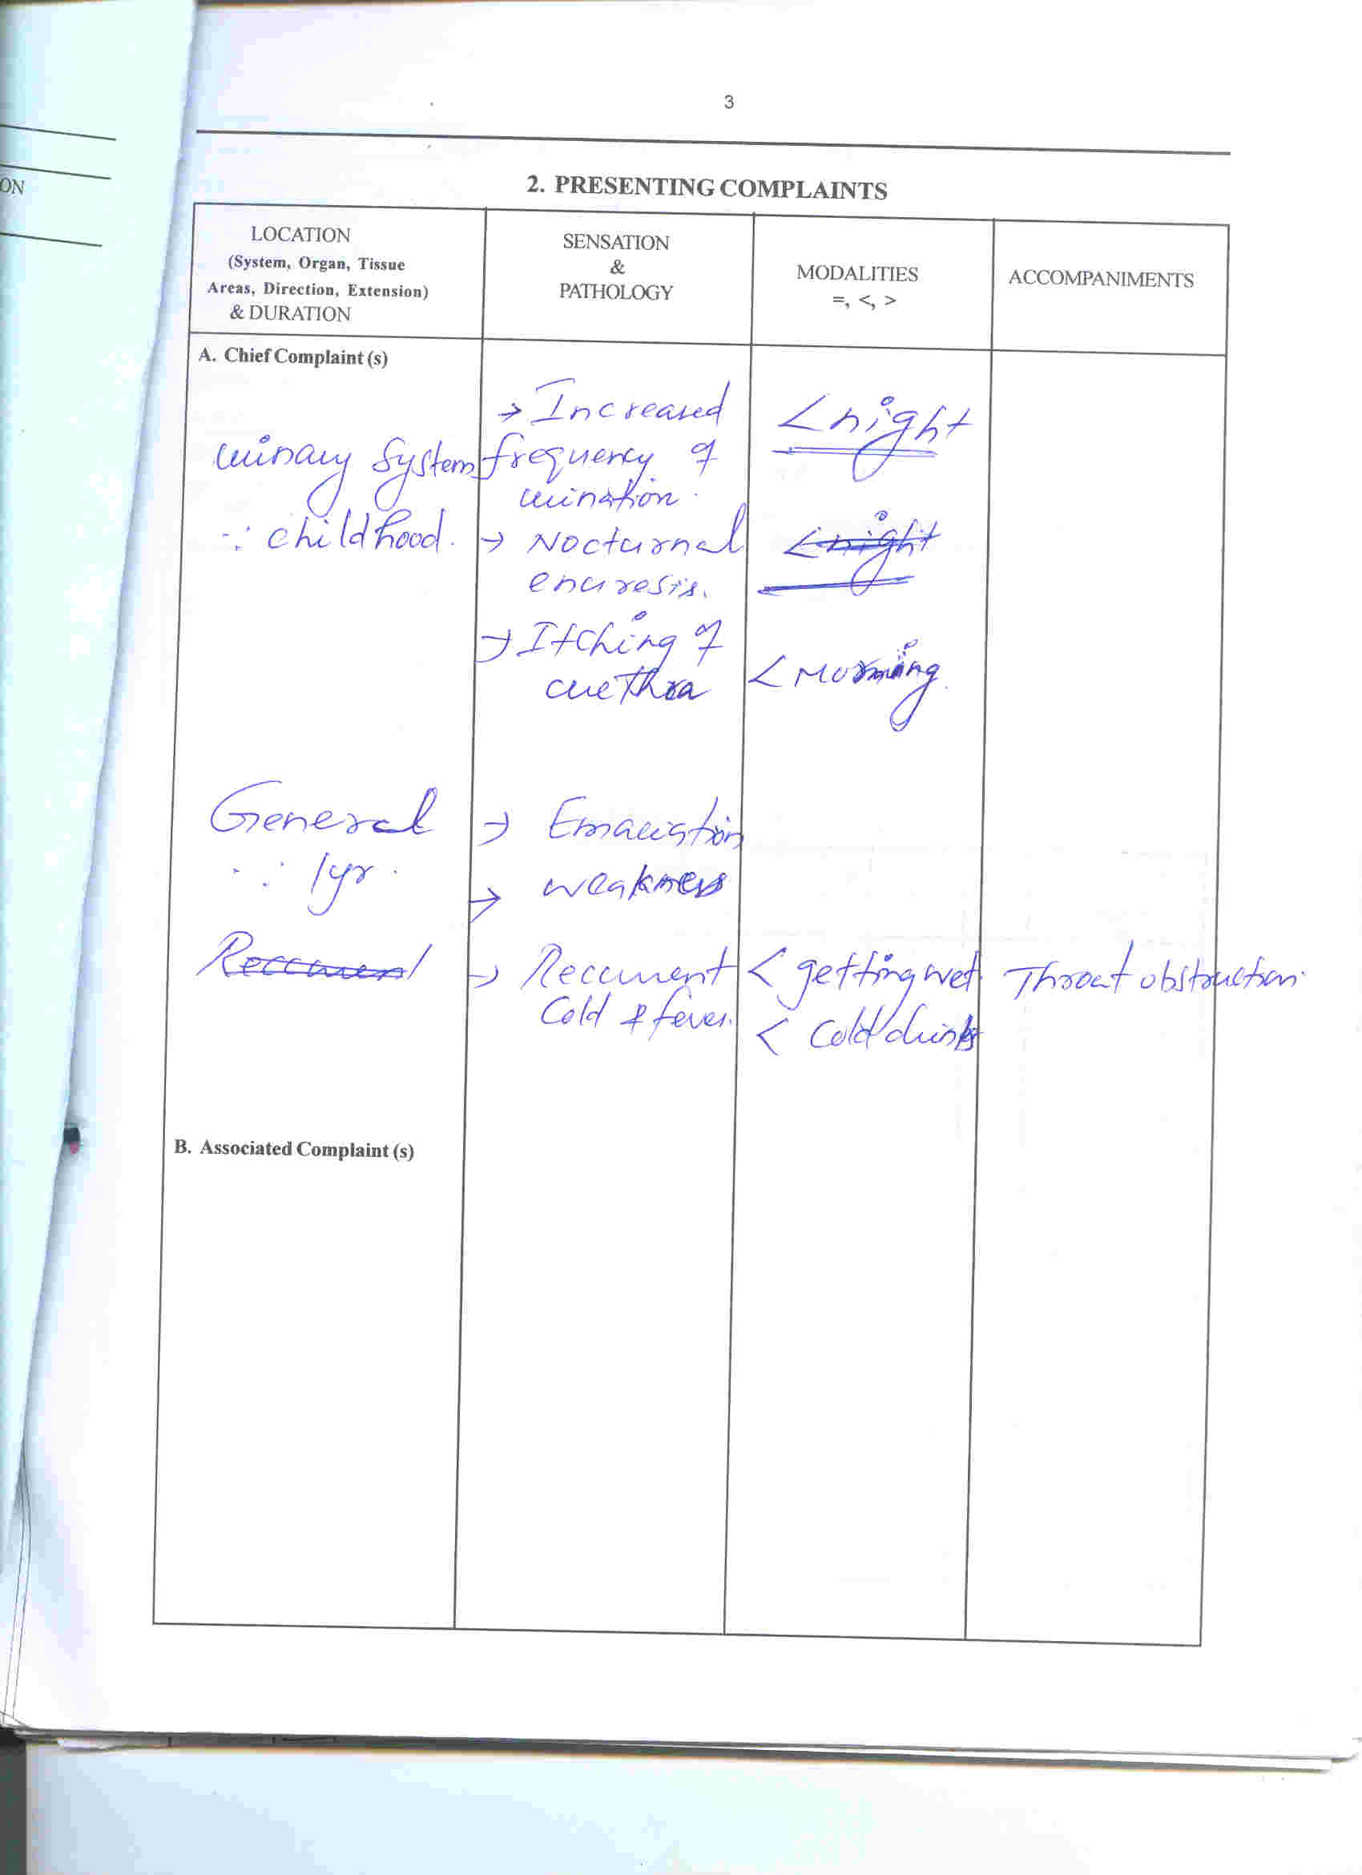
C
A
S
E
3

Slide 32
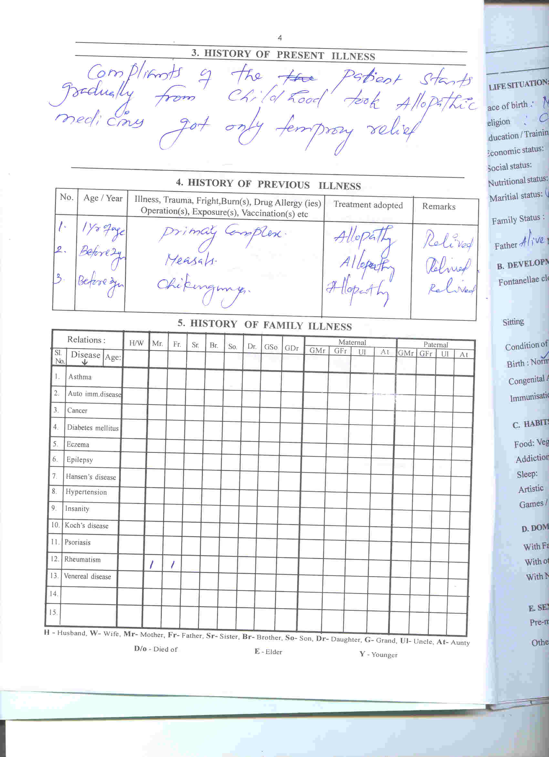
C
A
S
E
3

Slide 33
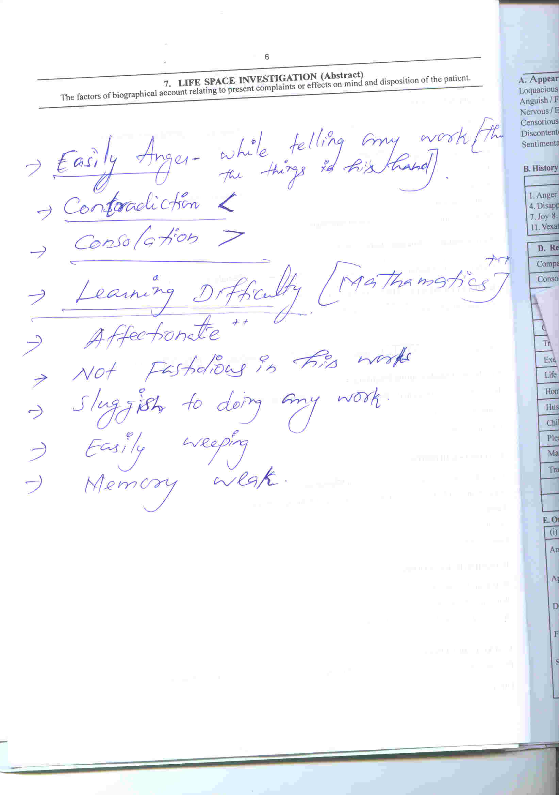
C
A
S
E
3

Slide 34
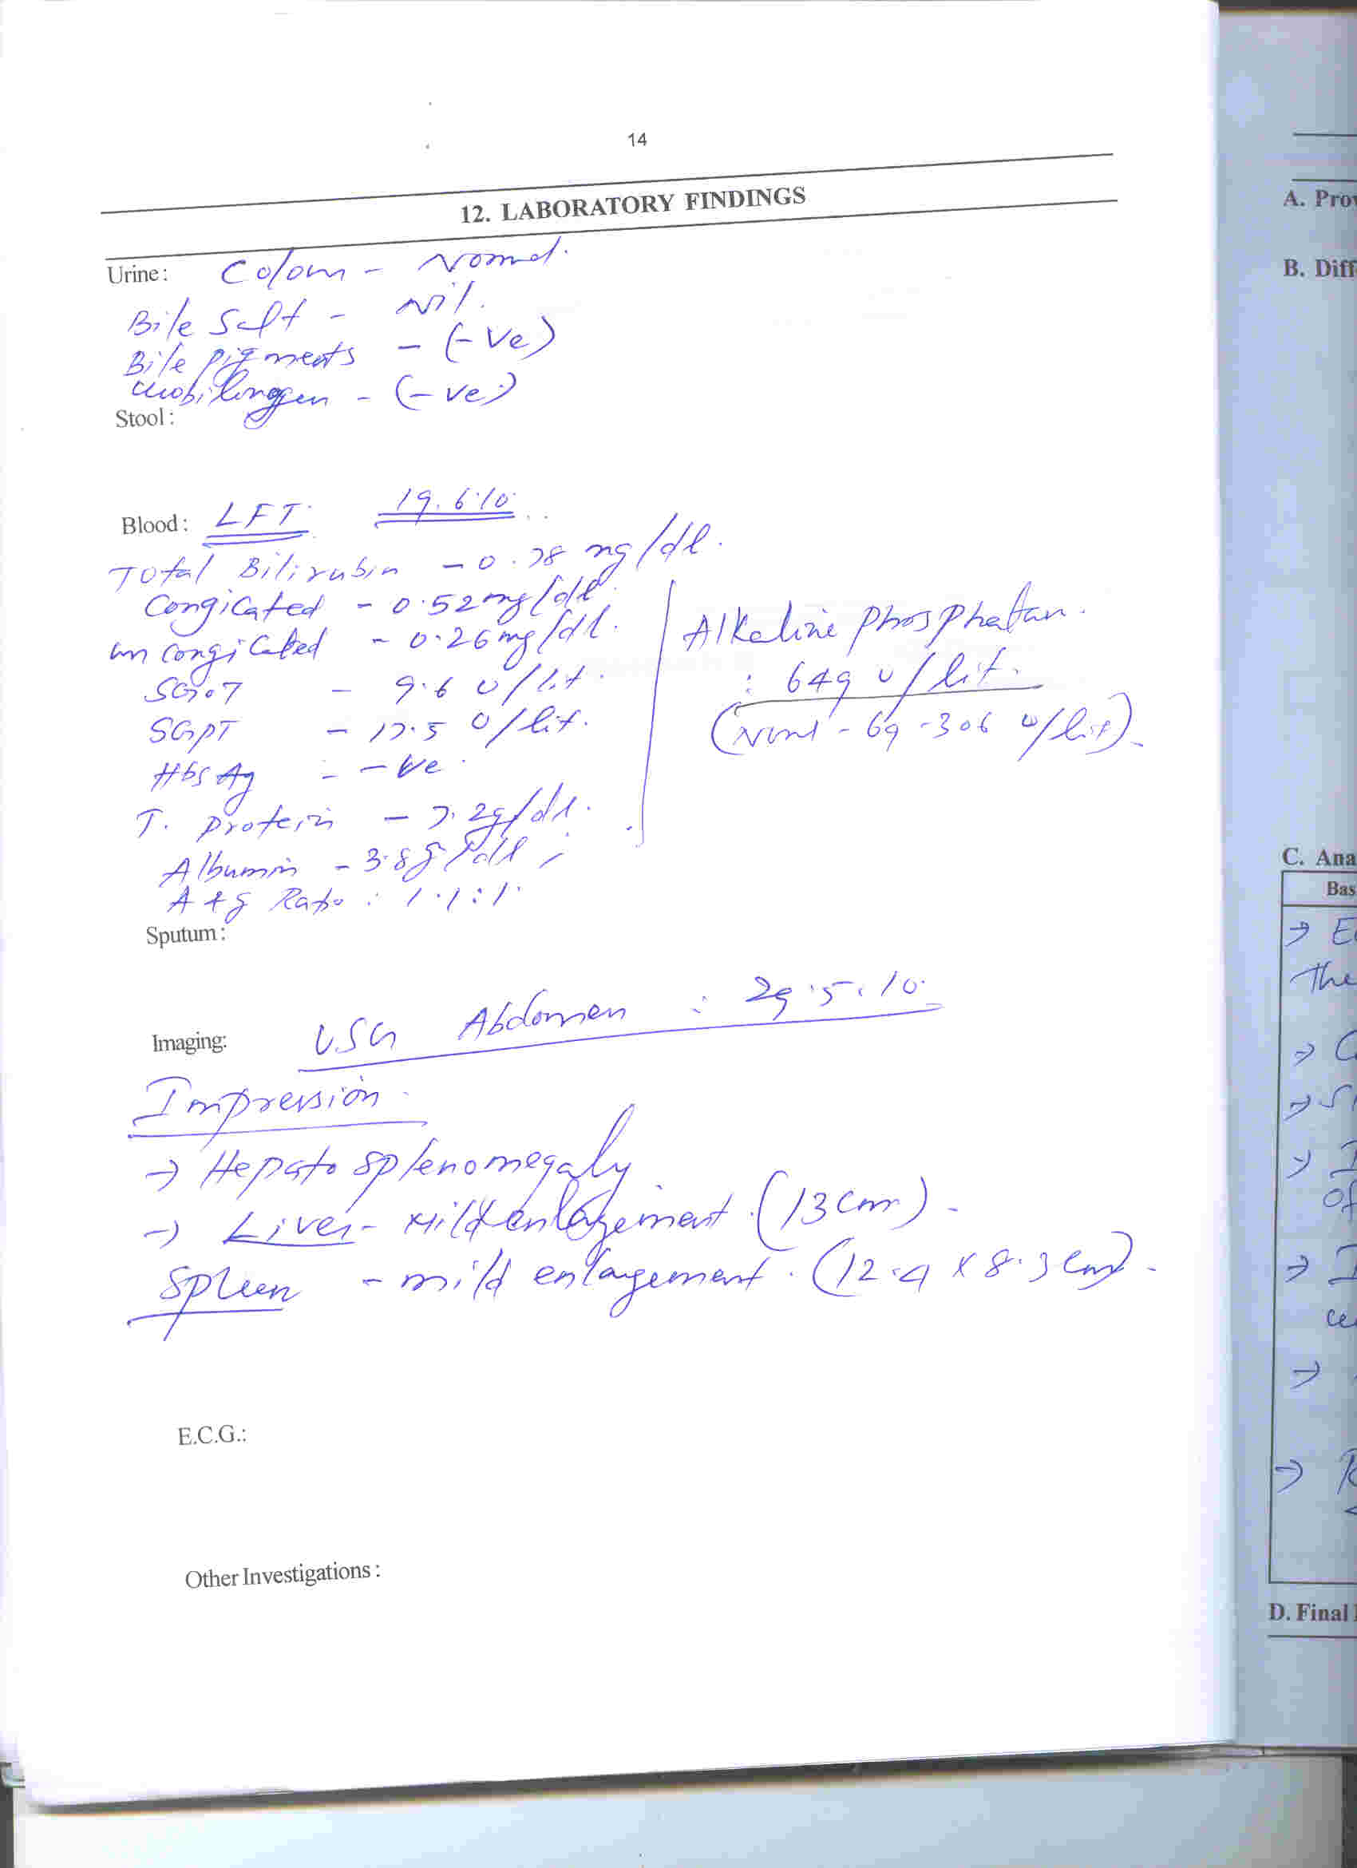
C
A
S
E
3

Slide 35
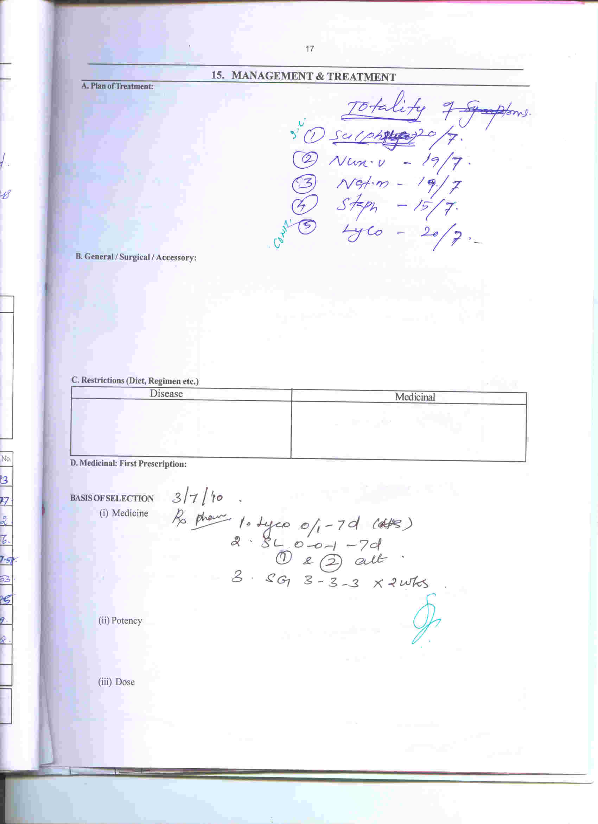
Differential Remedies
C
A
S
E
3

Slide 36
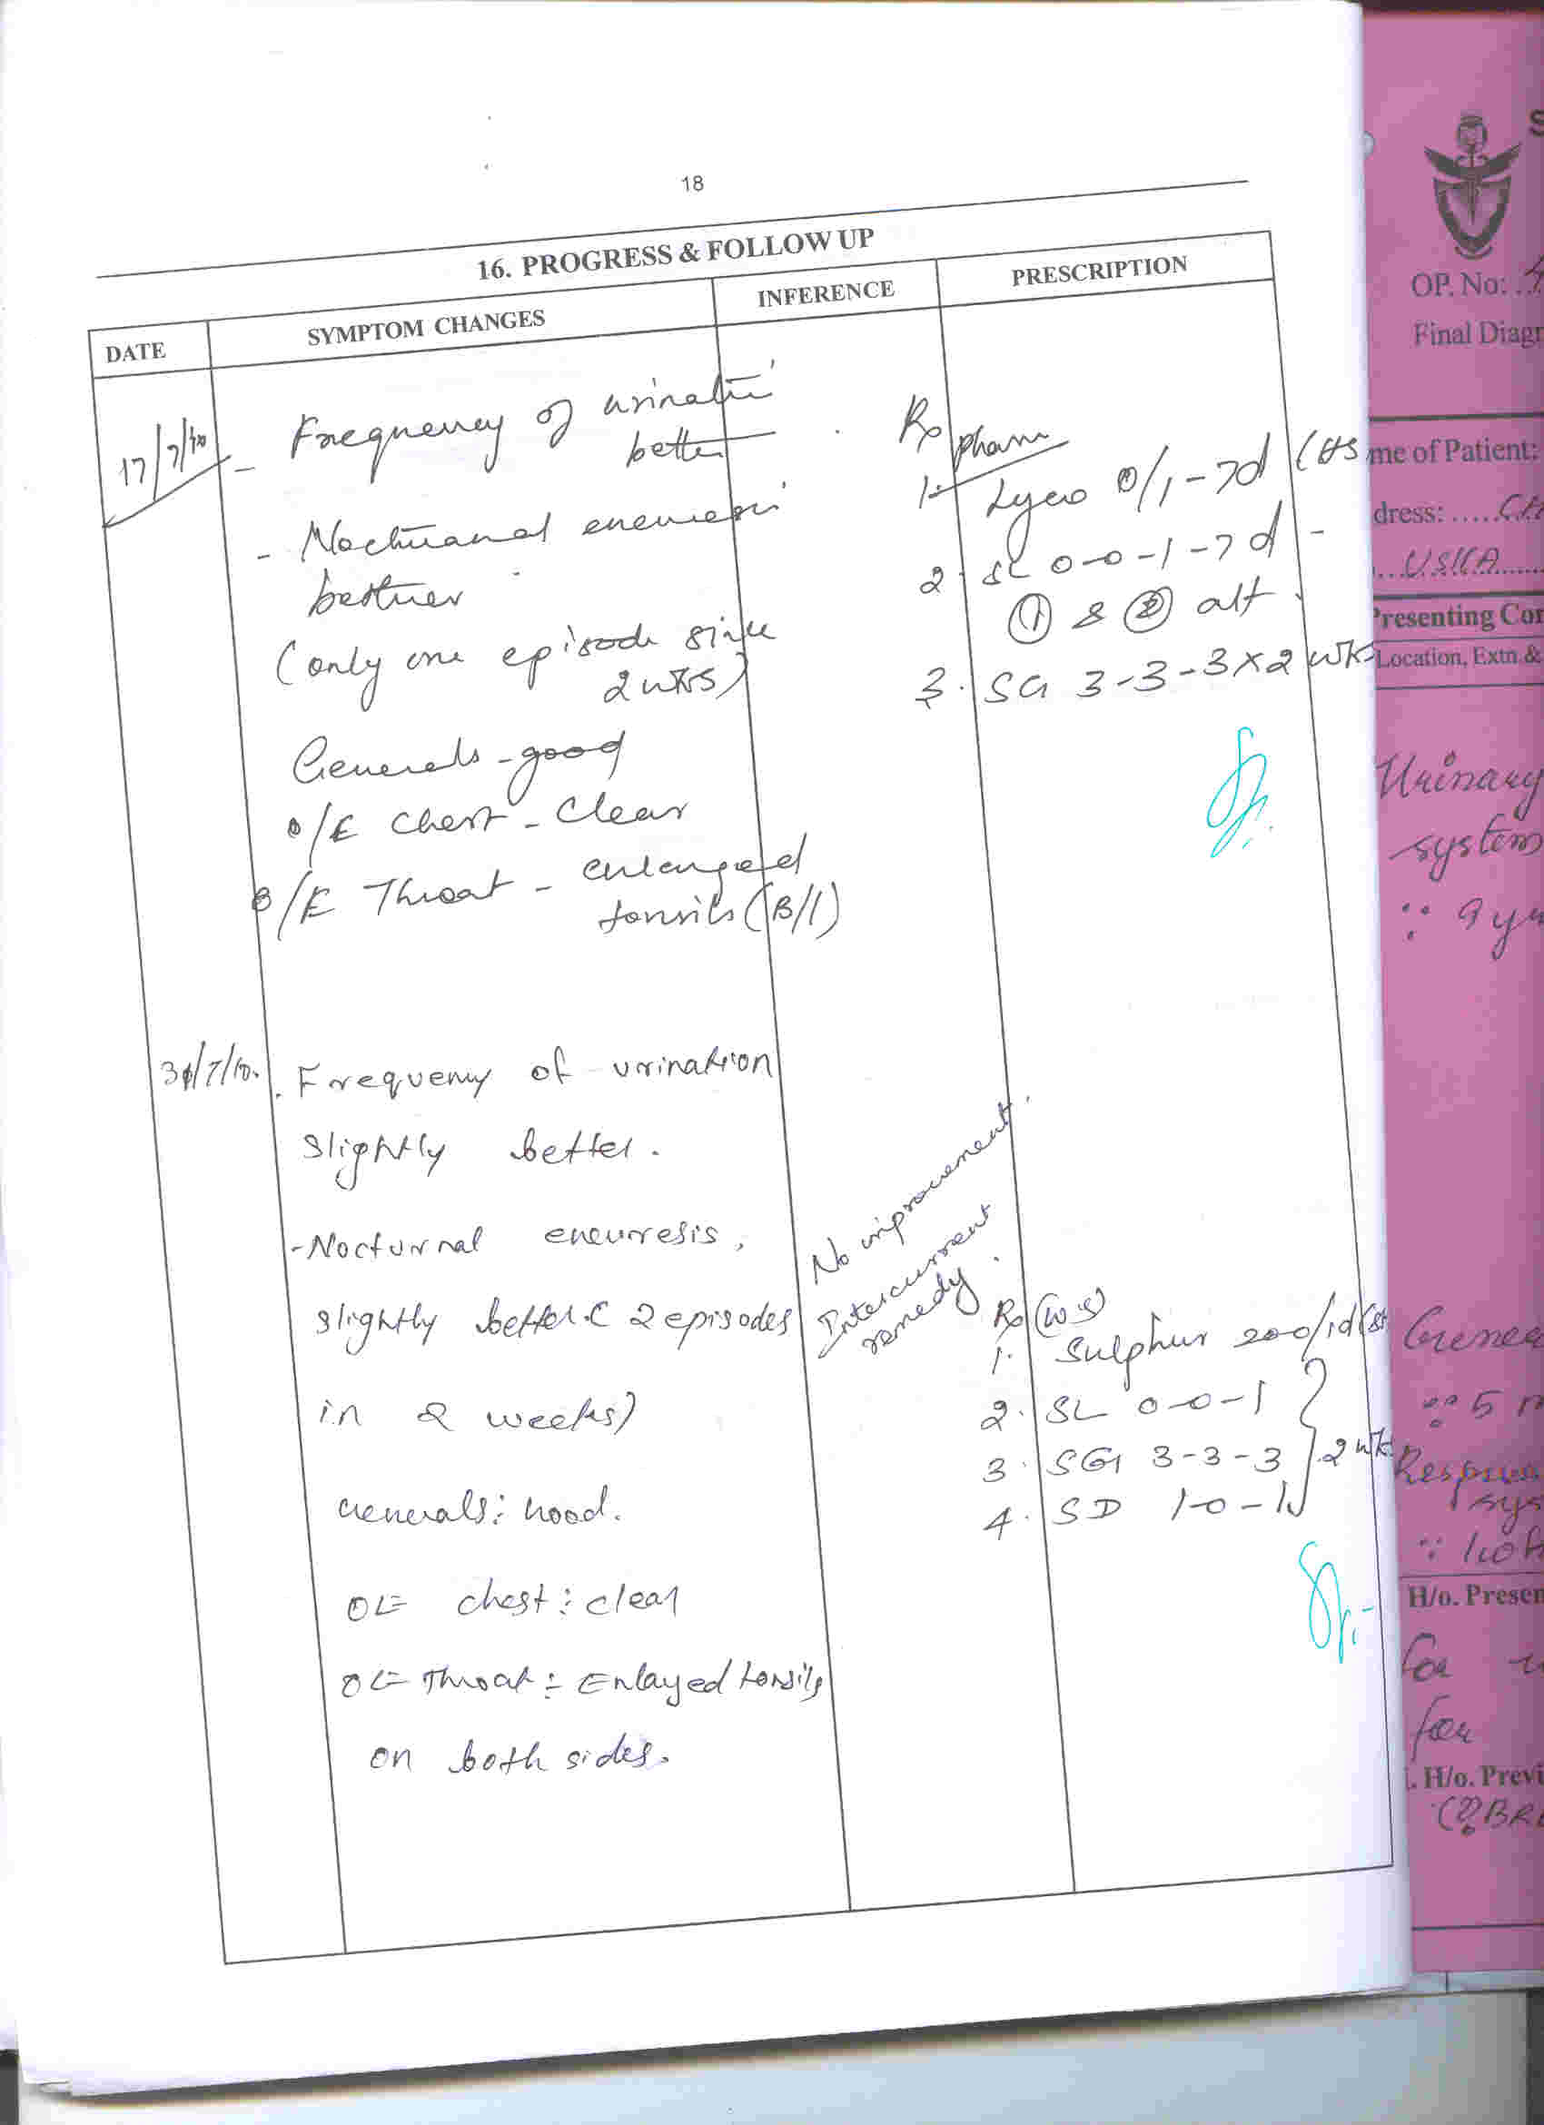
C
A
S
E
3

Slide 37
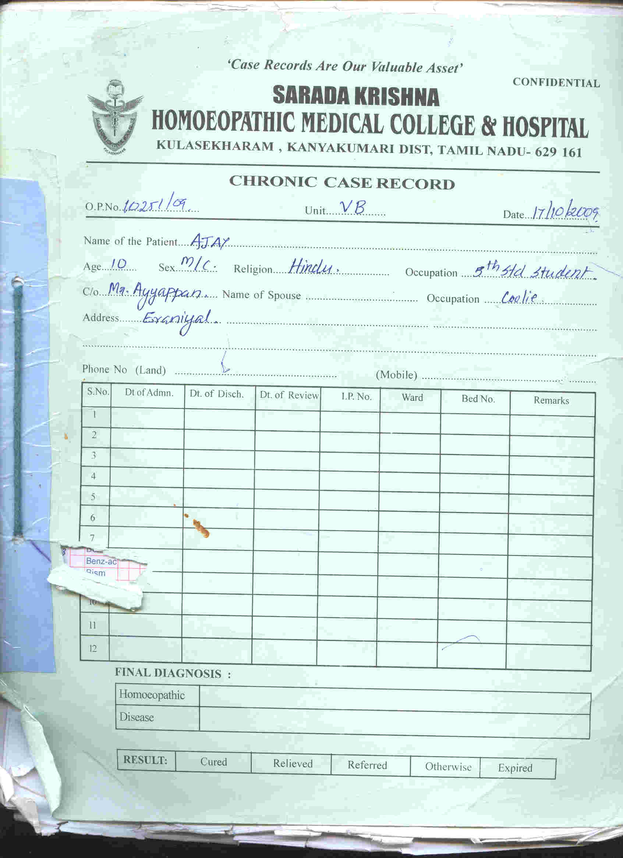
C
A
S
E
4

Slide 38
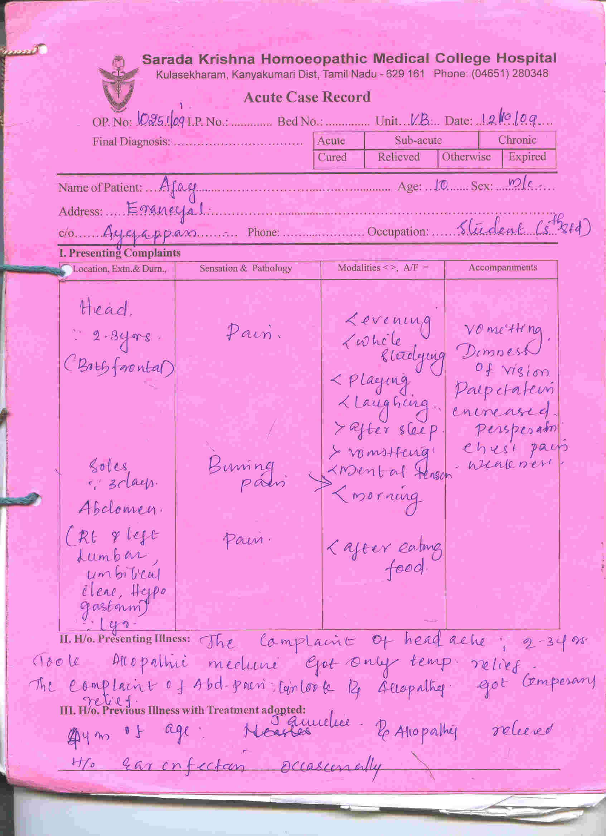
C
A
S
E
4

Slide 39
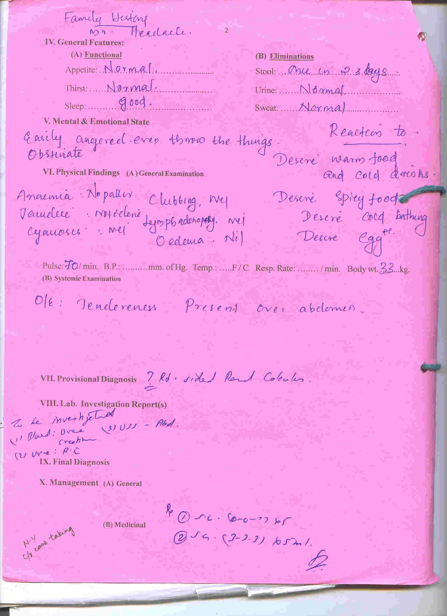
C
A
S
E
4

Slide 40
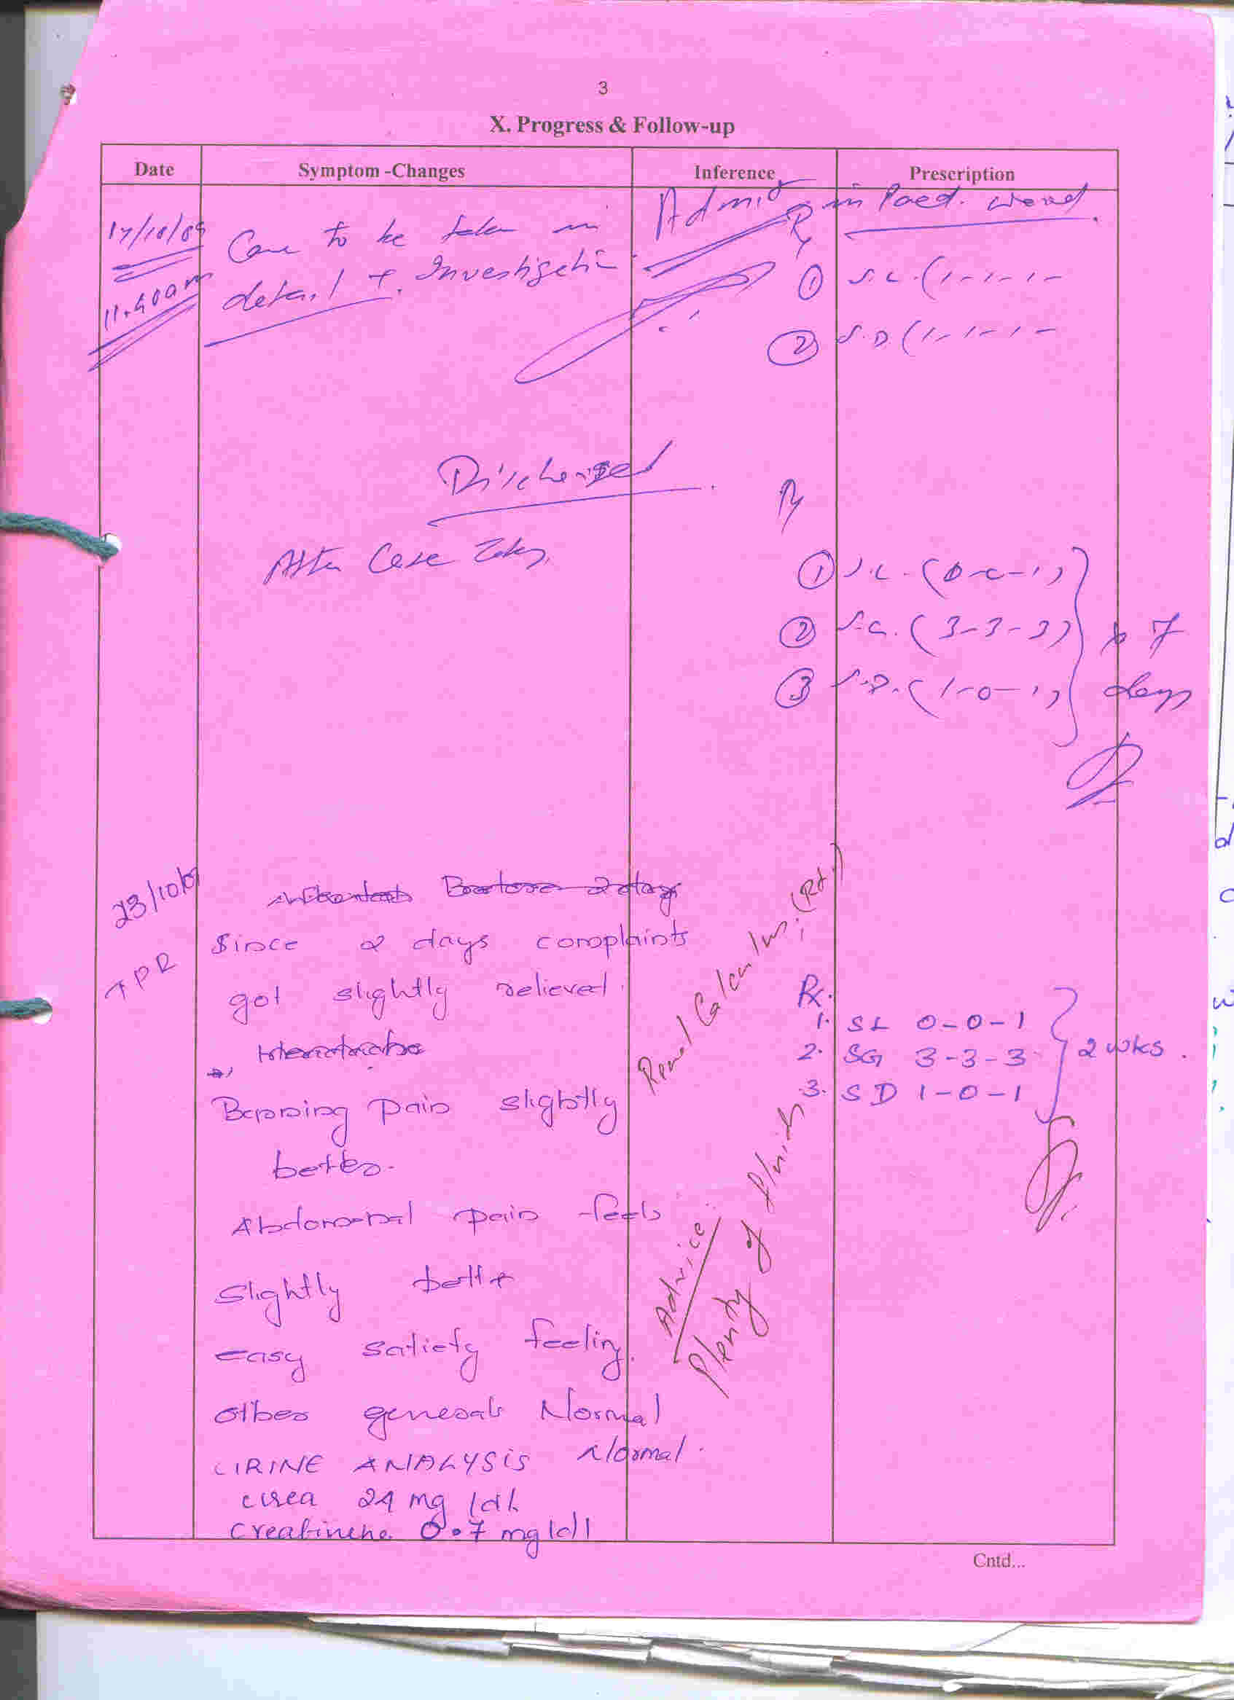
C
A
S
E
4

Slide 41
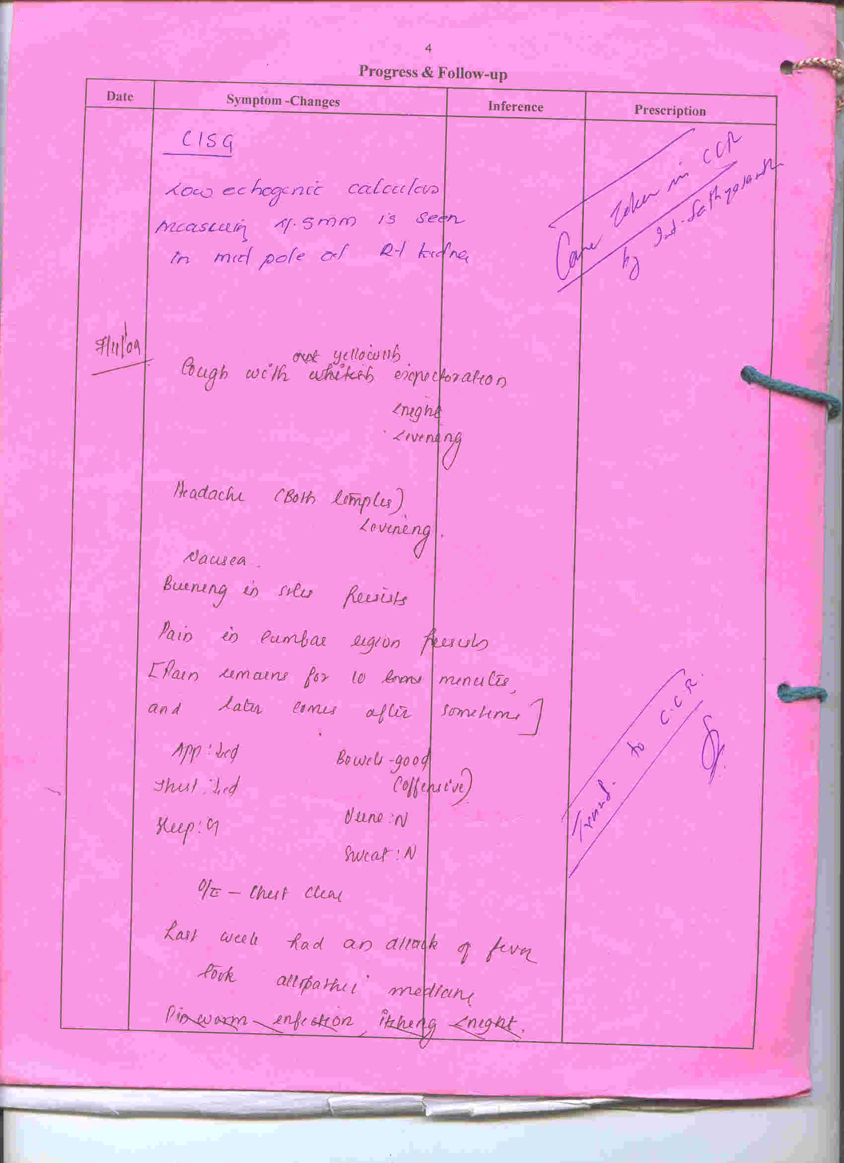
C
A
S
E
4

Slide 42
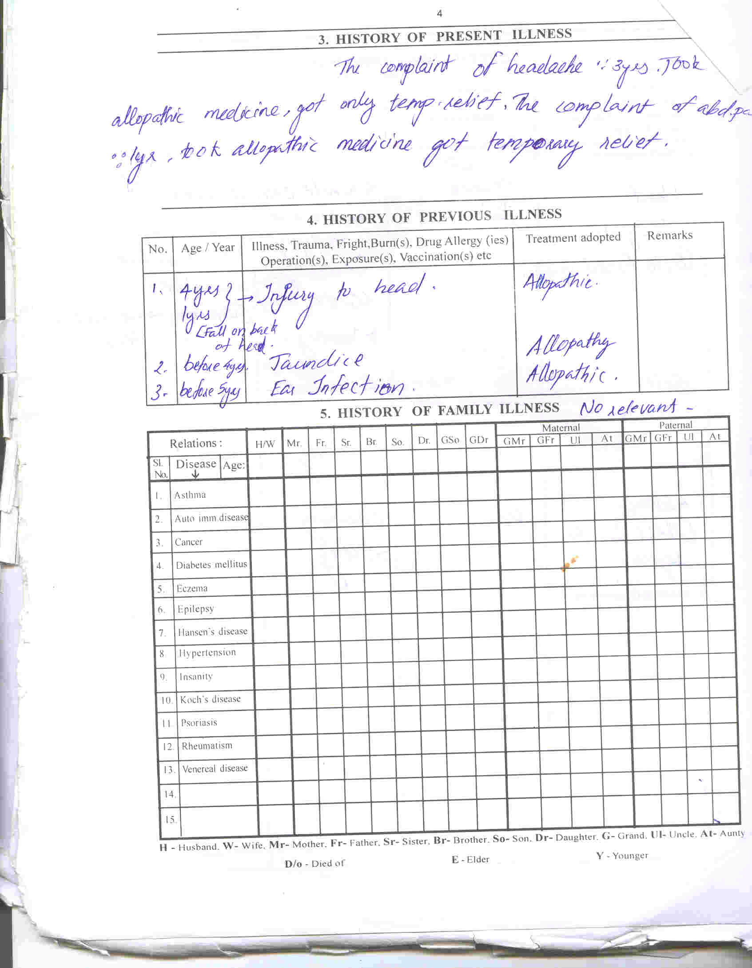
C
A
S
E
4

Slide 43
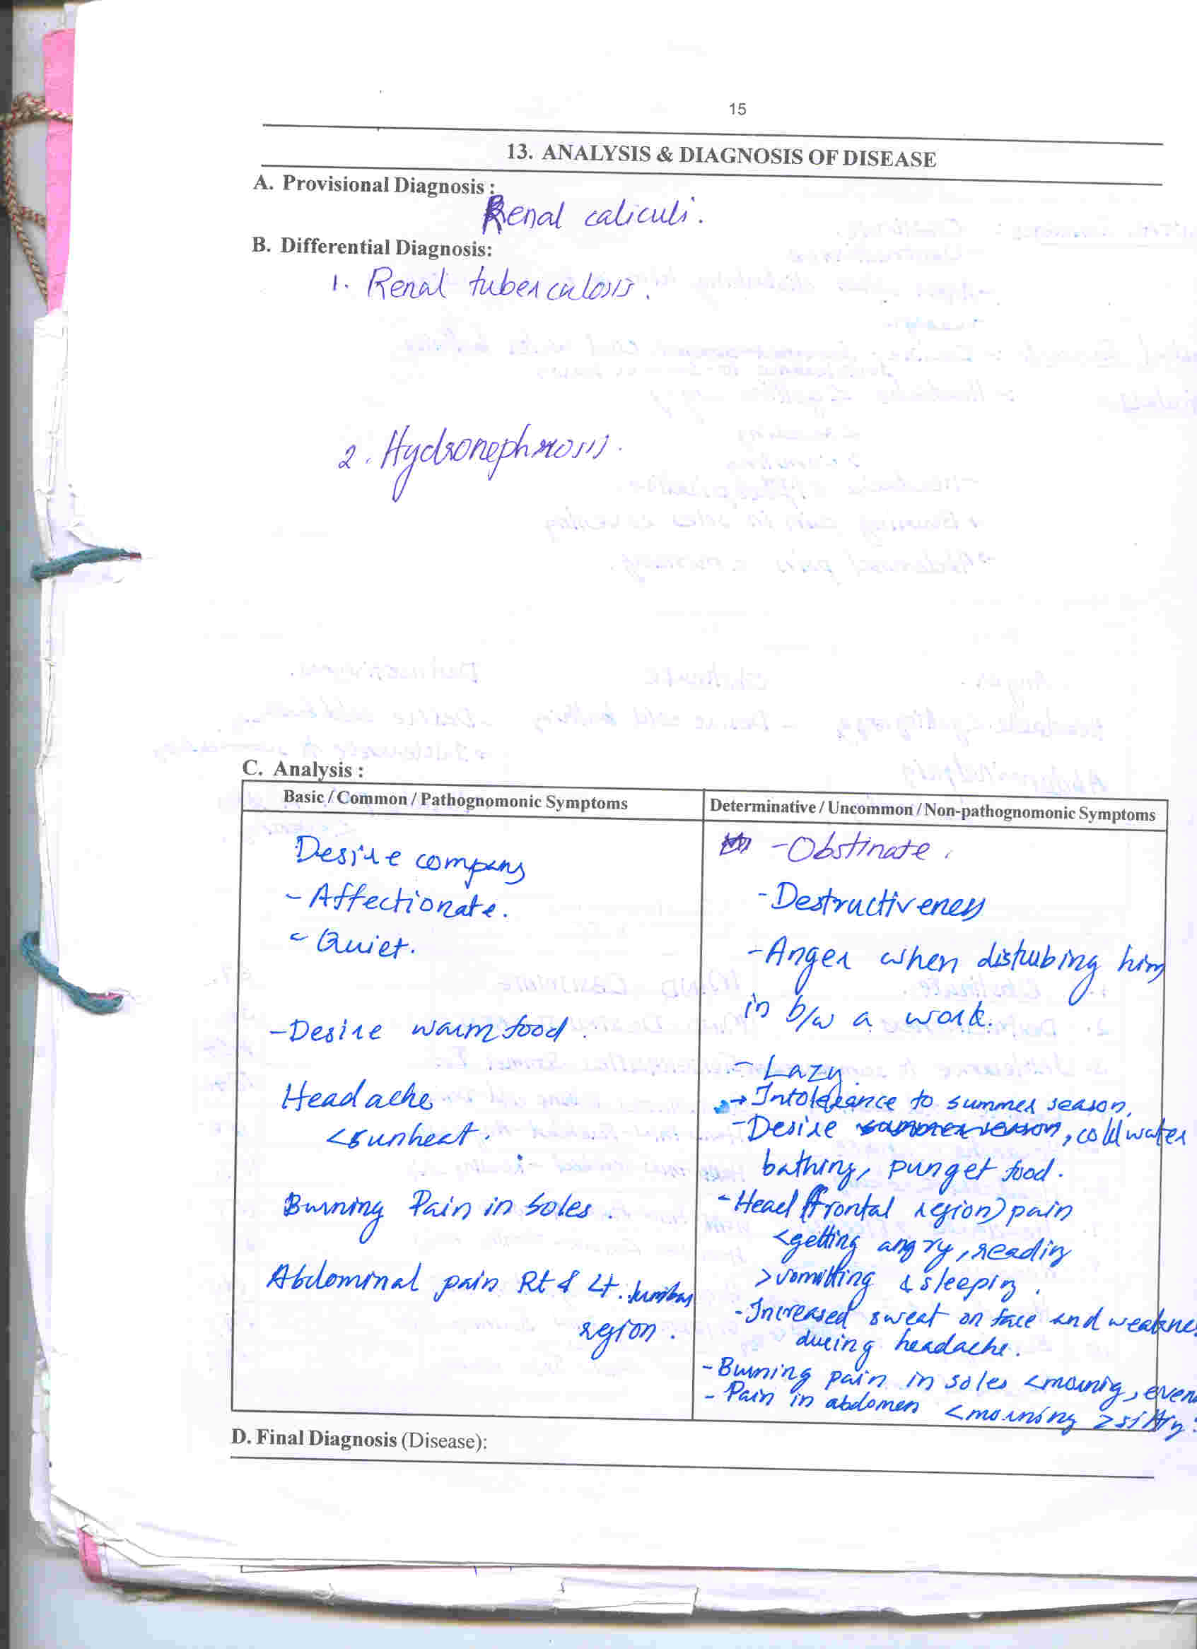
C
A
S
E
4

Slide 44
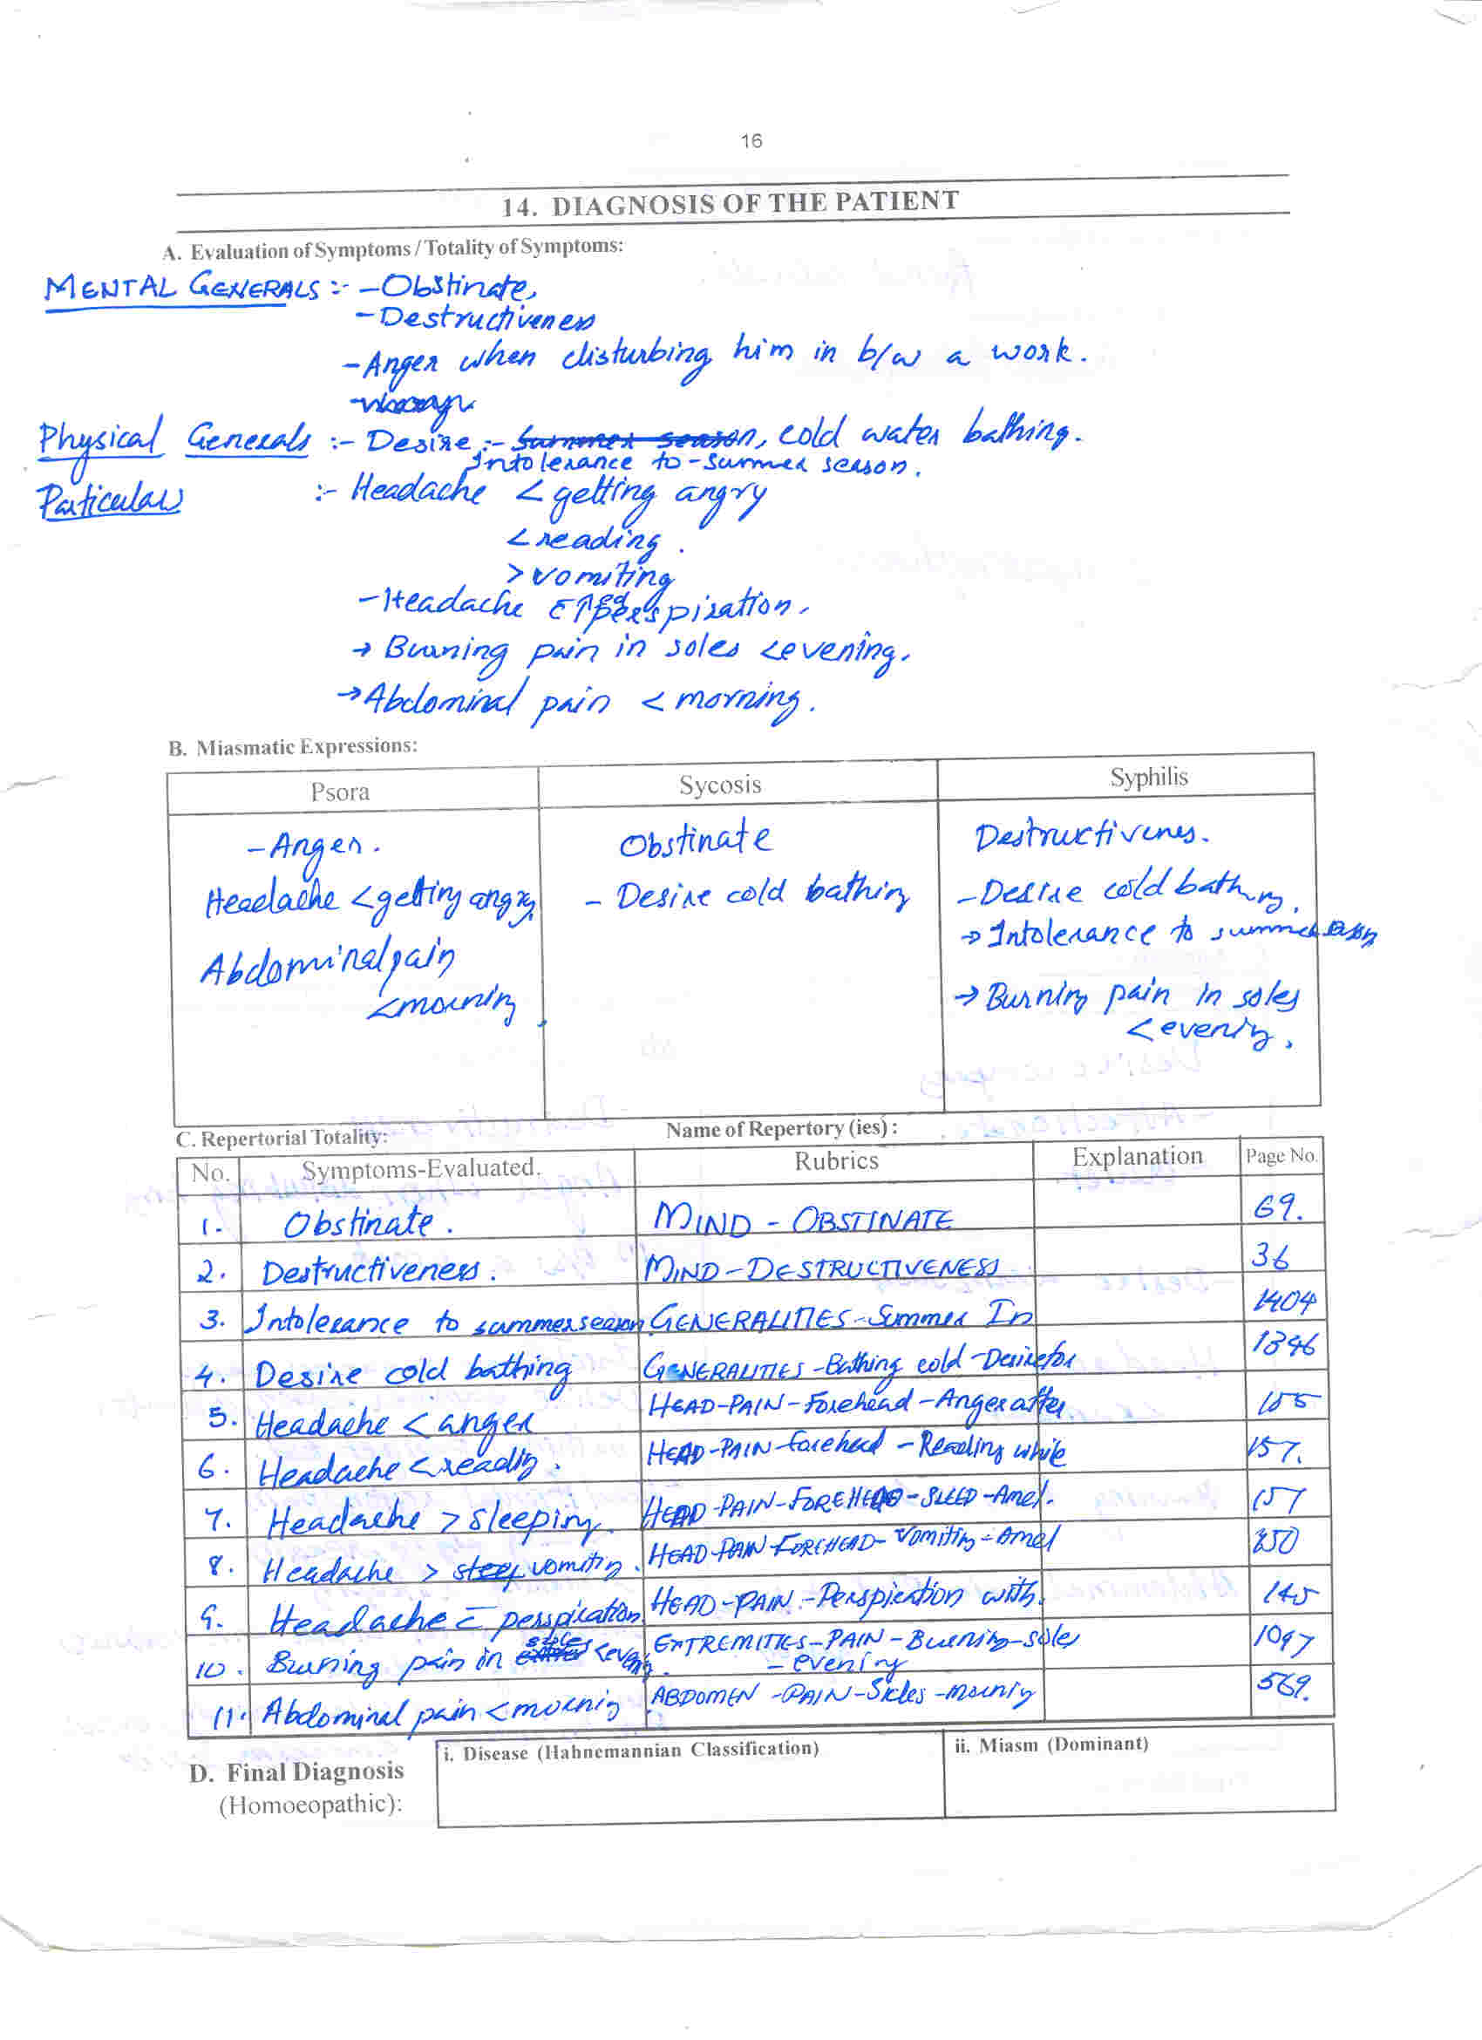
C
A
S
E
4

Slide 45
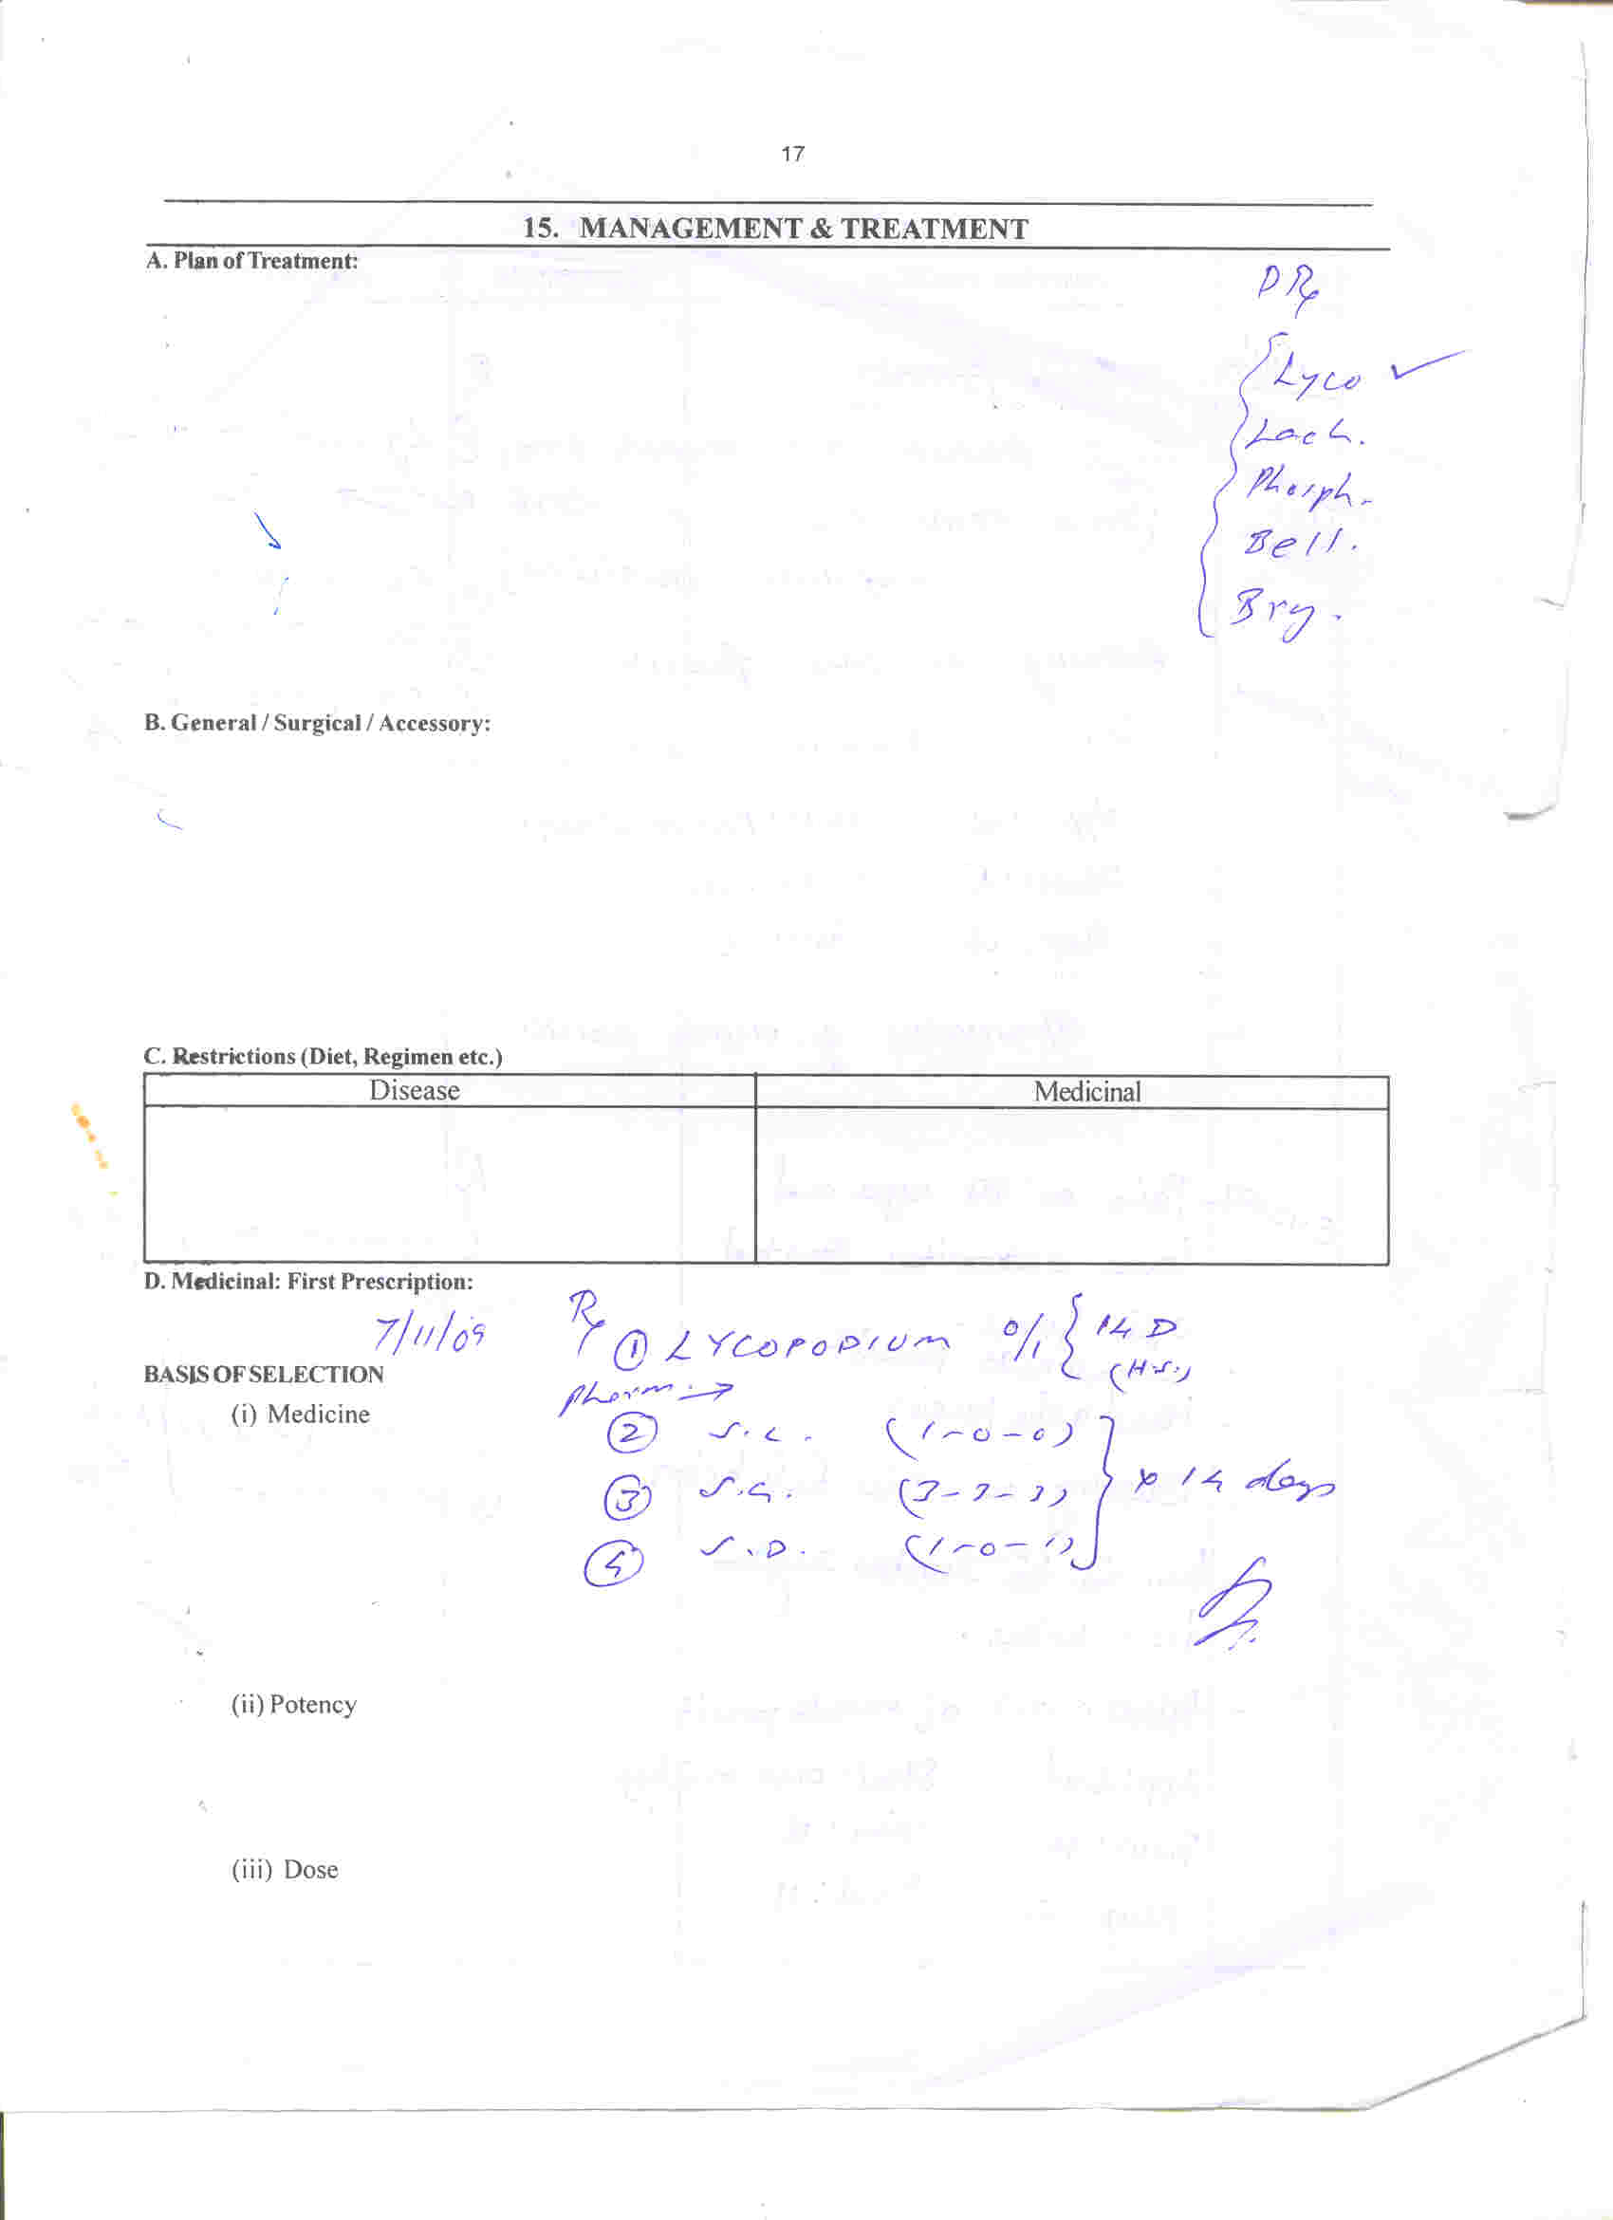
C
A
S
E
4

Slide 46
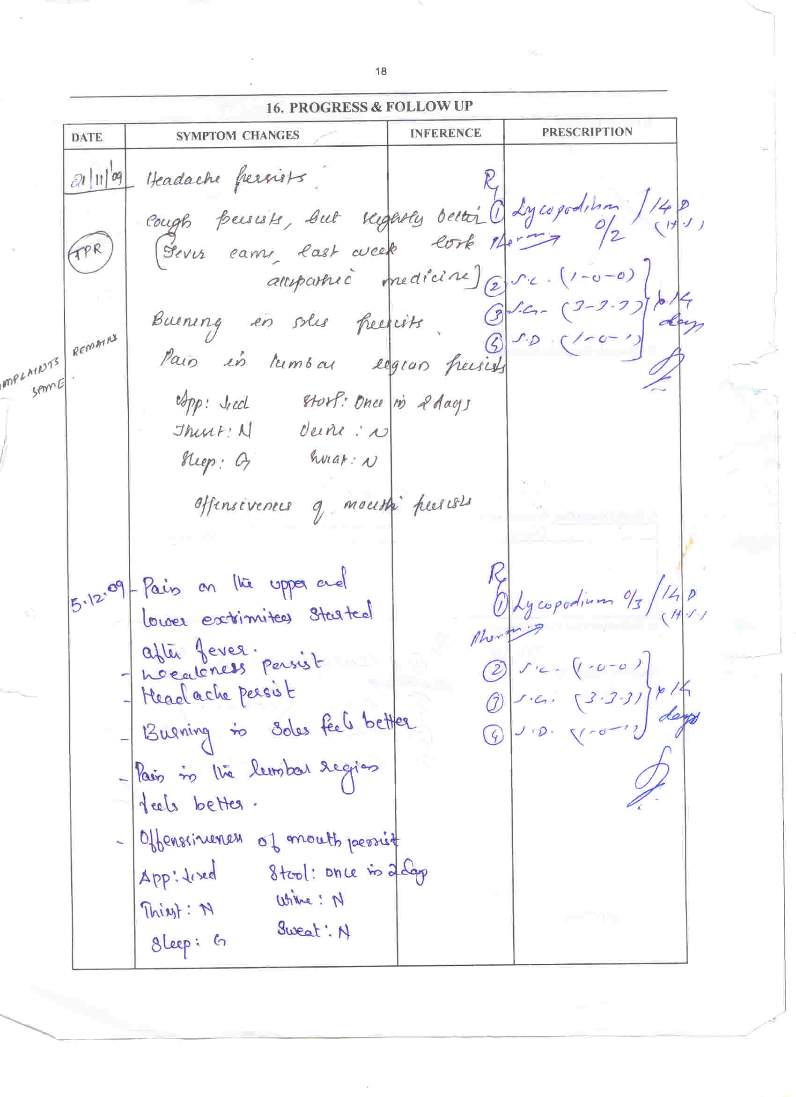
C
A
S
E
4

Slide 47
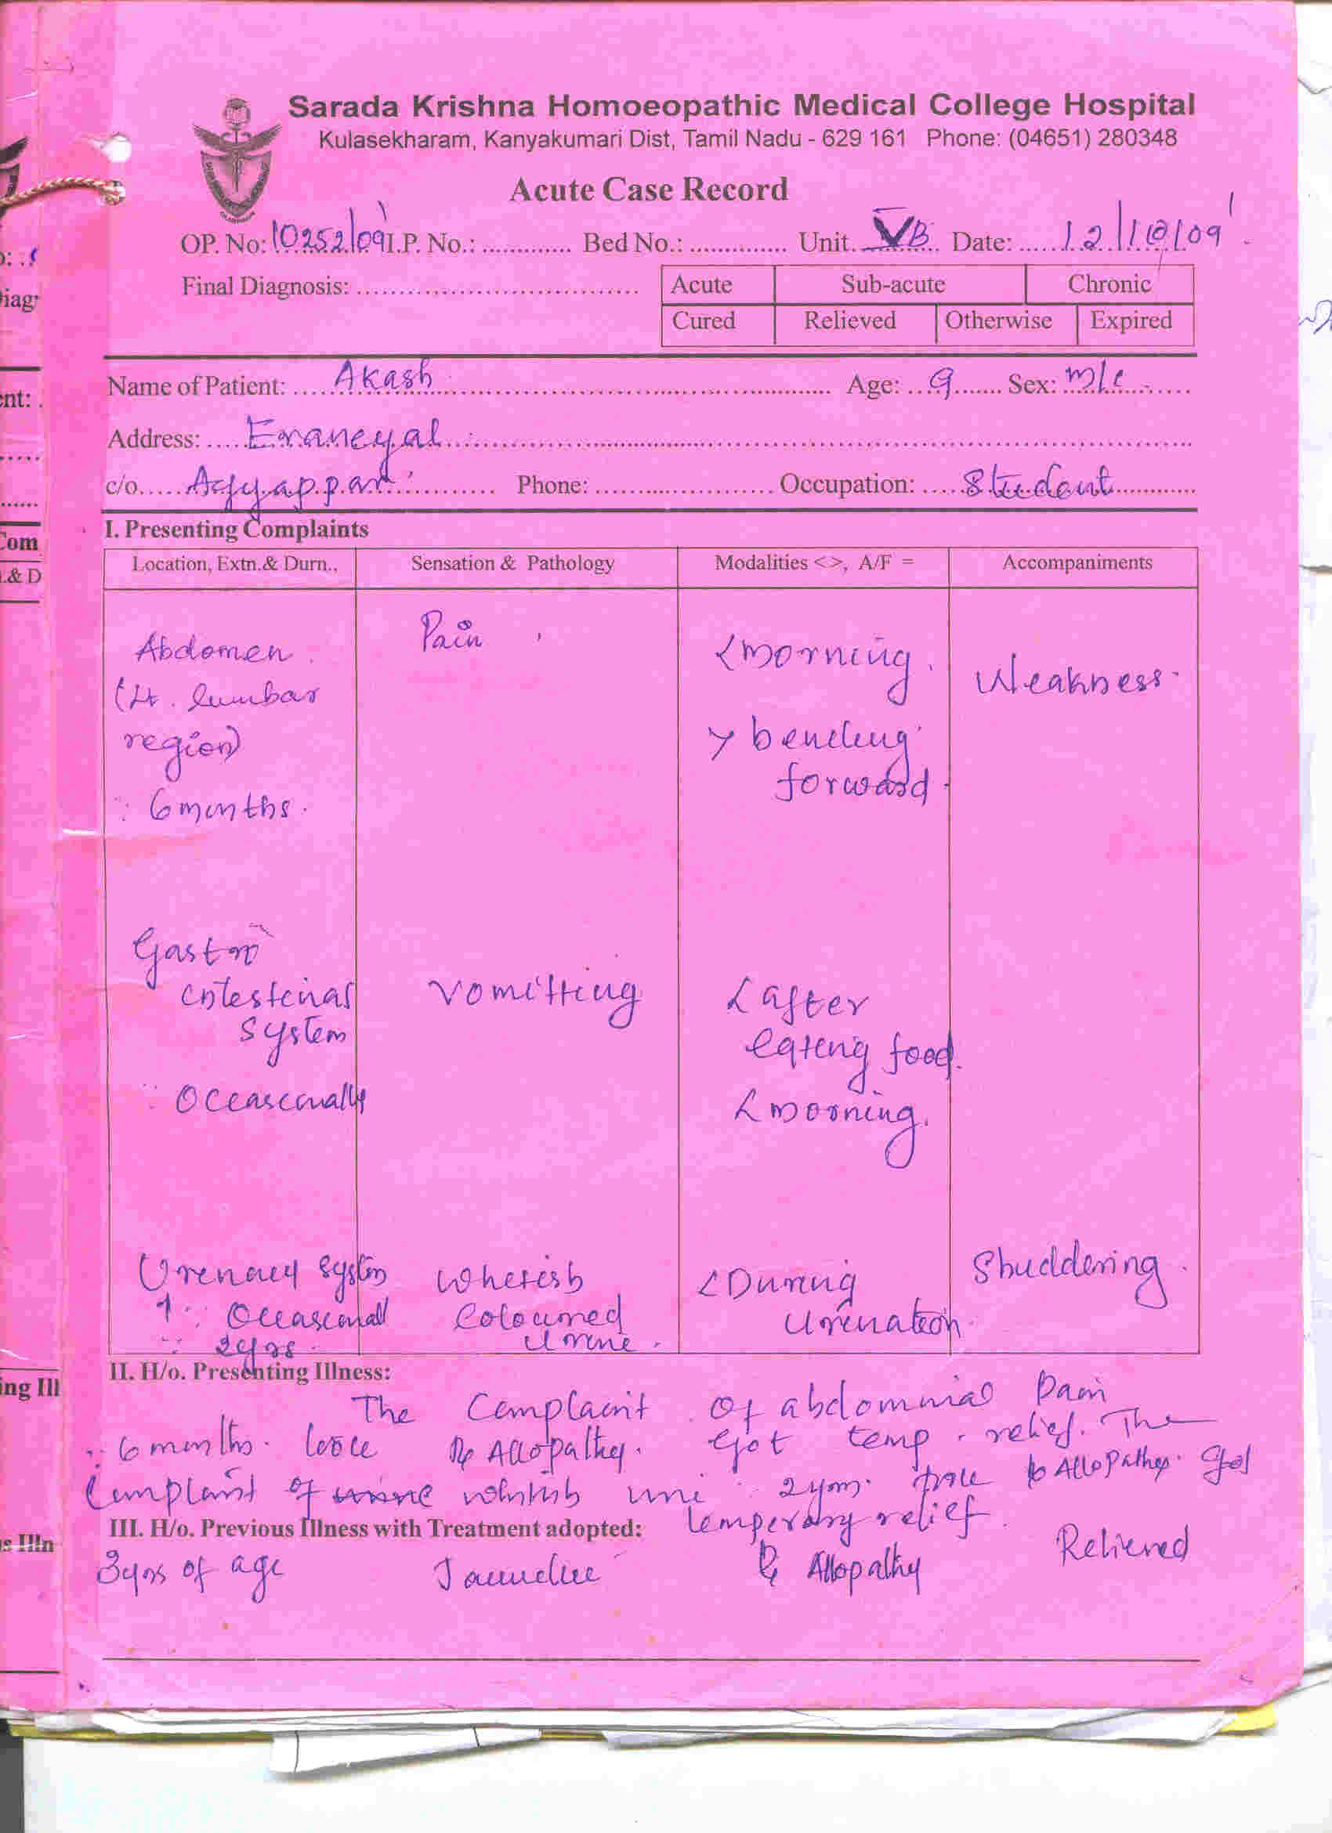
C
A
S
E
5

Slide 48
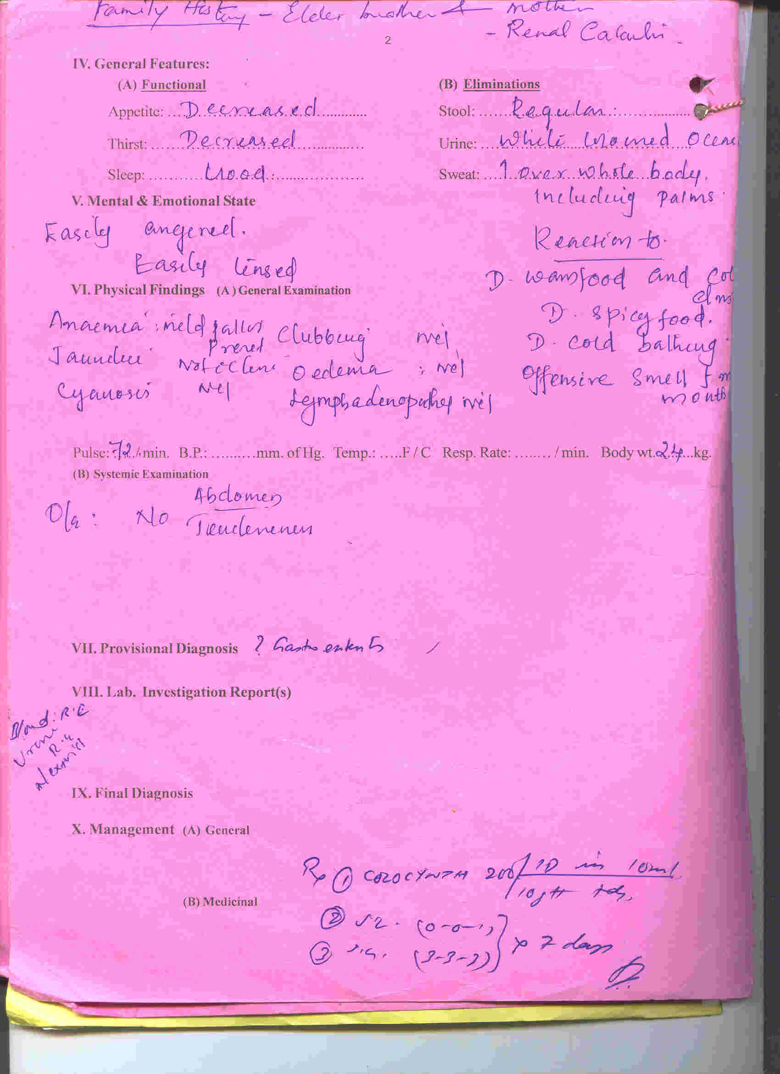
C
A
S
E
5

Slide 49
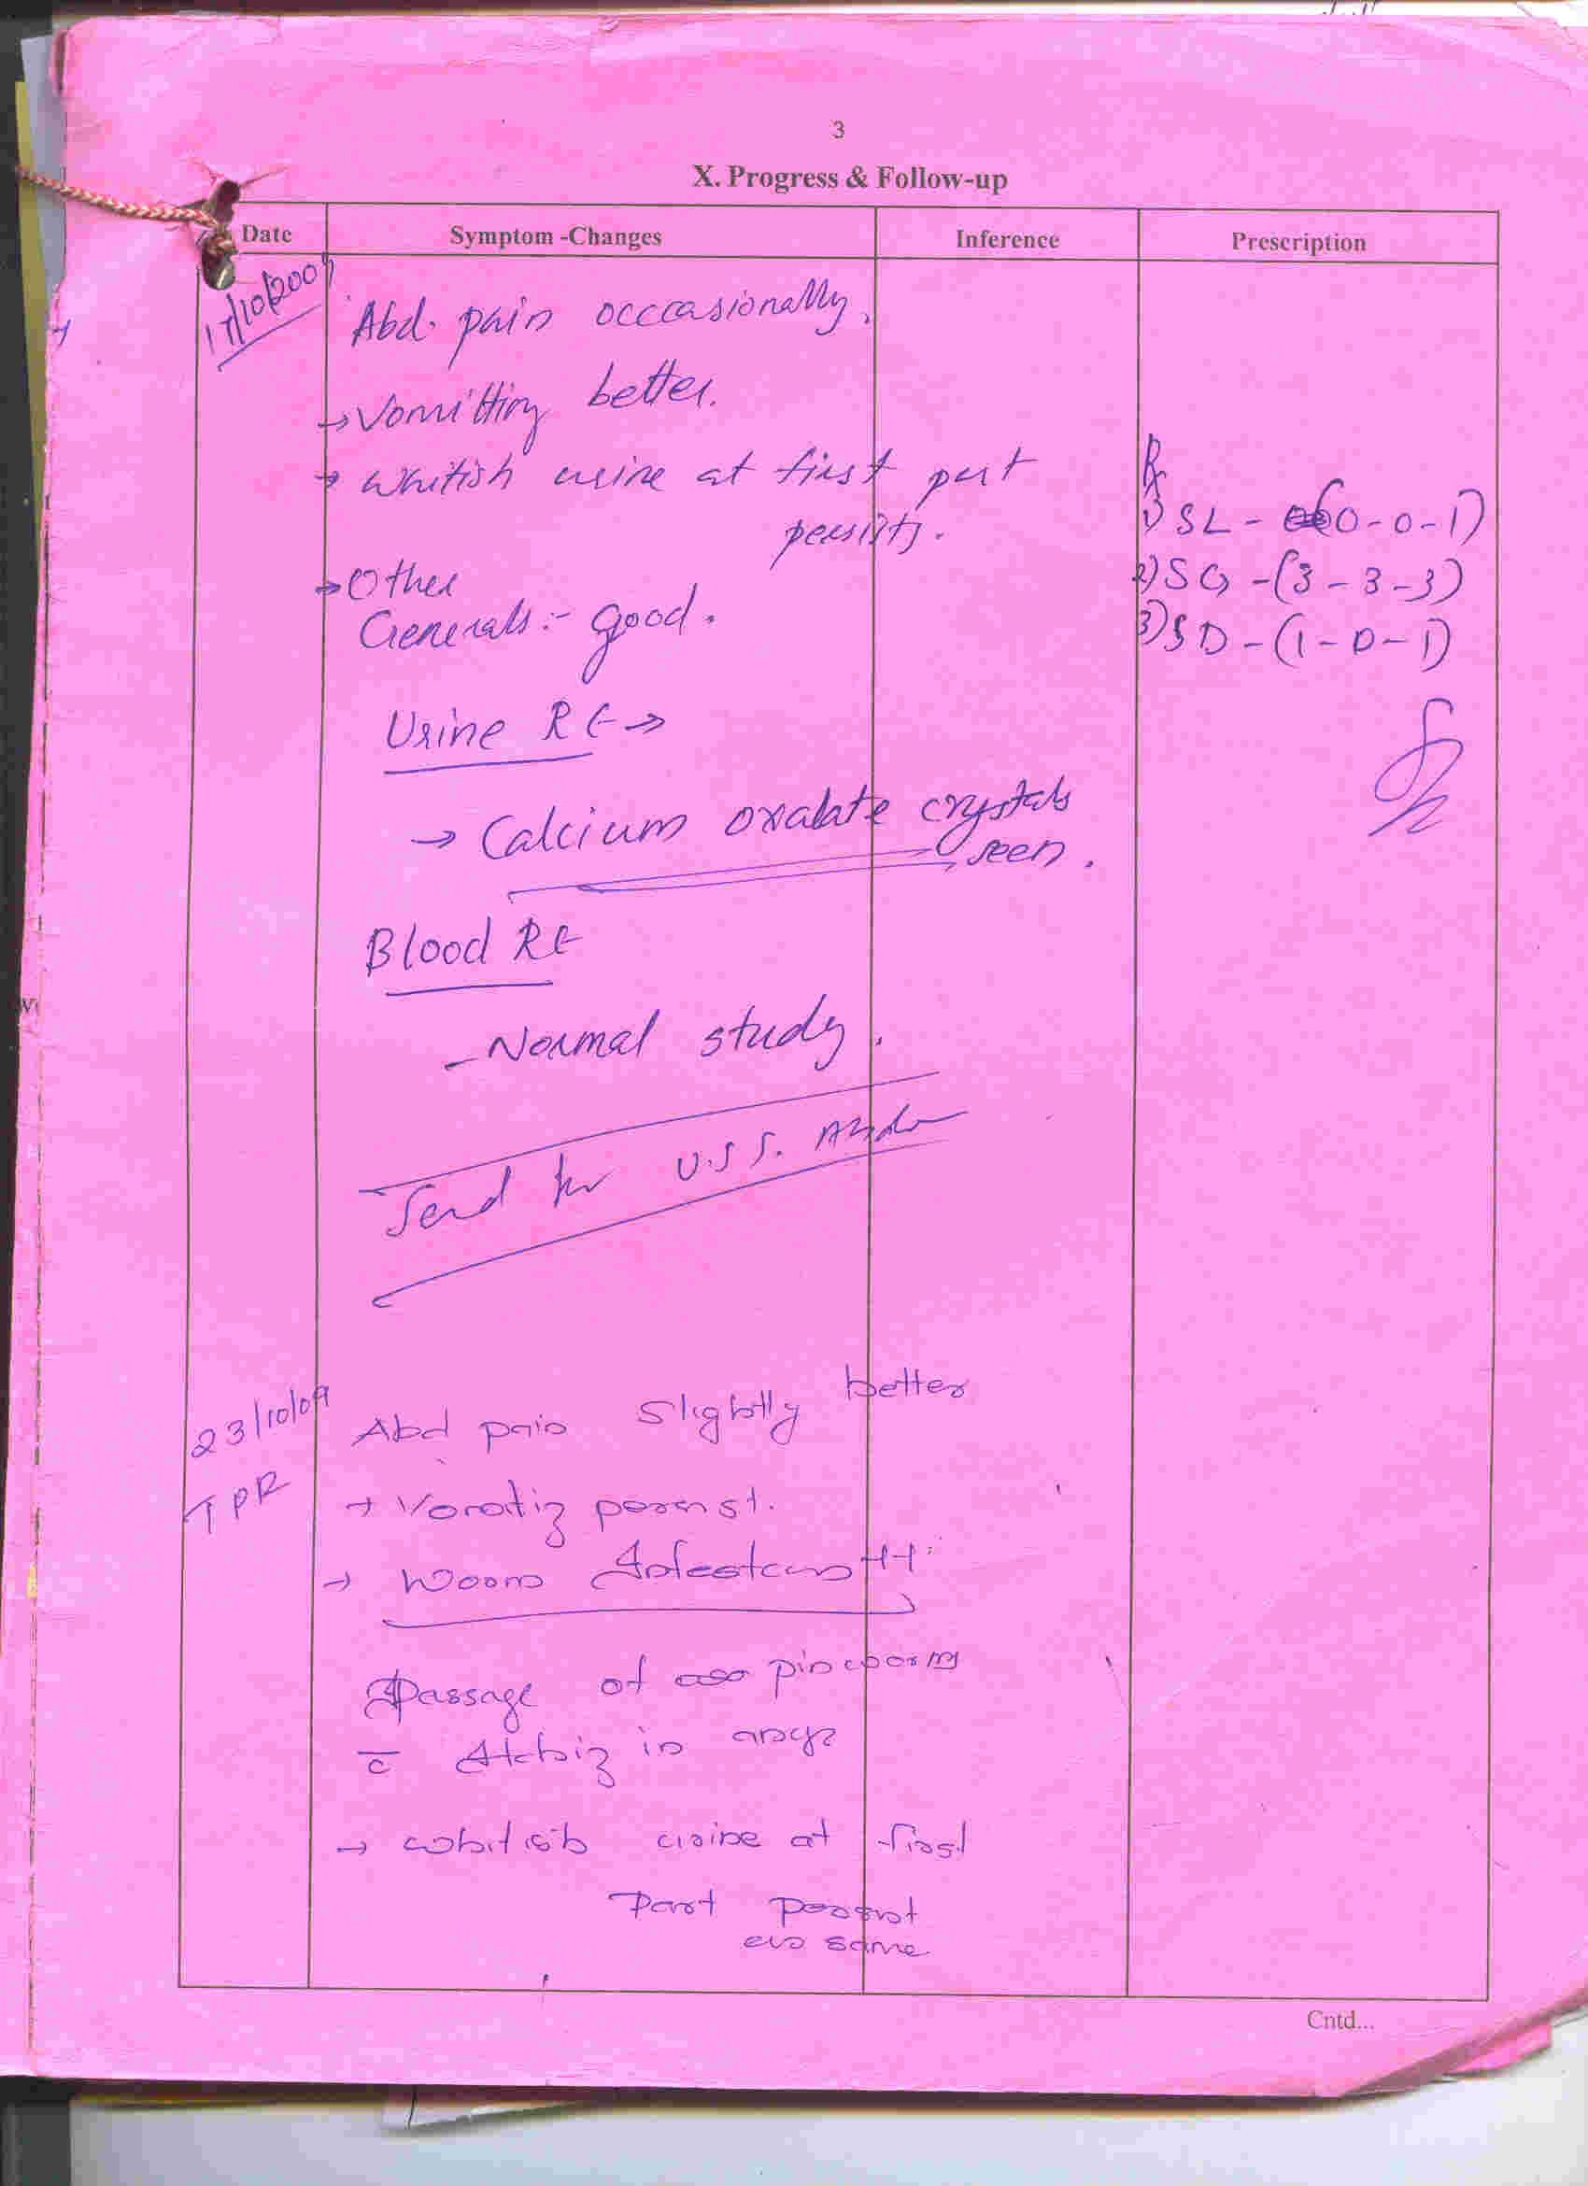
C
A
S
E
5

Slide 50
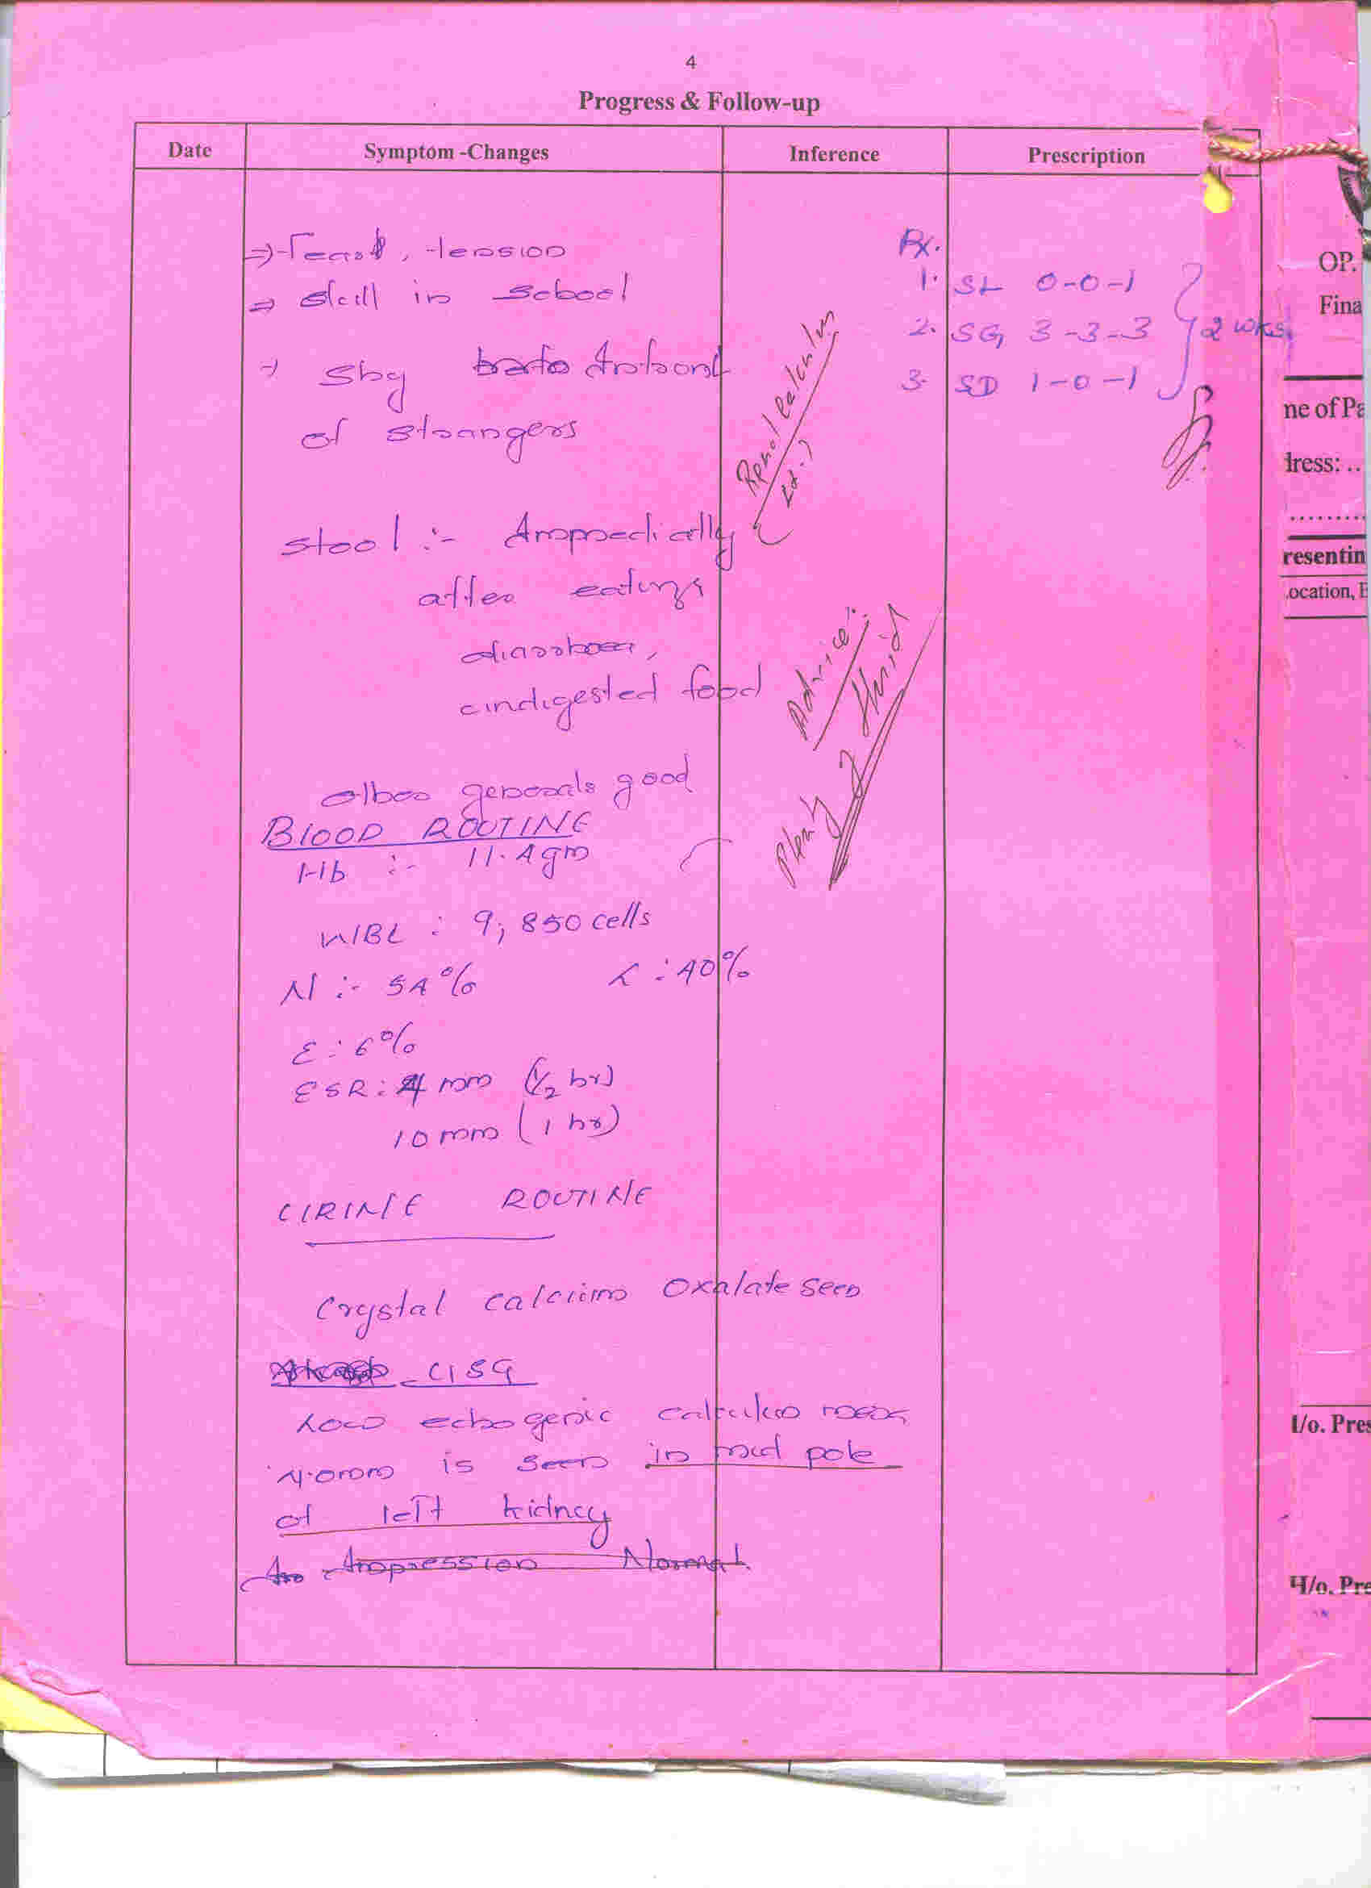
C
A
S
E
5

Slide 51
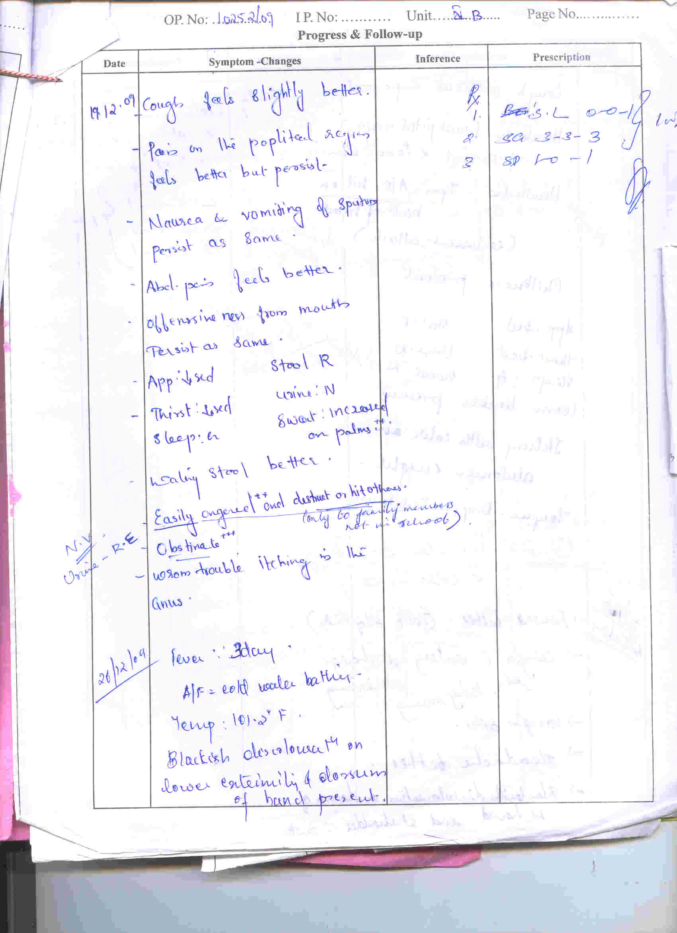
C
A
S
E
5

Slide 52
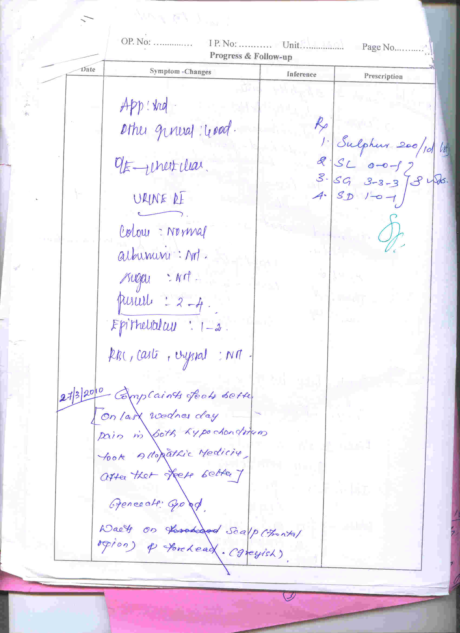
C
A
S
E
5

Slide 53
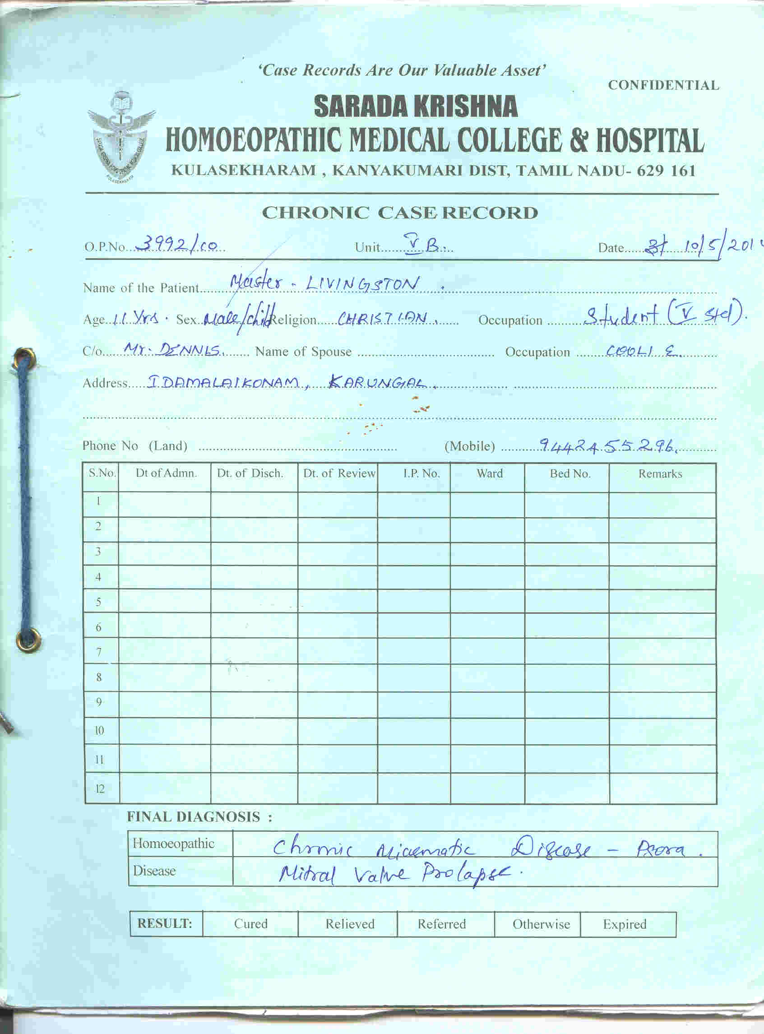
C
A
S
E
6

Slide 54
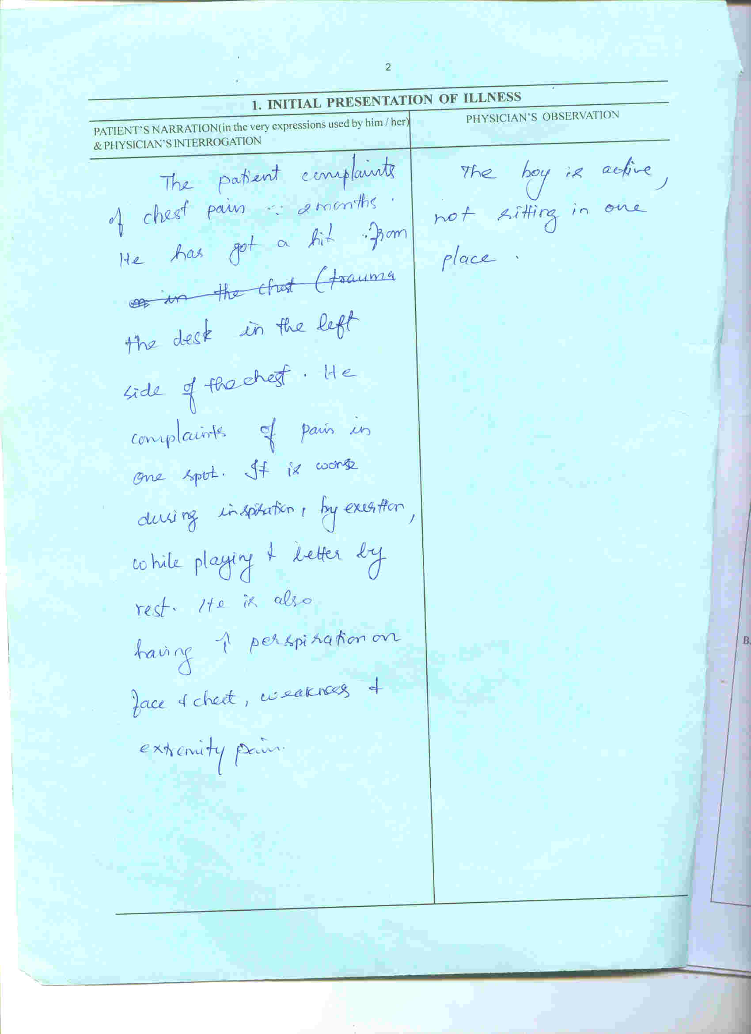
C
A
S
E
5

Slide 55
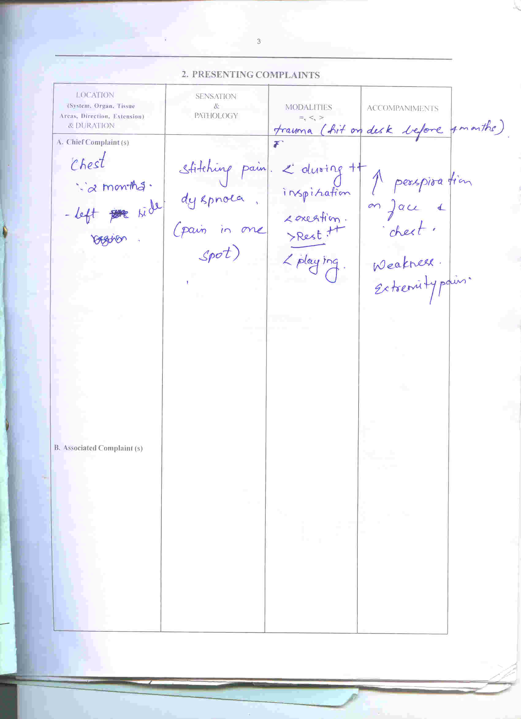
C
A
S
E
5

Slide 56
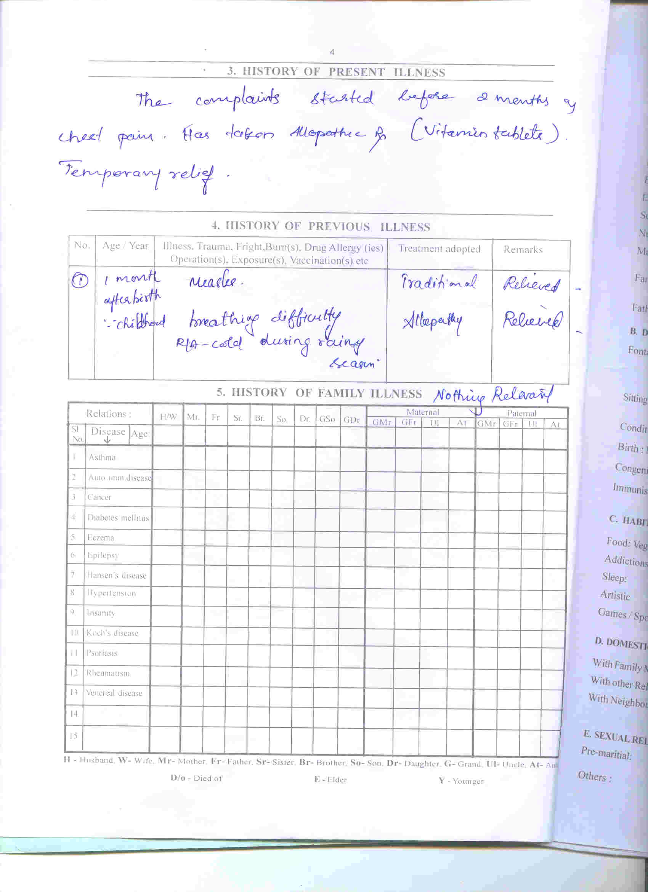
C
A
S
E
5

Slide 57
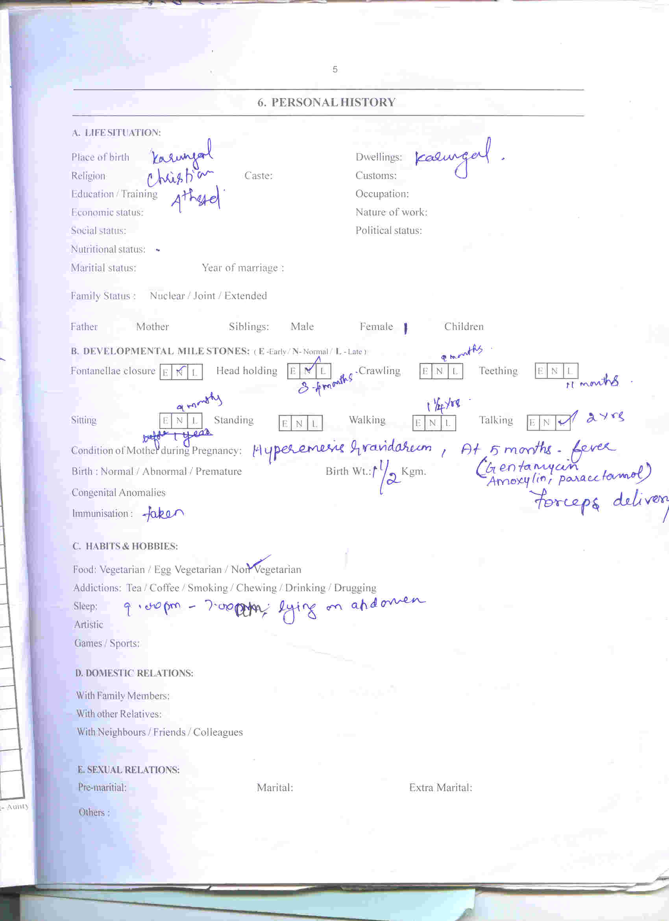
C
A
S
E
5

Slide 58
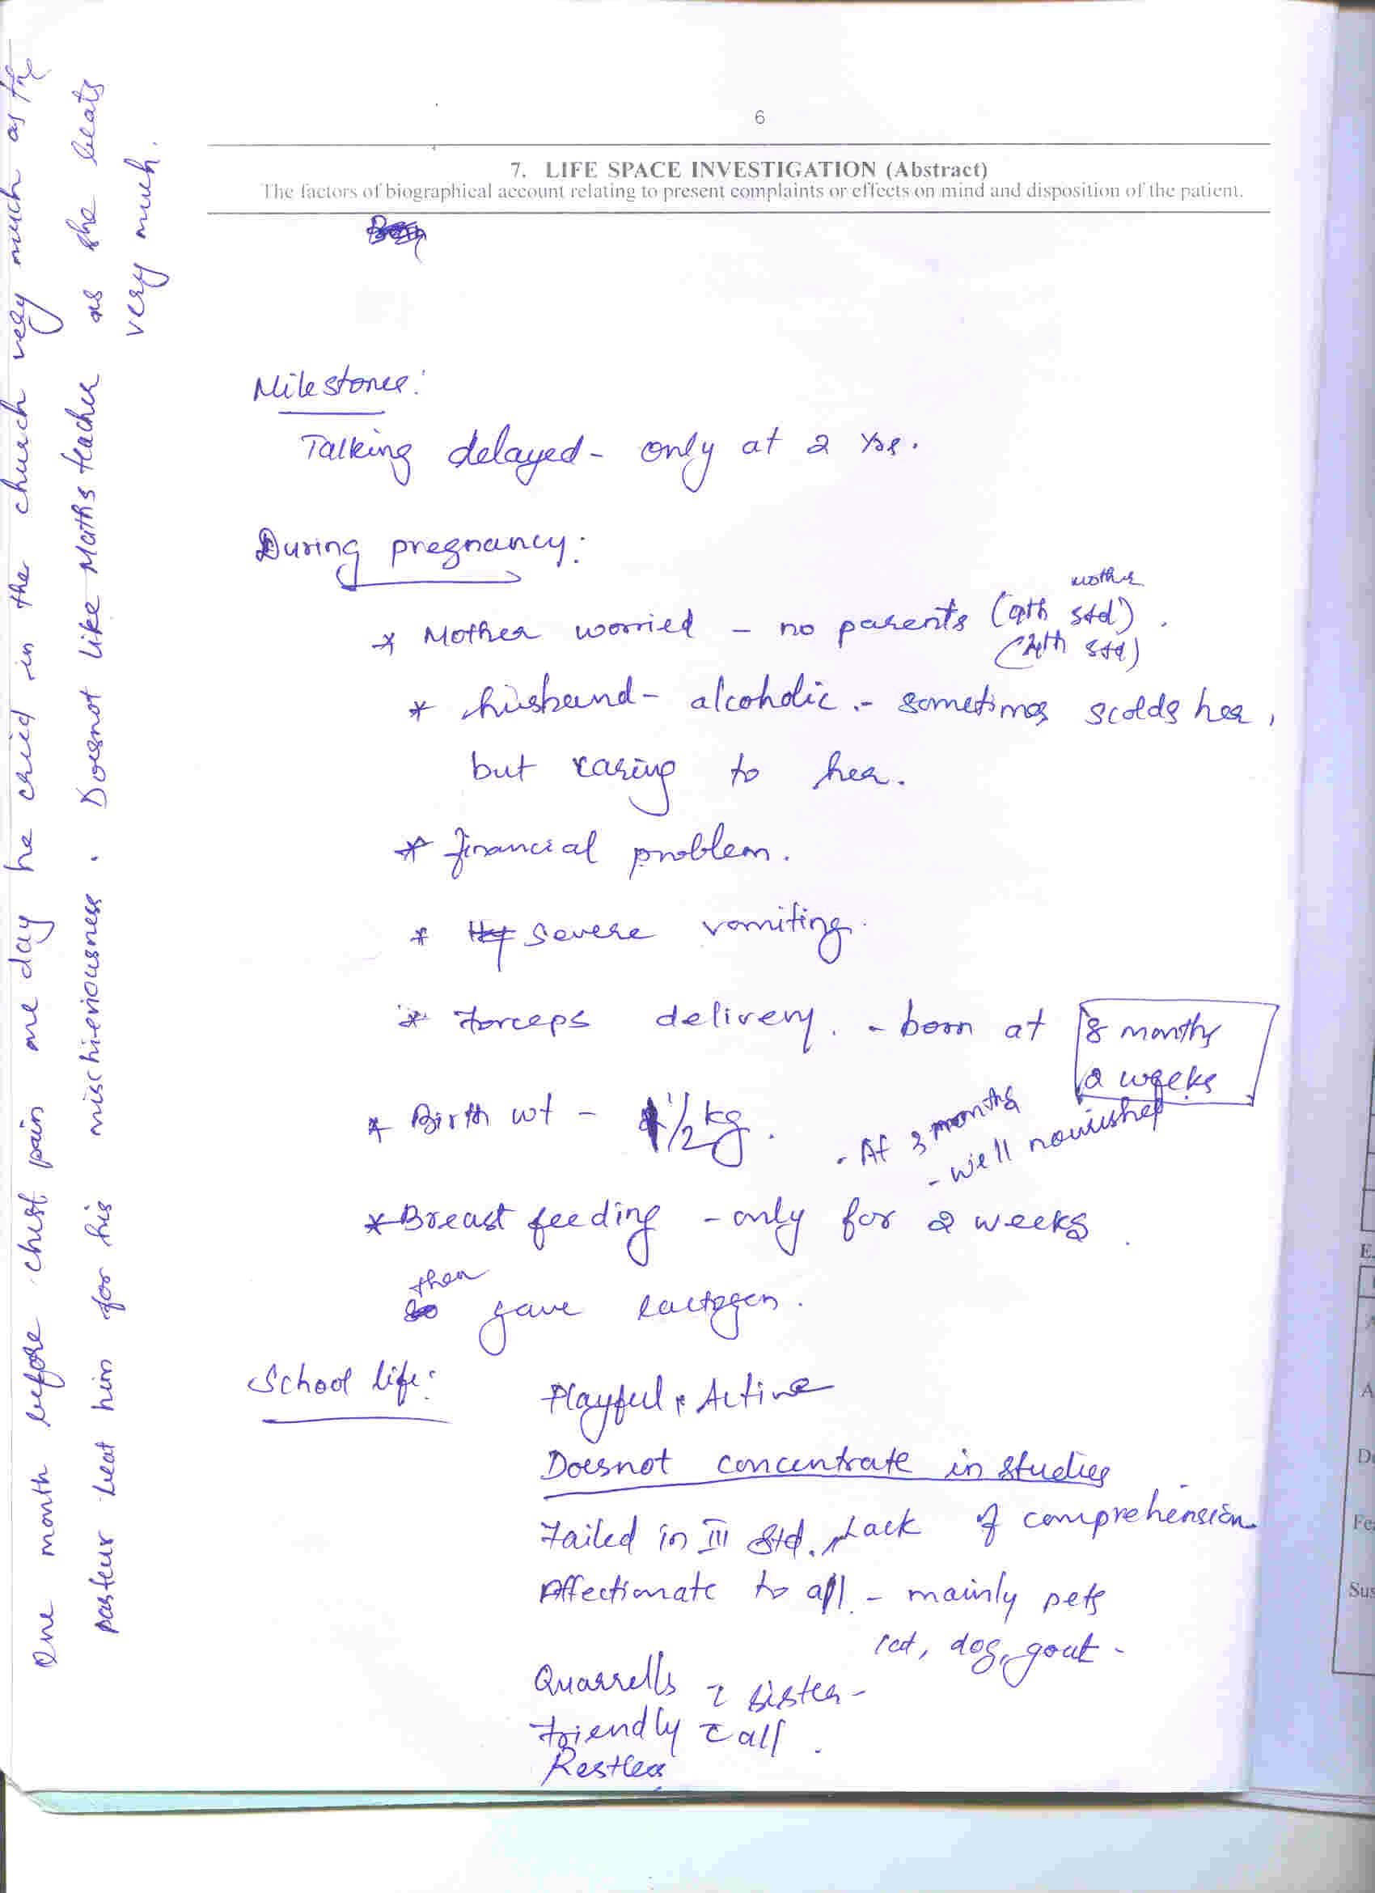
C
A
S
E
5

Slide 59
C
A
S
E
5

Slide 60
C
A
S
E
5

Slide 61
C
A
S
E
5

Slide 62
C
A
S
E
5

Slide 63
C
A
S
E
5

Slide 64
C
A
S
E
5

Slide 65
C
A
S
E
5

Slide 68
THANK YOU ALL

